Slide 1

Probing electronic interactions using electron tunneling
Pratap Raychaudhuri

Slide 2
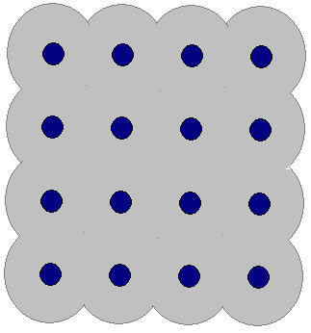
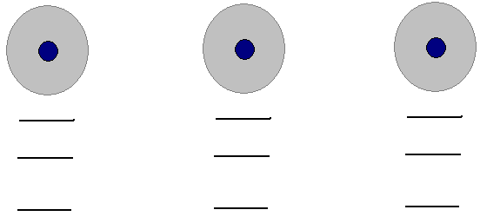
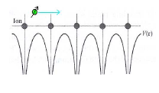
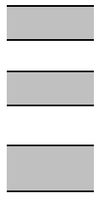
Electrons in a solid
Formation of energy bands
Solid
Free atoms
E₃
E₂
E₁
Individual levels
to nearly continuous bands
Allowed energy for an electron
Insulators
Energy
Metals

Slide 3
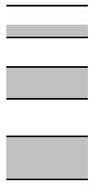
Electrons in a metal
V
E_{F}
~1-50meV
eV
Give rise to electrical conduction
Superconductivity
(Nb,Pb,Al,Sn)
Novel quantum phenonmenon
Quantum criticality, Unconventional superconductivity
Itinerant
Magnetism
(Fe,Co,Ni)
Quantum Hall effect
2D systems
Energy
Understanding the nature of electrons close to E_{F}

Slide 4
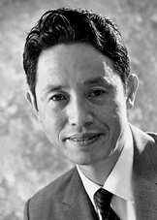
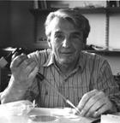
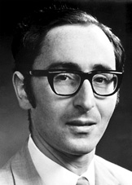
Tunneling in Solid State systems
Leo Esaki, b. 1925
Nobel Prize, 1973
The award is for their discoveries regarding tunneling phenomena in solids. Half of the prize is divided equally between Esaki and Giaever for their experimental discoveries regarding tunneling phenomena in semiconductors and superconductors respectively. The other half is awarded to Josephson for his theoretical predictions of properties in a supercurrent flowing through a tunnel barrier, in particular the phenomena generally known as the Josephson effects.
Ivar Giaever, b. 1929
Nobel Prize, 1973
Brian Josephson, b. 1940
Nobel Prize, 1973

Slide 5
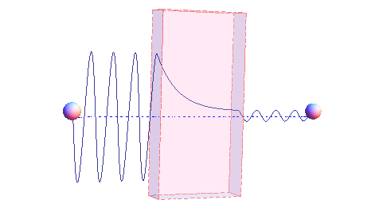
Electron tunneling in solids
N₁
N₂
T(1→2)∝ e^{-κd} N₁N₂δ(Ε₁-Ε₂)
d
E
Metal 1
Metal 2
Electrons close to the Fermi level can tunnel from one metal to another
E_{F}+δ
E_{F}-δ
Metal A
Insulator
Metal B

Slide 6
Electron tunneling does happen!!!
Conduction band
Leo Esaki, b. 1925
Nobel Prize, 1973
Fermi Energy
(E_{F})
Valence
band
Intrinsic
Semiconductor
n-doped
Semiconductor
p-doped
Semiconductor
Heavily doped: >10¹⁹ cm⁻³

Slide 7
The Esaki (Tunnel) diode
n-doped
p-doped
n-doped
p-doped
Potential barrier
Potential barrier
No Bias
Reverse bias: Electrons will tunnel from p-doped to n-doped region

Slide 8
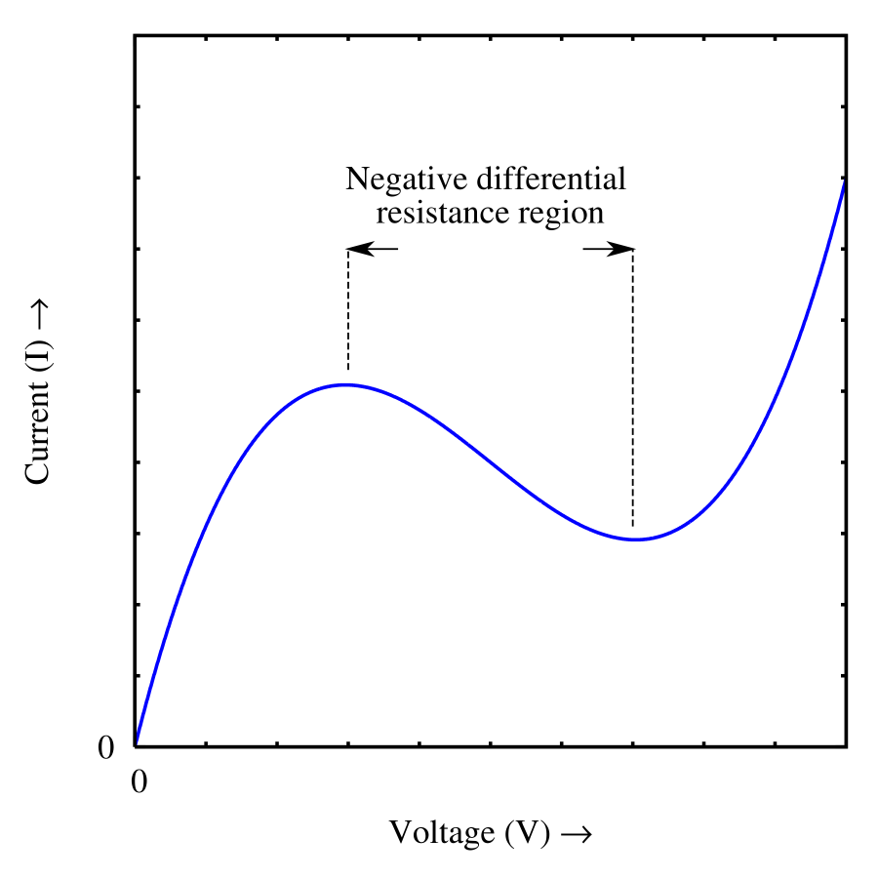
The Esaki (Tunnel) diode: Forward bias
n-doped
p-doped
Electrons will tunnel from
n-doped to p-doped region
Potential barrier
No states available to tunnel to
Electrons will tunnel from
n-doped to the conduction band of p-doped region
Small forward bias
Intermediate forward bias
Large forward bias

Slide 9
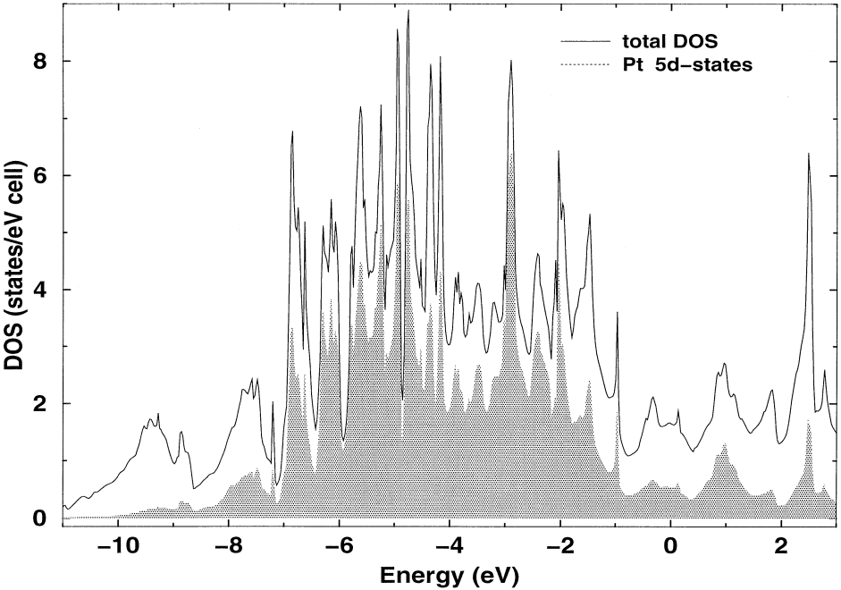
How to use tunneling as a spectroscopic probe?
What do we want to know about electrons?
The number of electronic states available in an energy interval E to E+δE: Density of states: N(E)
Ivar Giaever, b. 1929
Nobel Prize, 1973
Free electrons+ periodic potential
Free electrons
E
E
Bandgap
N(E)
N(E)

Slide 10

Principle of Tunneling spectroscopy as an energy resolved probe
V=0
V>0
V<0
E_{F}
E_{F}
Metal A
Insulator
Metal B
In a realistic situation V is limited to few hundred mV
In simple metals such as Cu, Ag, Au, Al, N(E) is almost constant over this range

Slide 11
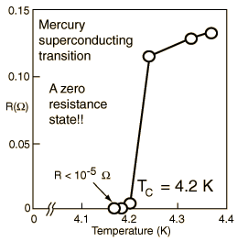
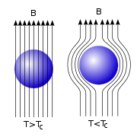
Superconductivity
Perfect diamagnet:
Meissner –Ochsenfeld effect
The resistance is as close
to zero as measurable
K Onnes (1911)

Slide 12
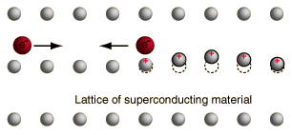
Superconductors
k_{B}T_{c} ~1-20meV
T<T_{c}
k
k
-k
-k
ξ₀~5-50nm
Energy
E
E
∞
3-4 meV
E_{F}
N(E)
2Δ
∞
Superconducting state DOS
T>T_{c}
Normal state DOS
T<T_{c}

Slide 13
Tunneling: Experiment
Tunnel junction formed here
Fabrication of a tunnel junction
Step 1: Deposit a metal such as Al, Pb, Nb which forms native surface oxide
Step 2: The surface of the metal is oxidized through controlled exposure to air
Step3: Deposit the counter-electrode
Step 4: Put gold pads for electrical contacts

Slide 14
Tunneling measurement
Differential conductance measurement
Current: I=I_{dc}+I_{ac}sinωt
Voltage: V_{dc}+V_{ac}sinωt
I
d.c. bias V=V_{dc}
G(V)=dI/dV≈I_{ac}/V_{ac}
V
Advantage of this technique:
Direct measurement of differential conductance
V_{ac} can be measured with a lock-in amplifier which greatly improves the sensitivity

Slide 15
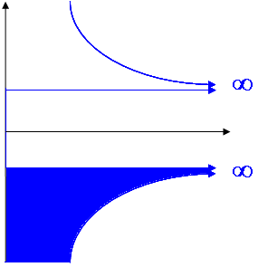
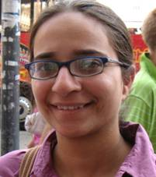
Tunneling spectroscopy in superconductors
Normal metal/Superconductor tunneling
Calculated conductance Vs voltage
V
2Δ
Madhavi Chand
NbN/I/Ag

Slide 16
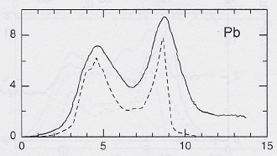
Interactions of electrons with other excitations
Phonon density of states

Slide 17
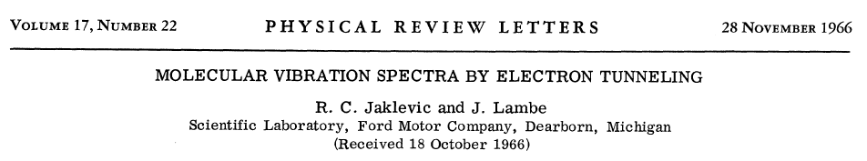
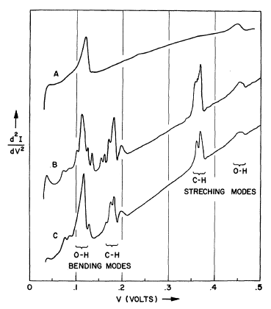
“Clean” junction
The Al/AlO_{x} layer was exposed to a small amount of organic molecules before depositing the Pb counter-electrode
Propionic acid
CH₃(CH₂)COOH
Acetic acid
CH₃COOH

Slide 18
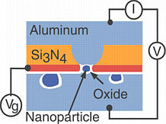
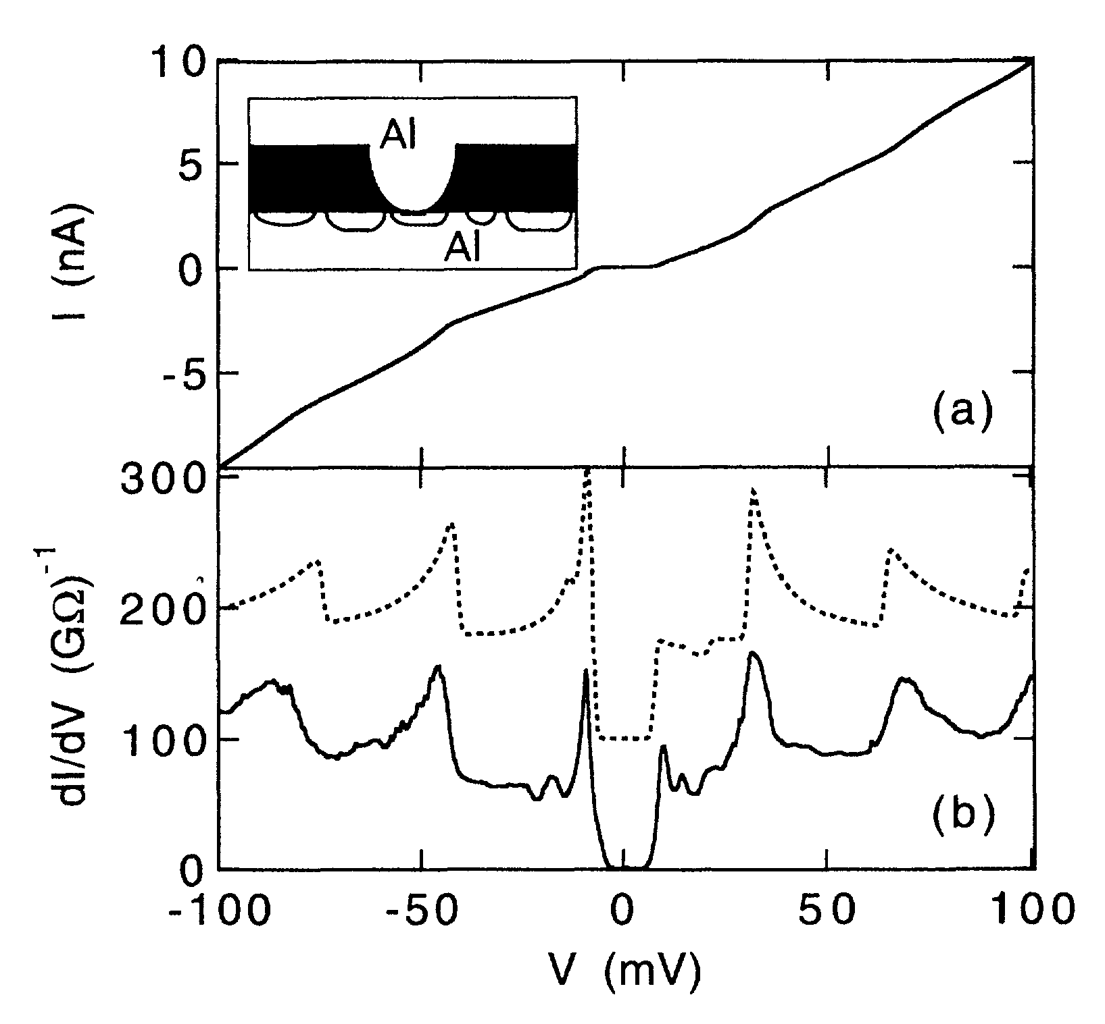
Tunneling through a nanometer sized particle
Quantized levels of particles in a box
Discrete energy levels
CB
Atomic levels
VB
Atom
Nanoparticle
Solid
Ralph et al, Phys. Rev. Lett., 1996

Slide 19
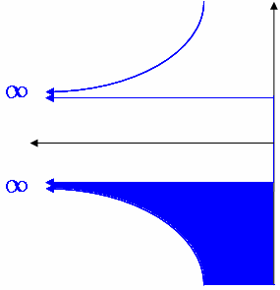
Superconductor-Superconductor Tunneling
Dissimilar superconductor
T≠0
Thermally excited quasiparticle
Onset for the 1st channel of current is at V=|(Δ₁-Δ₂)|/e
Onset for the 2nd channel of current is at V=(Δ₁+Δ₂)/e
2Δ₁
2Δ₂
V=0
V>|(Δ₁− Δ₂)| /e
V>(Δ₁+ Δ₂) /e
NbN/Insulator/Pb junction

Slide 20
T≠0
|(Δ₁-Δ₂)|/e
(Δ₁+Δ₂)/e
Townsend & Sutton, PR128, 591 (1962)

Slide 21
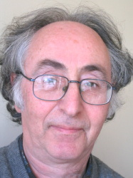
The Josephson Effect
T=0
Dissipation-less current up to a certain current I_{c}
Current flows in a Josephson junction even at V=0
2Δ₁
2Δ₂
V=0
Predicted: 1961-62, Nobel Prize in 1973

Slide 22
Macroscopic Quantum State
Superconductor
Random Phase approximation
Since energy/momentum of the electron is altered statistically after travelling a distance l φ does not matter
Phase important for Cooper pair tunneling

Slide 23
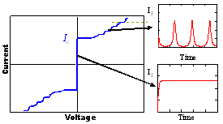
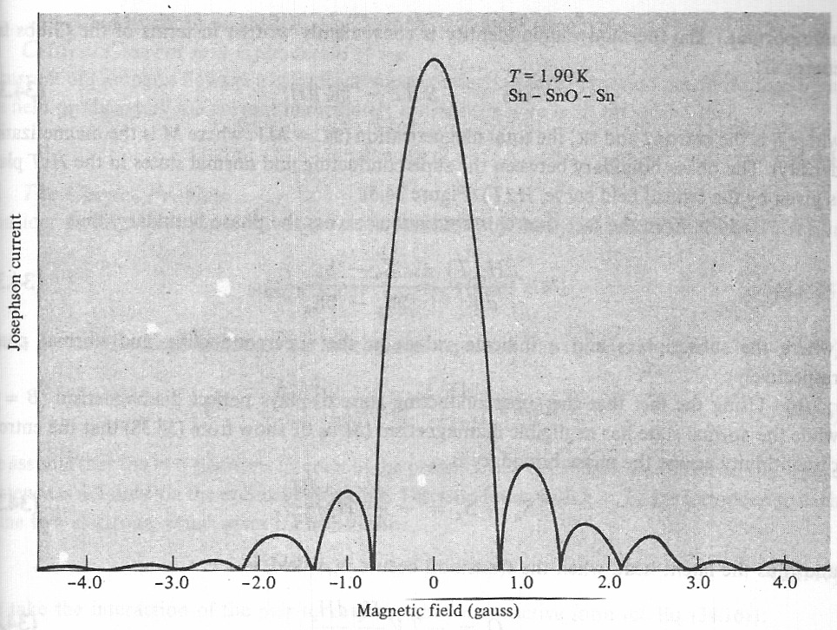
Josephson effect…
This effect is over and above the single particle tunneling current.

Slide 24
Where is the Josephson effect???
Anderson & Rowell, PRL10, 230 (1963)

Slide 25
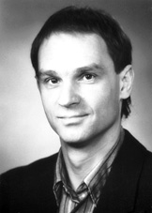
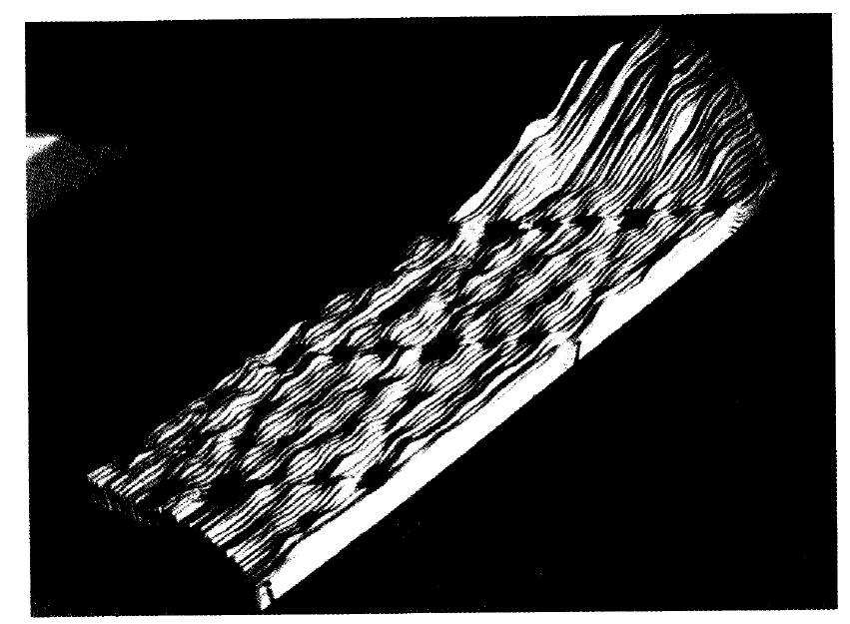
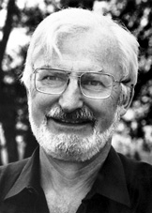
The scanning tunneling microscope
I realized that actually doing physics is much more enjoyable than just learning it. Maybe 'doing it' is the right way of learning, at least as far as I am concerned.
Gerd Binnig, b. 1947
Nobel Prize: 1986
Heinrich Rohrer, b. 1933
Nobel Prize: 1987
7X7 reconstruction of Si (111)

Slide 26
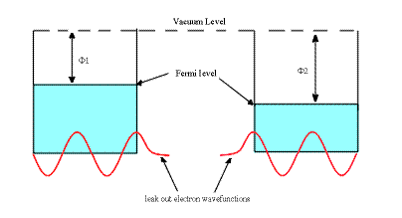
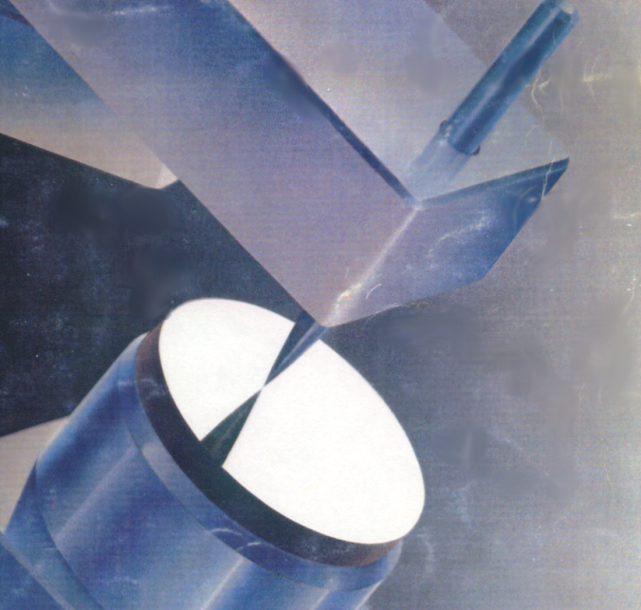
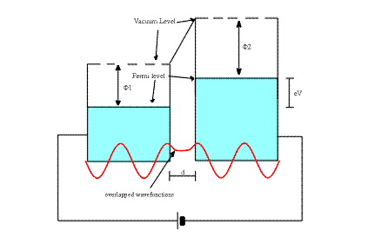
Vacuum tunneling between two planar electrodes
V
STM basis
For low bias voltage (eV << φ ):
I ∝ f(V) exp (-2κ d)
V

Slide 27
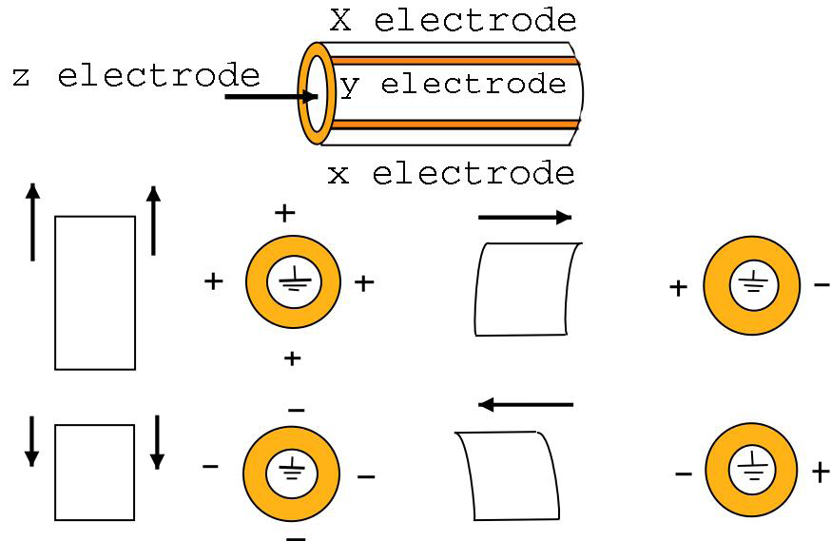
Piezoceramic tube

Slide 28
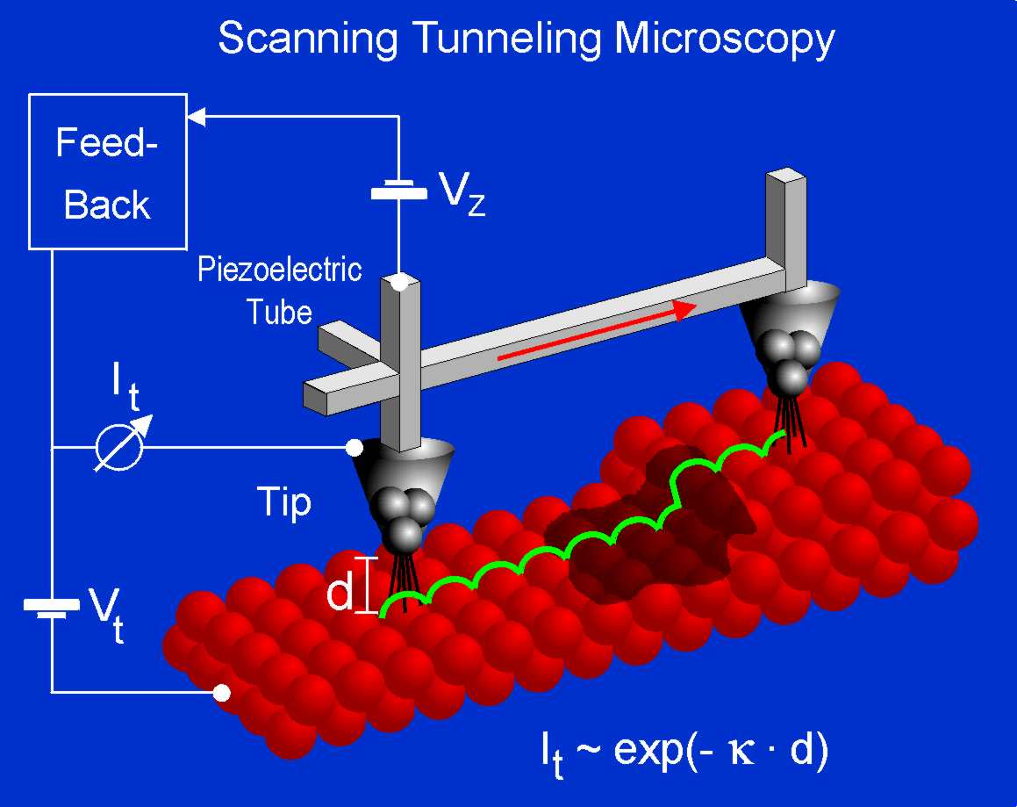
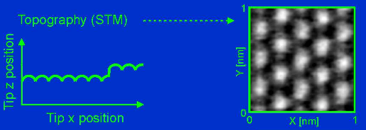
Scanning Tunneling Spectroscopy
Graphite

Slide 29
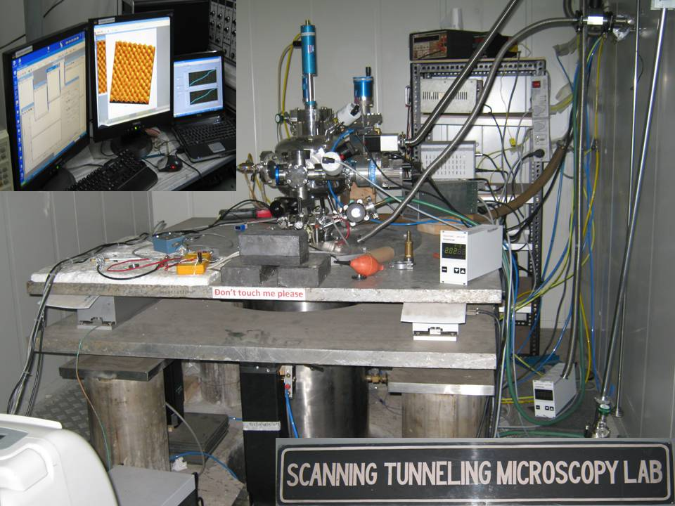

Slide 30
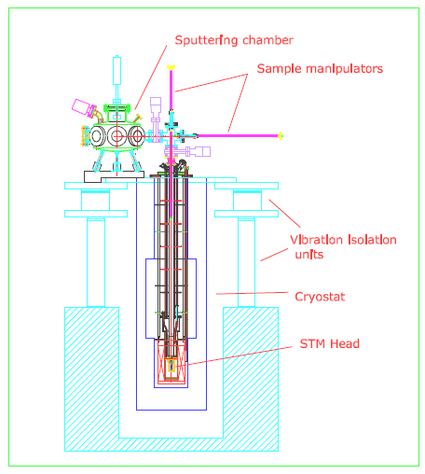

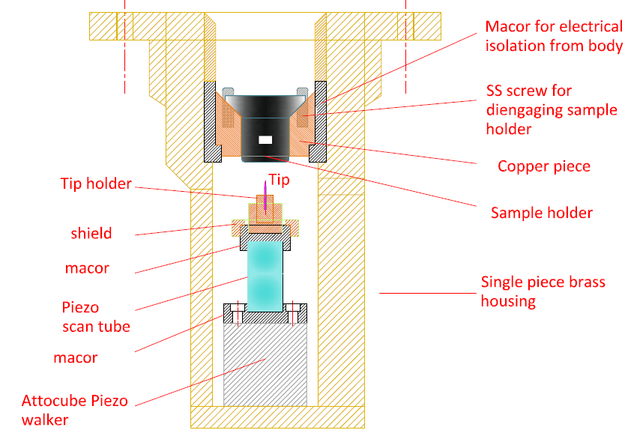
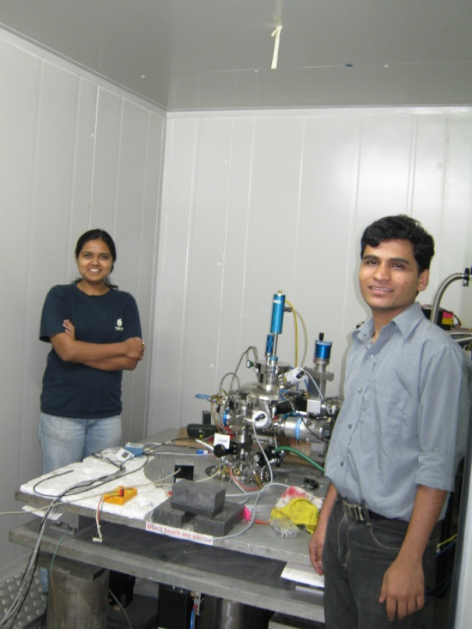
The TIFR (low temperature high vacuum) STM
Sourin Mukhopadhyay
(currently post-doc in Cornell)
Anand Kamlapure and Garima Saraswat
With active design help from Dr. Sangita Bose

Slide 31
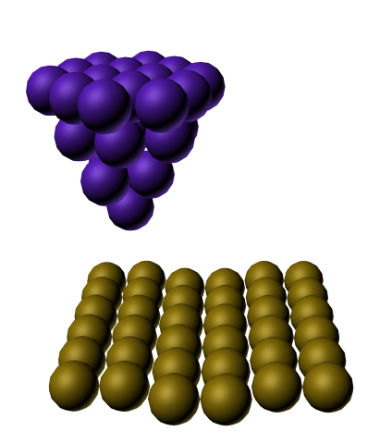
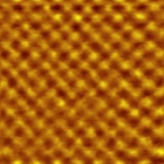
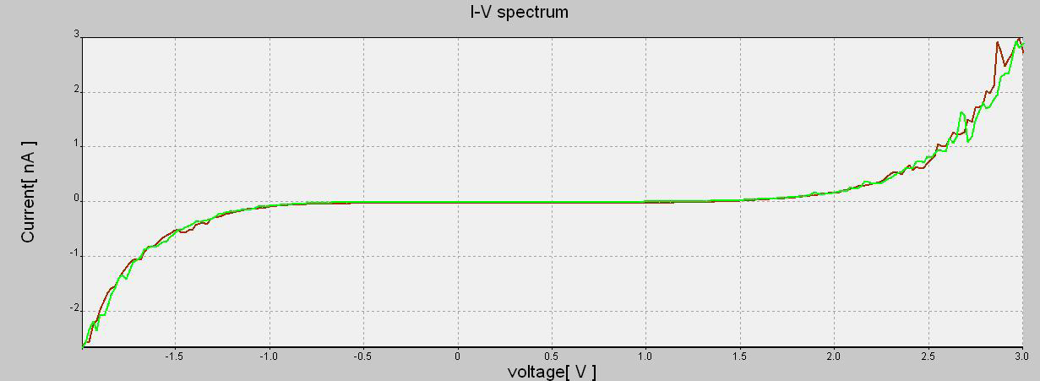
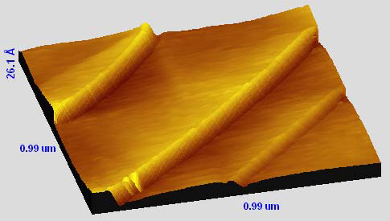
Topographic image/spectroscopy
V
FeSe_{0.5}Te_{0.5} single crystal: Grown by P. L. Paulose
Atomic steps on grapite surface
GaAs epilayer by MOVPE: Grown by Arnab Bhattacharya

Slide 32
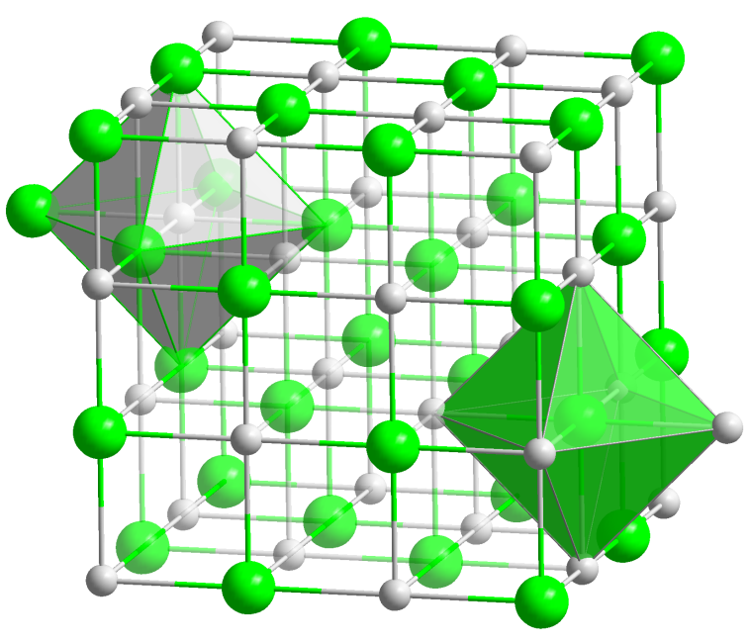
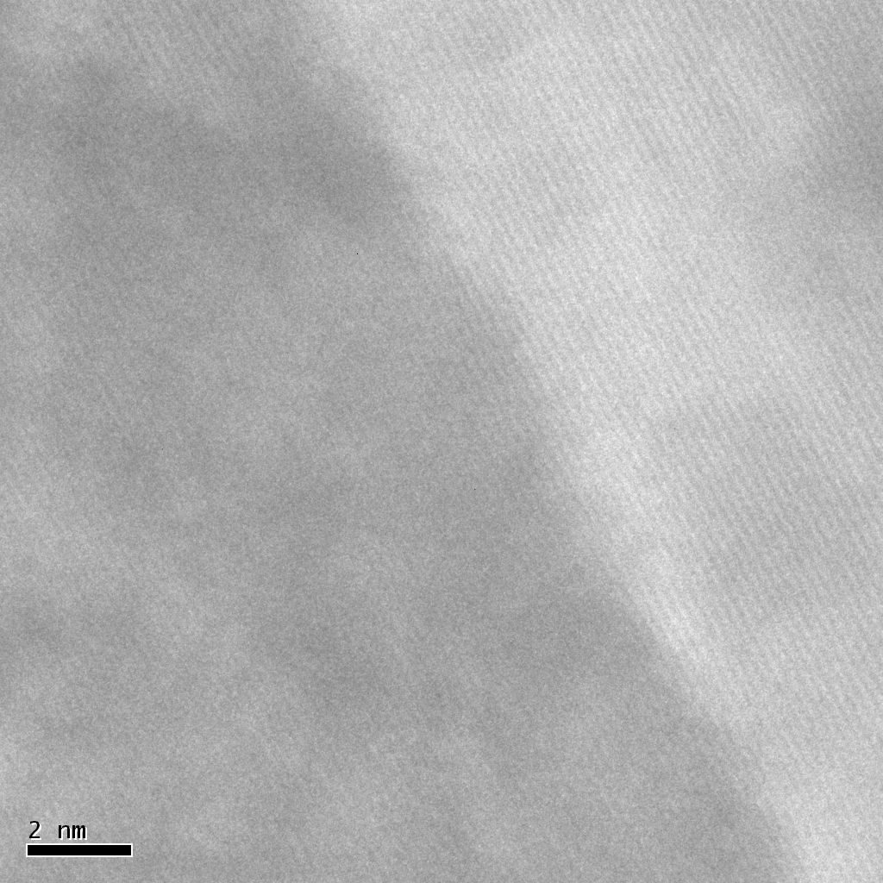
NbN
T_{c}~16K
ξ∼5nm λ∼200nm
Thickness of our films ~ 50nm >> ξ
Grows as epitaxial thin film on (100) MgO substrate using reactive magnetron sputtering:
MgO
NbN
NaCl structure

Slide 33
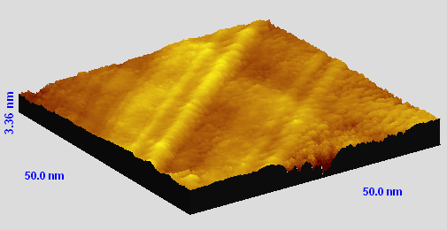
Topographic image
Strain relaxed structure on a 50 nm thick film
Atomic step edges on a 6nm thick film

Slide 34
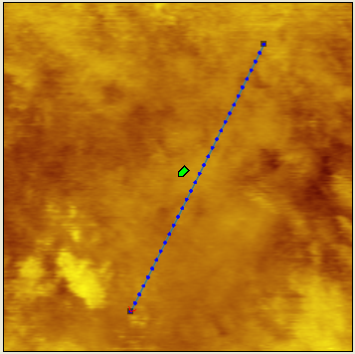
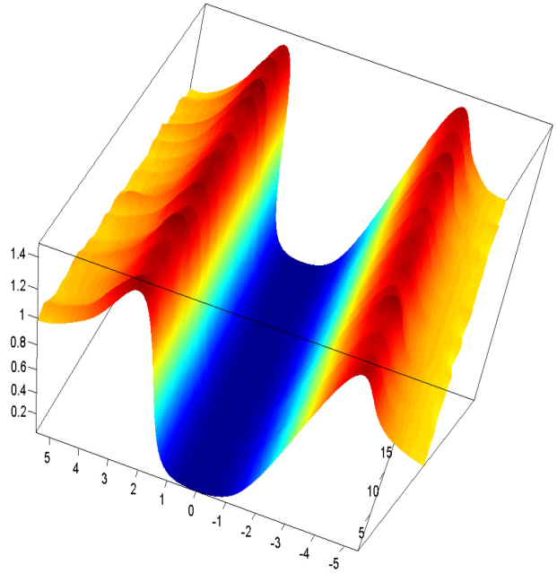
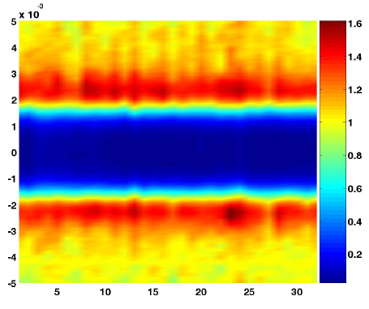
Superconducting tunneling using STM
G(V)
V (mV)
G(V)/G_{N}
Bias (mV)
150nm

Slide 35
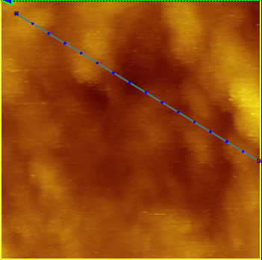
Superconducting Tunneling
150 nm

Slide 36

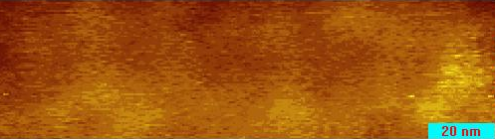

The superconducting gap map
Topographic image
Superconducting gap map

Slide 37



Combining Spectroscopy with Imaging
Mapping inhomogeneities in a superconductor: BSCCO
A Pushp et al. Science 320, 196(2008)

Slide 38





Observation of shell effects in superconducting nanoparticles
Atomic shell structure
Magic number of electrons : closed shells : Inert gas atoms
Manifestation of shell structure : oscillation in the ionization energy
Superconducting nanoparticles : formation of shells
11 nm
h_{i}
V
E_{F}
STM : single nanoparticle
Pairing
Region E_{D}
I_{t}
δ = mean energy level spacing
0 nm
Discrete Energy level
-E_{D}
E_{F}
+E_{D}
E
Discrete energy levels have a degeneracy depending on the symmetry of the grain
Each degenerate energy level : SHELL
Sangita Bose et al., Nature Materials (in press)

Slide 39
Sangita Bose et al., Nature Materials (in press)

Slide 40


Particle in a box (again)
M.F.Crommie et al. Nature 363, 524 (1993)
M.F.Crommie et al., Science (1993)

Slide 41
Imaging in the momentum space
Au surface: Topography
1mV
Courtesy: Sangita Bose, MPI Stuttgart

Slide 42
How to accentuate spacial variation of the Local Density of States
E
eV
N(E)

Slide 43


dI/dV image
k = 1.5 nm⁻¹
Fourier Transform
Courtesy: Sangita Bose, MPI Stuttgart

Slide 44




Unusual Superconducting states: Ca_{2−x}Na_{x}CuO₂Cl₂
Difference of conductance map +6 and -6 meV
Hanaguri et al.

Slide 45




Exploring Molecules: Homo Lumo gap
Pentacene
Theory
Repp and Meyer

Slide 46



Resolving spins: Spin polarized STM
Tip coated with ferromagnetic material

Slide 47




Make your own STM (Rs.50000/-)
http://www.e-basteln.de/
AMATEUR STM
http://web.archive.org/web/20021219052018/http://www.peddie.k12.nj.us/Research/STMProject/
http://www.angelfire.com/electronic2/spm/index.html
http://sxm4.uni-muenster.de/introduction-en.html
Simple STM Project
http://www.geocities.com/spm_stm/

