Slide 1
Elliptic Flow of Electromagnetic Radiation & Thermalization Time @ RHIC
Rupa Chatterjee
Variable Energy Cyclotron Centre, Kolkata

Slide 2
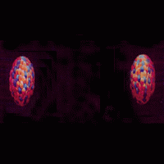
Collision of heavy nuclei at relativistic energies leads to formation of Quark- Gluon Plasma (QGP)
Strong confirmation arises from the recent observation @ Relativistic Heavy Ion Collider (RHIC) of strong anisotropic
flow .
Bulk evolution is described by relativistic fluid dynamics. The
application of fluid-dynamics implies that the medium is in local
thermal equilibrium!
Large anisotropies in the particle emission are a collective phenomenon.
If the nucleus – nucleus collisions were a simple super position of independent nucleon - nucleon collisions, then resultant particle distribution would be isotropic in momentum spectra.

Slide 3
Non-central collision of spherical nuclei
or collision of deformed nuclei
Coordinate space
y
`
x
Overlapping zone is of almond shape
Momentum space
Co ordinate space anisotropy is converted into
momentum space anisotropy via the action of
azimuthally asymmetric pressure gradient
p_{y}
p_{x}
Elliptic flow

Slide 4


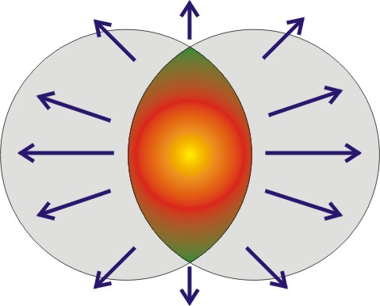
Elliptic Flow
Elliptic flow is a measure of collectivity and early thermalisation of the new form of matter.
It is sensitive to the early phase and does not depend on the freeze –out dynamics of the system.
Fluid-dynamics can not make any statements how the medium reached the equilibrium stage…
Reaction
plane
z
y
x
Flow is understood as reflecting collective aspects of the interacting medium depending on the collision energy
transverse momentum, rapidity, impact parameter etc.
Gradients of almond-shape surface will lead to preferential emission in the reaction plane.

Slide 5
At mid rapidity (y=0) and for collision of same type of nuclei,
Systems evolution is mirror symmetric with respect to the reaction plane.
Thus observables under investigation respect the symmetry f(φ)=f(−φ),
sin terms will not appear in the above equation.
For reflection symmetry in the transverse plane, f(φ)=f(π+φ),
only even terms (v₂,v₄, . . . .) survive in the above series.
∫
dϕ cos(2ϕ)
dN(b)
p_{T}dp_{T}dydϕ
v₂(p_{T},b) =
∫
dϕ
dN(b)
p_{T}dp_{T}dydϕ

Slide 6
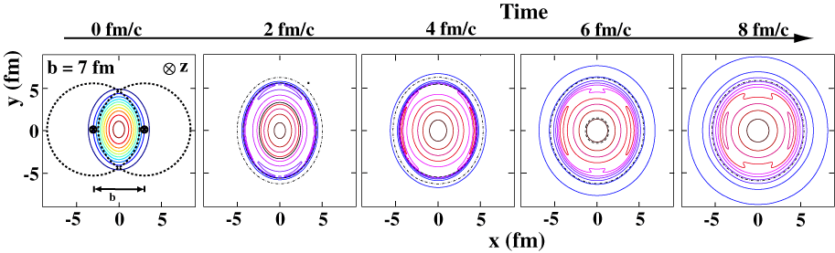
Elliptic Flow: self quenching
P.F. Kolb and U. Heinz, in Quark Gluon Plasma, nucl-th/0305084
The driving force of elliptic flow dominates at “early” times
Elliptic flow acts against its own cause, it shuts itself off after some time as pressure gradient vanishes.

Slide 7
Photons come out from every stage of the expanding system
t
freeze-out surface
qgp phase
hadronic phase
pre-equilibrium
phase
mixed phase
z
Mean free path of photons is larger than system size.
After production photons leave the system without any re-scattering.
Thus they carry undistorted information from the production point
to the detector.

Slide 8
Problems of Photon Probe
Inclusive photon spectrum contains a huge background.
More than 90% of the produced photons are from 2-γ decay of π⁰ and
η mesons.
Needs to subtract the huge background in order to get direct photons.
Different mechanisms are available these days (such as mixed event analysis) to subtract decay contribution from total spectrum.
Direct photon measurement by the subtraction method: WA98 PRL 85 (2000) 3595, PHENIX PRL 94 (2005) 232301
  from πº ∼ 80%
  from η ∼ 13%
  from ω ∼ 2%
  from η’ ∼ 1.3%

Slide 9
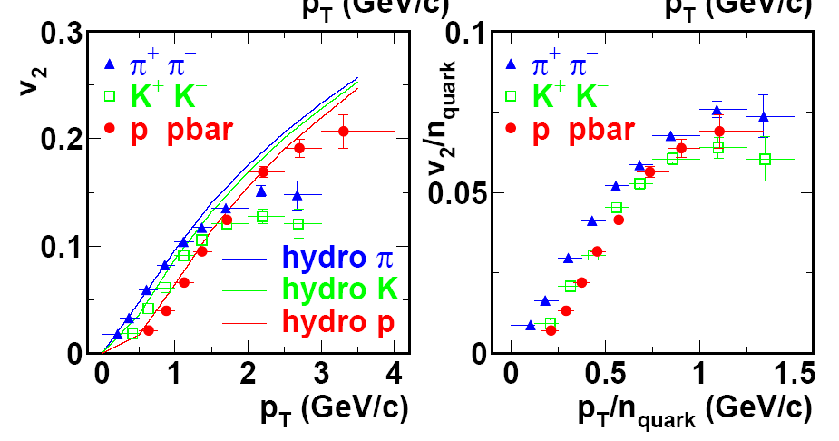
Hydrodynamic description of v₂
Hydrodynamic by Huovinen et al.
Experimental results are from PHENIX,
PRL 91, 2003
Elliptic flow of identified particle and mass ordering is well described by hydrodynamic models at low p_{T}

Slide 10
Elliptic flow of
thermal photons
& dileptons

Slide 11
Compton scattering annihilation process
Photon production from QGP phase:
Different hadronic channels take part in hadronic phase photon production:
ρ ◊ π + π + γ π + ρ ◊ ω ◊ π + γ
π + π ◊ ρ + γ π + K ◊ K∗ + γ
π + ρ ◊ π + γ π + K∗ ◊ K + γ
Photon production from hadronic phase:

Slide 12
The thermal photon emission from the QGP and the hadronic phases are obtained by integrating the rates of emission over the space time history of the fireball.
E dNγ/d³p=∫[{…} exp (p^{μ}.u_{μ}/T )] d⁴x
p^{μ}=( p_{T} coshY, p_{x}, p_{y}, p_{T}sinhY ) =>4-momentum of the photons
u_{μ}=γ_{T}(cosh η, v_{x}(x,y), v_{y}(x,y), sinh η ) =>4 velocity of the flow field
d⁴x=τ dτ dx dy dη =>4-volume element , Y= rapidity (=0 at mid rapidity)
τ= [t² - z²]^{1/2} =>proper time, η= tanh⁻¹(z/t) => space time rapidity
γ_{T}=1/[1 - v_{T}²]^{1/2} => Lorentz factor, v_{T}= [v_{x}² + v_{y}² ]^{1/2} =>radial flow velocity and p_{T}= [p_{x}² + p_{y}² ]^{1/2} =>transverse momentum
Taking the azimuthal angle for transverse momentum as φ (in the reaction plane ) we can write :
p^{μ}.u_{μ} =γ_{T}[ p_{T}cosh(Y-η)–p_{x}v_{x}–p_{y}v_{y}]

Slide 13
Initial parameters for Au+Au collision at 200 AGeV
Initial time τ₀ = 0.2 fm
Initial entropy density (s₀) = 351 fm⁻³
Impact parameter b = 7 fm
Freeze-out energy density (ε_{f} )= 0.075 GeV/fm³
Initial entropy density ~ α*N_{WN} +(1-α)*N_{BC}
Where α=0.75
N_{WN} (x,y,b) = Number of wounded nucleons
N_{BC} (x,y,b) = Number of binary collisions

Slide 14
QGP photon from:
P. Arnold, G. D. Moore & L. G. Yaffe
J . High Energy Physics. 12 (2001) 009.
Photon radiation from hot hadron gas:
S. Turbide, R. Rapp & C. Gale
Phys. Rev. C 69, 014903 (2004).

Slide 15
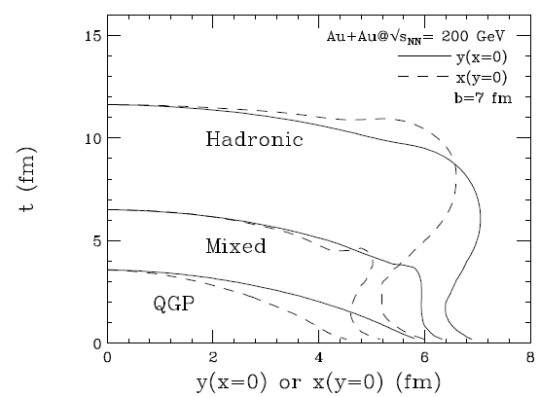
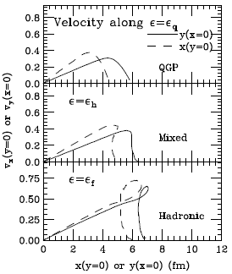
Constant energy density contours for ε= ε_{q}, ε_{h} and ε_{f} , along y(x=0) (solid curves)
and x (y=0) (dashed curves).
Where,
ε_{q} = 1.6 GeV/fm³
ε_{h} = 0.45 GeV/fm³
ε_{f} = 0.075 GeV/fm³

Slide 16
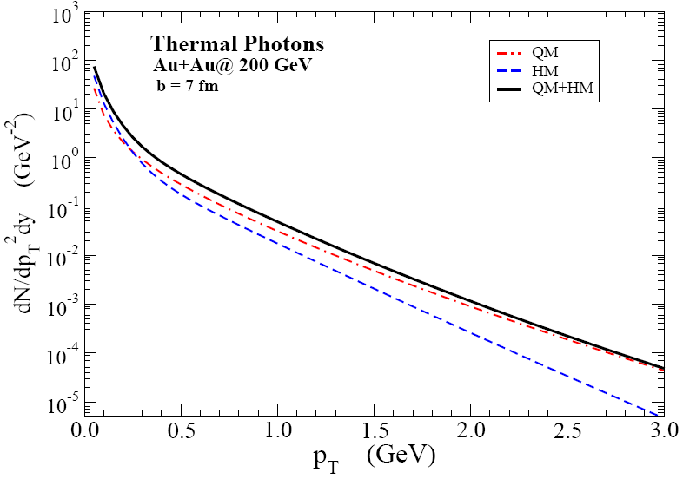
Thermal photons from QGP & hadronic matter:
For very small p_{T} values, photons from hadronic matter dominate the
total p_{T} spectrum.

Slide 17
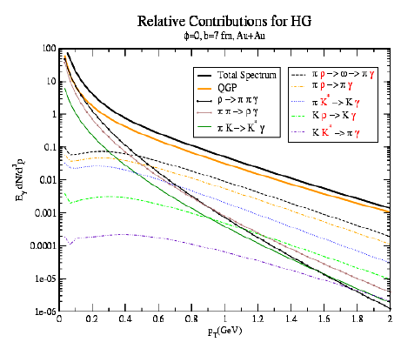
Relative contribution of different channels in the hadronic phase.
ρ ◊ π π γ & π π ◊ ρ γ are the dominant photon producing channels upto
p_{T} ~ 0.5 GeV. Above that p_{T} range π ρ ◊ π γ become significant.
U. Heinz, R. Chatterjee, E. Frodermann, C. Gale, D. K. Srivastava, Nucl. Phs. A 783, 379. (2007)

Slide 18
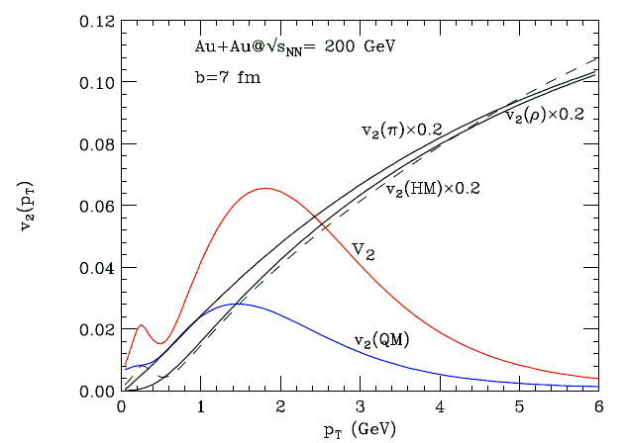
Thermal photon elliptic flow @ RHIC
Elliptic flow of thermal photons as function of transverse momentum
p_{T} shows interesting nature…………
R. Chatterjee, E. Frodermann
U. Heinz, D. K. Srivastava.
PRL 96, 202302 (2006)
v₂(QM) is small at high p_{T} and rises with smaller values p_{T}, peaks
around 1.5-2.0 GeV & then drops.
v₂(HM) rises monotonically with higher values of p_{T}.

Slide 19
Thermal photon elliptic flow @ RHIC
Sum v₂ tracks v₂(QM) at high p_{T}, reflects anisotropies of the partonic
phase at early times.
Interesting structure at p_{T} ∼ 0.4 – 0.5 GeV, should sustain in the
experimental data.
v₂(π) & v₂(ρ) are plotted to compare with v₂(HM).

Slide 20
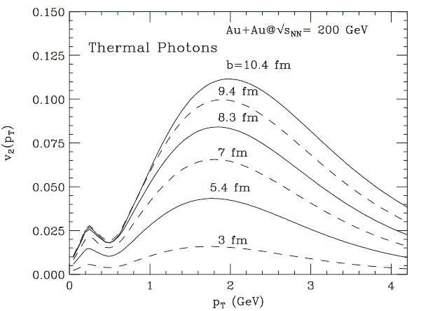
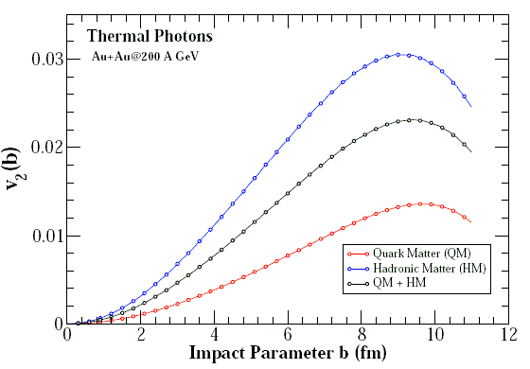
All v₂(p_{T})=0 at b=0
v₂ (p_{T}) increases with rise in impact parameter b.
With rise in b, relative contributions
of QM & HM in the total v₂ changes.
HM contribution increases compared
to QM at larger b values.
p_{T} integrated v₂(b) rises with rise in
b .
v₂’s from QM, HM and QM+HM are shown separately.
For b ∼ 2R_{A} ,( R_{A} is the nuclear radius) v₂(b) drops as system size itself becomes very small.

Slide 21
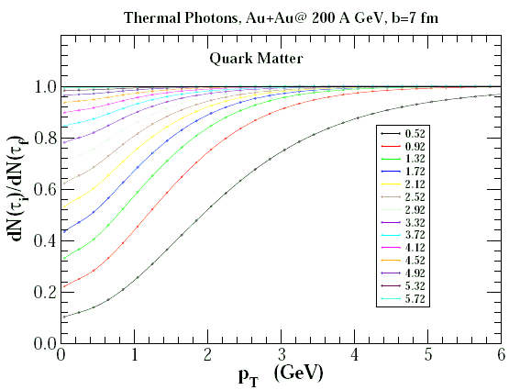
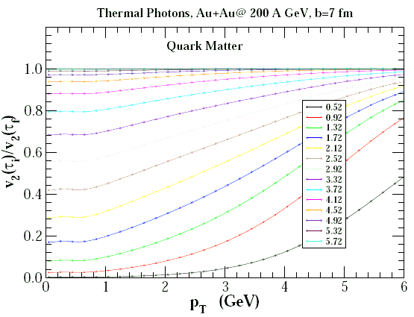
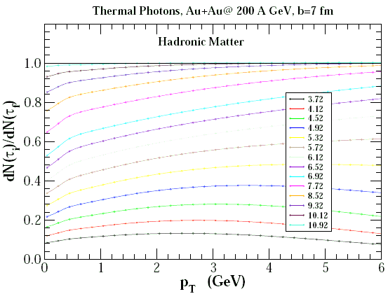
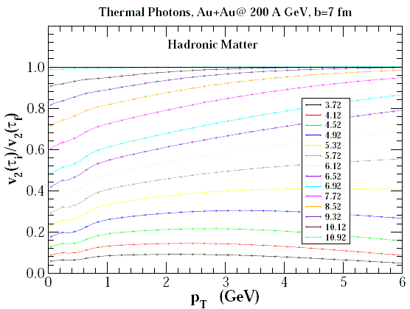

Slide 22
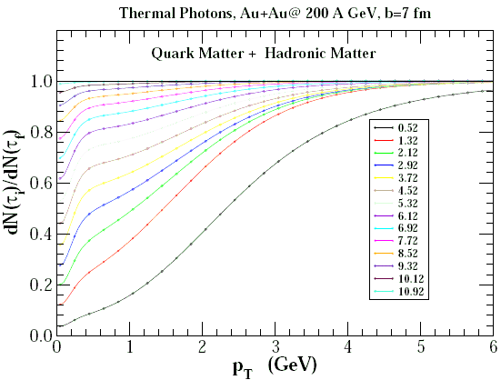
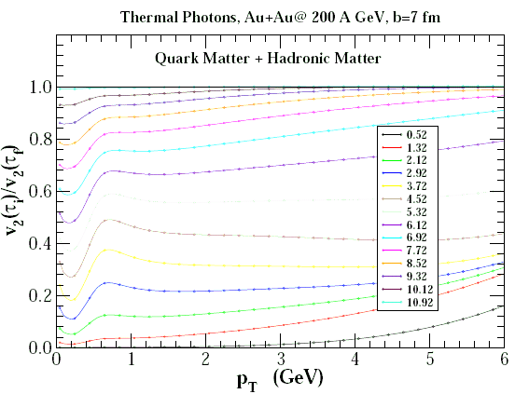
Time evolution of spectra and elliptic flow at b=7 fm
p_{T} > 2.0 GeV most of the photons are from QGP phase and with in a time period of 4 fm. For very low p_{T} radiation from HM is significant.
Sum v₂ shows relative contribution from QM and HM depending on the p_{T} range and τ value.

Slide 23
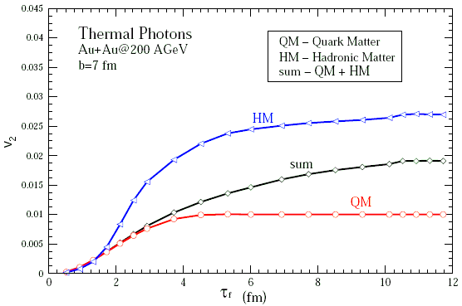
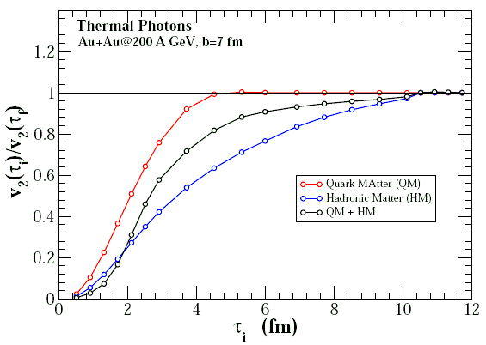
Time evolution of p_{T} integrated elliptic flow at b = 7 fm
R. Chatterjee, D. K. Srivastava, U. Heinz (in preparation)
v₂(τ) as function of τ from different phases are shown separately.
v₂(QM) saturates within time period of 4-5 fm.
v₂(HM) continuously grows upto time of freeze out.

Slide 24
How does PHENIX measure direct photons and v₂?
Measure inclusive photon yield, N_{inc}
Measure hadron contribution components π⁰ and η
By Monte Carlo calculate π⁰ and η decay background in inclusive sample, N_{bg}
Calculate direct photon excess over hadron decays, R
Measure inclusive and hadron v₂ by reaction plane method
Calculate direct photon v₂ as,
R * v₂^{inc} – v₂^{BG}
v₂^{dir} =
R – 1
R = N^{inc} / N^{BG}

Slide 25
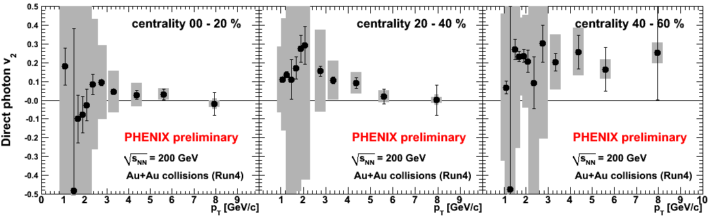
PHENIX Run4 Result
Direct photon v₂ at 200GeV Au+Au (Run4)

Slide 26
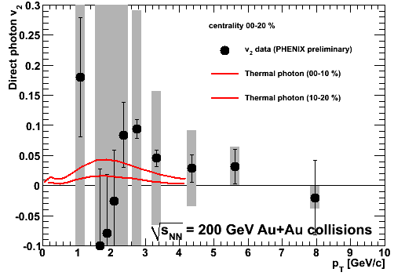
Photon v₂ from hydrodynamics and PHENIX data
Plot shown by Kentaro Miki @QM2008

Slide 27
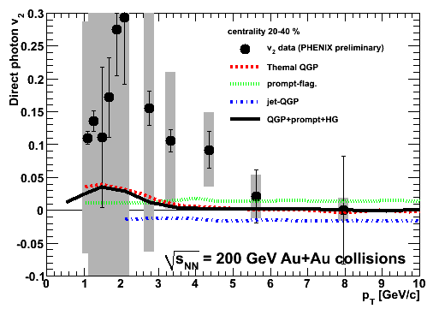
Turbide et al calculation
2D+1 hydrodynamical model several different sources are considered.
arXiv:0712.0732

Slide 28
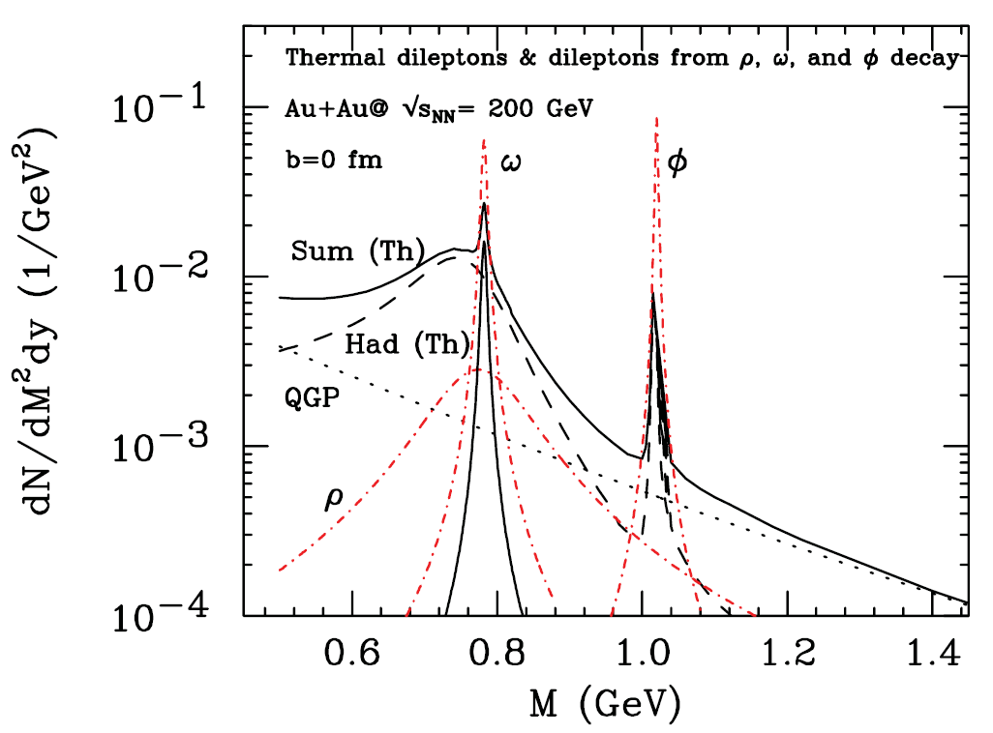
Invariant mass dependent thermal dilepton spectra:
b = 0 fm
QM
HM
QM+HM
Post freeze-out ρ, ω, φ
R. Chatterjee, D. K. Srivastava,
U. Heinz, C. Gale
PRC 75, 054909 (2007)
Contributions from QM, HM are shown separately along with total
spectrum.
Sum spectrum shows well defined peak structures at ρ, ω & φ masses,
which are mainly the contributions from hadronic phase.
QGP radiation becomes significant above the φ mass.
Larger peaks of ω & φ mesons (post freeze-out) show the long life
time of theses two vector mesons.

Slide 29
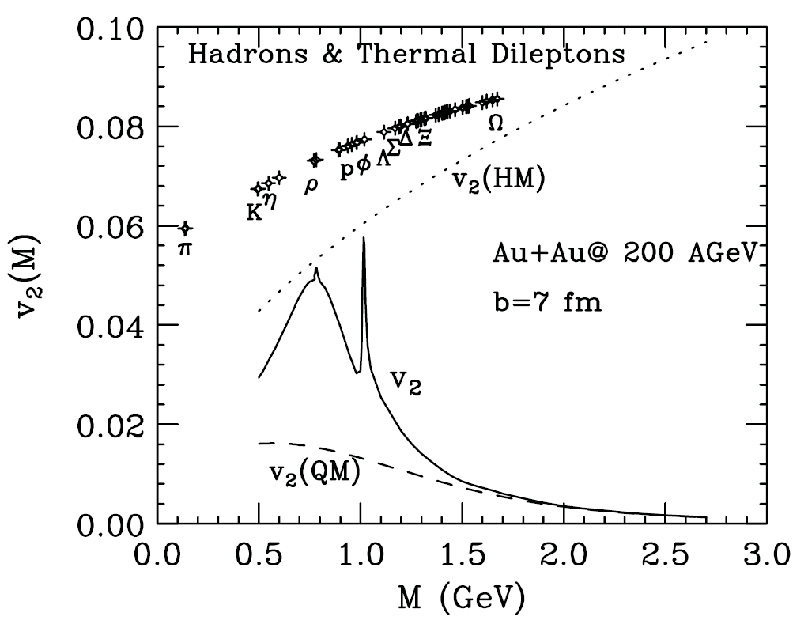
v₂ of thermal dileptons at b= 7 fm
v₂(QM) shows similar nature of thermal photon v₂, small at large M and then
increases with lower M values.
At the resonance masses sum v₂ touches the v₂(HM).
For M>M_{φ}, v₂(HM) much higher than v₂(QM), however sum v₂ approaches
v₂(QM) as dileptons from HM are negligible compared to those from QM at
that mass range.

Slide 30
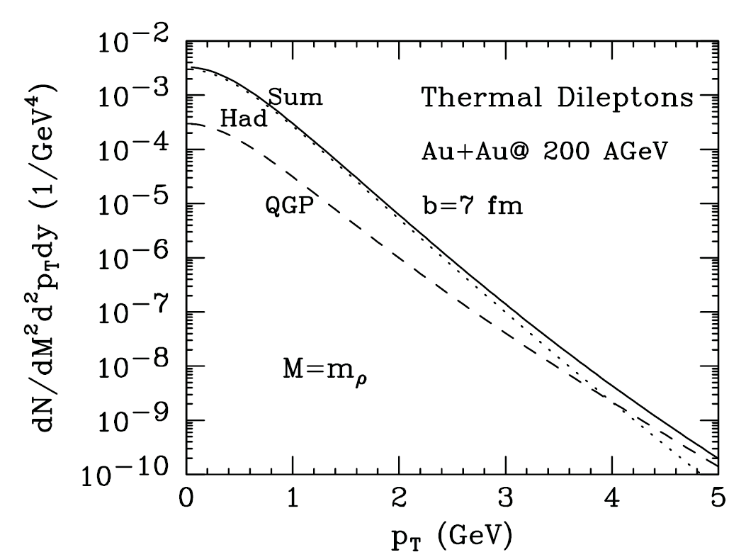
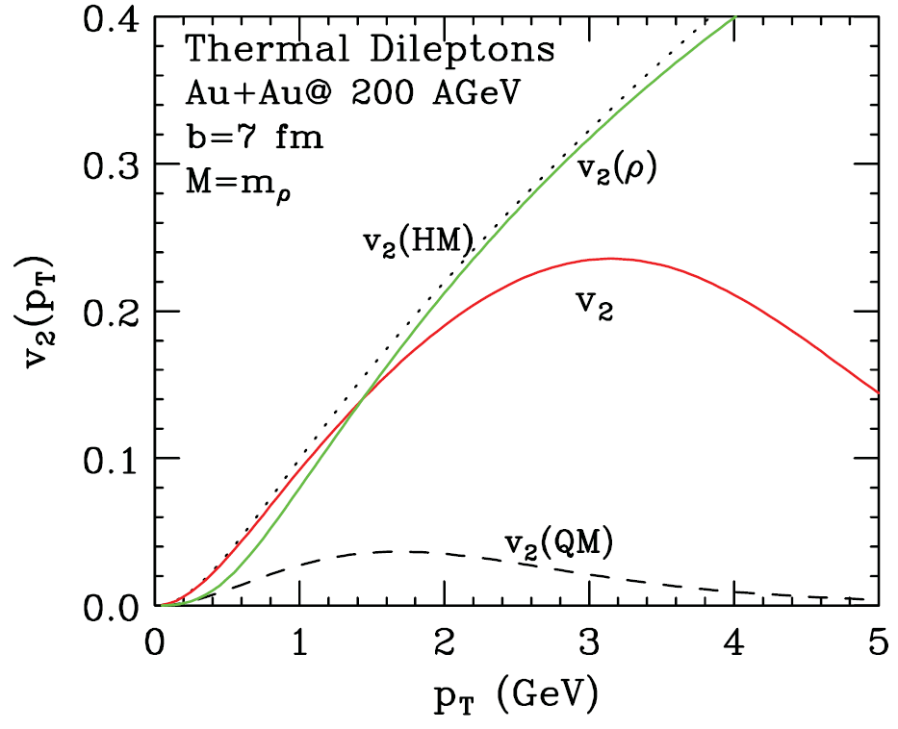
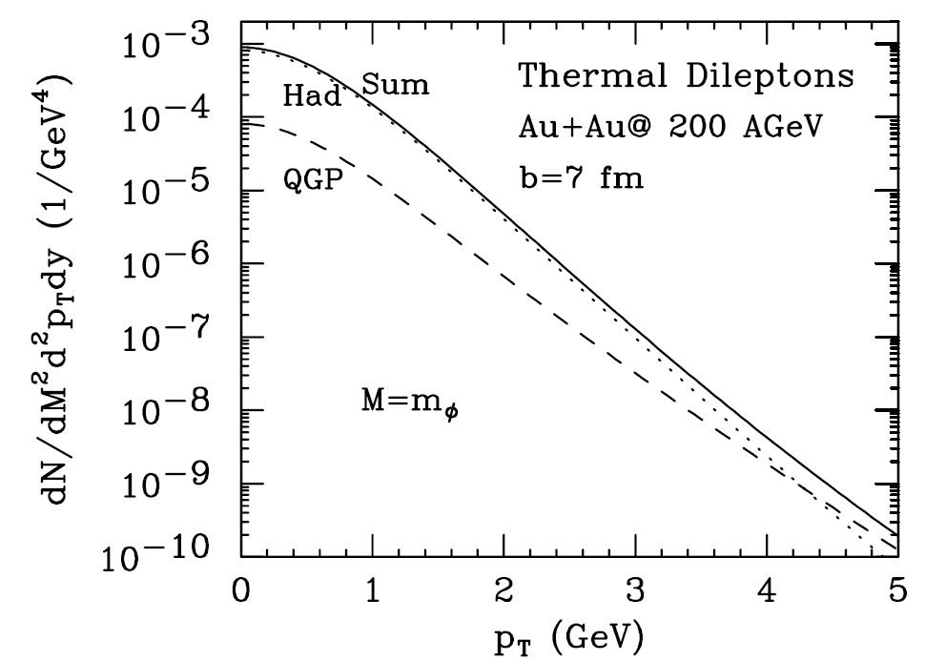
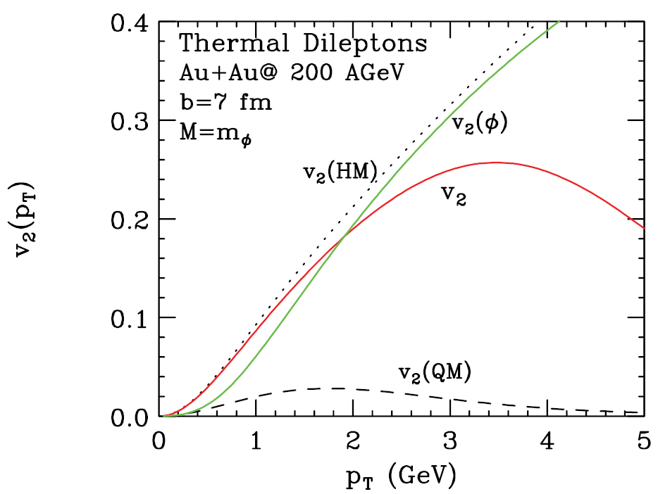
Differential elliptic flow of thermal dileptons at M=m_{φ} and M=m_{ρ}

Slide 31
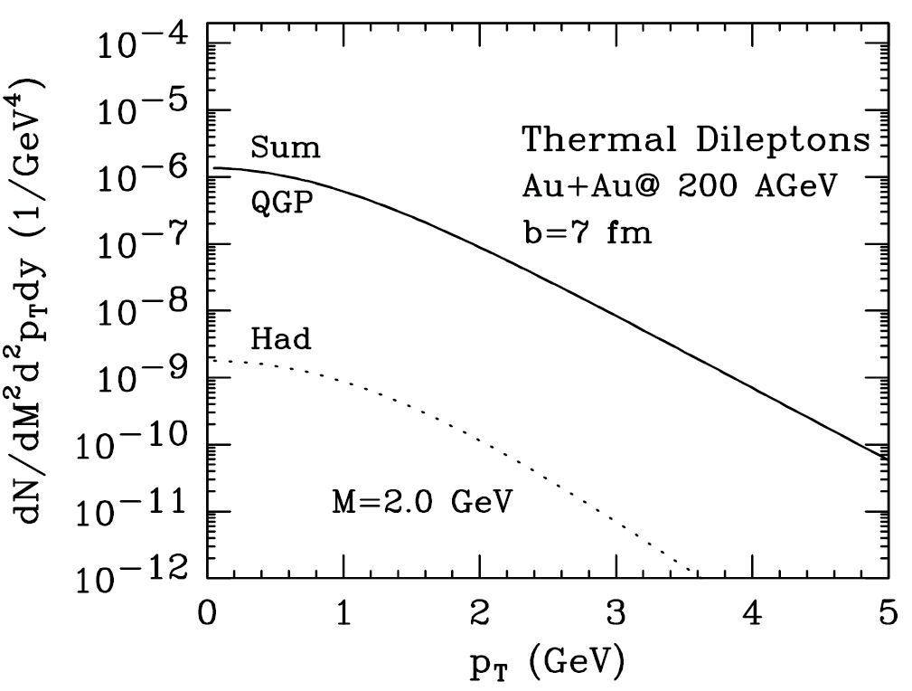
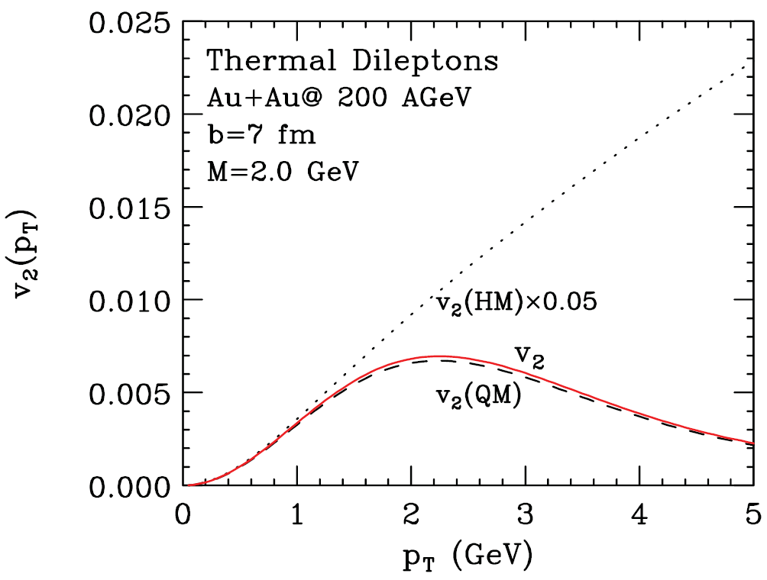
Spectra and v₂ of thermal dileptons at M = 2 GeV
At invariant mass M=2 GeV, QGP spectra is almost 3 order of
magnitude larger than hadronic spectra and almost identical to the
sum spectra.
v₂(HM) is almost 20 times larger than v₂(QM), still sum v₂ is similar
to v₂(QM).
v₂ measurement at high invariant masses will give pure QGP
signature, where subtraction of hadronic contribution is not required.

Slide 32
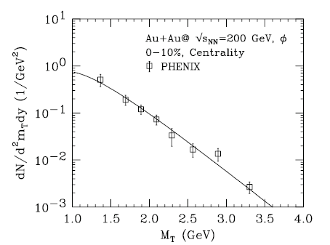
Comparison of PHENIX (experimental) data with theoretical results
from ideal hydrodynamics:
PHENIX data
m_{T} spectra of φ meson matches very well with PHENIX data.

Slide 33
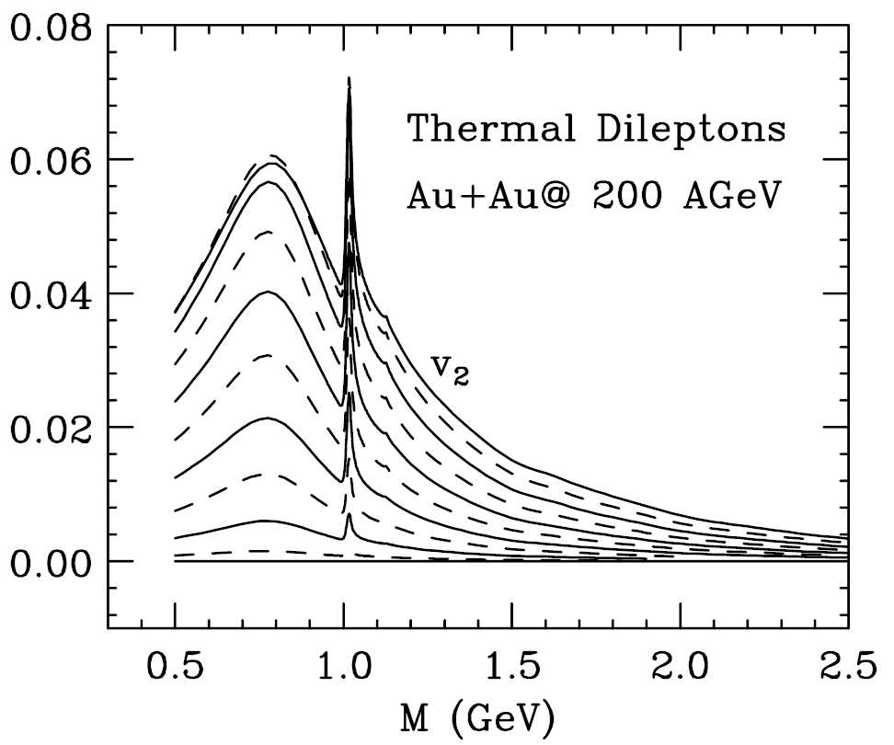
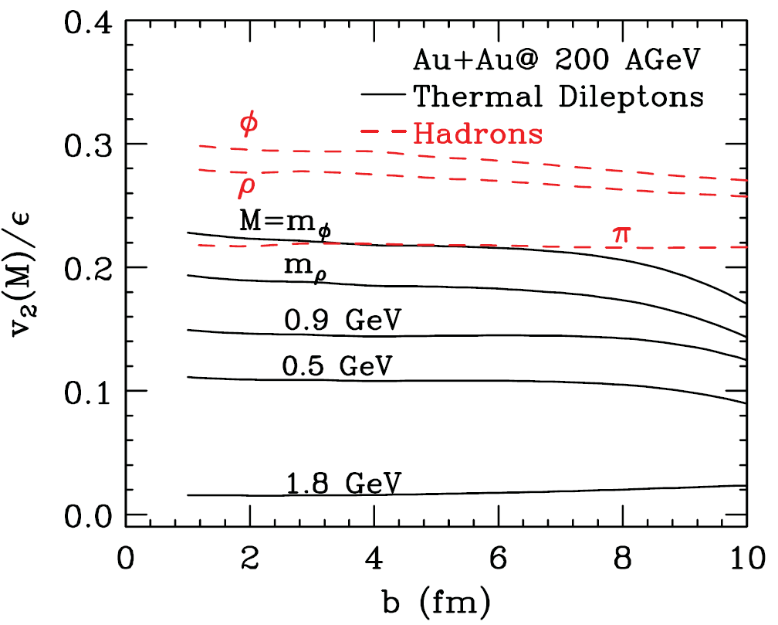
For thermal dileptons v₂(M) rises
towards peripheral collisions.
At the resonance masses peak structures
can be clearly seen for all the impact
parameters.
v₂(M) for b=10 fm is marginally smaller
than v₂(M) for b=9 fm.
Initial spatial eccentricity scaled v₂ of
thermal dileptons for several masses
and for different hadrons.
v₂/ε remains constant upto a very large
value of impact parameter.
Ideal hydrodynamics is scale invariant.

Slide 34
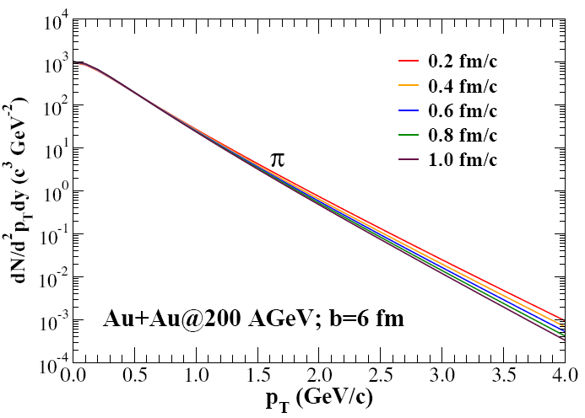
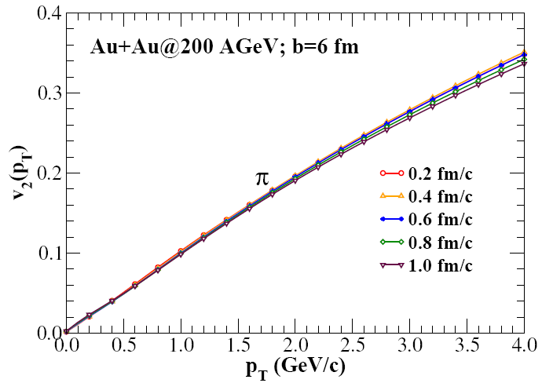
Spectra and v₂ of pions
R. Chatterjee, D. K. Srivastava, arXiv:0809.0548
For large initial times the inverse slope of pion spectrum is
smaller due to late start of flow.
Differential elliptic flow is almost independent of initial time.

Slide 35
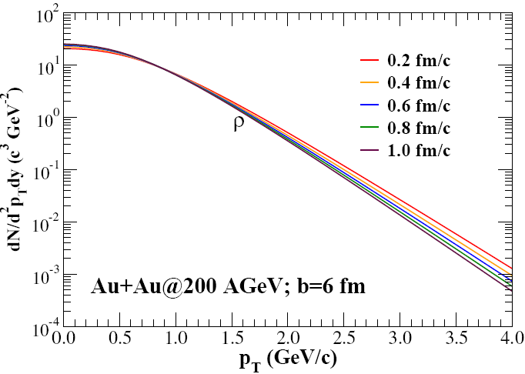
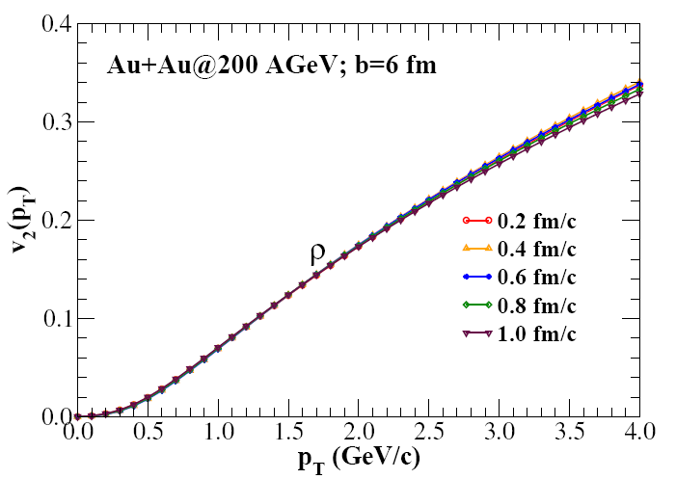
Spectra and v₂ of rho mesons

Slide 36
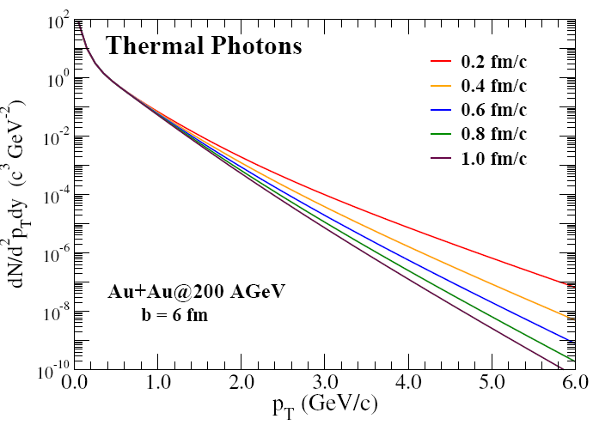
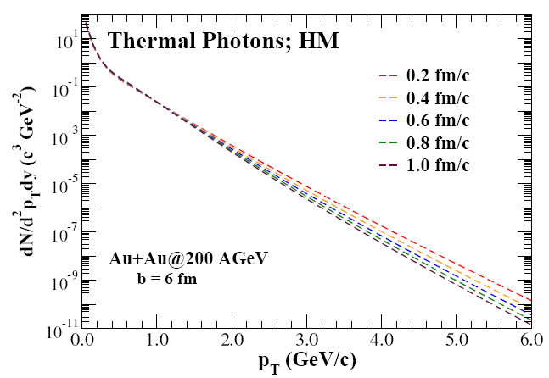
Thermal photon spectra at different τ₀
Contributions from hadronic matter for different starting times are only marginally different at lower p_{T}.
The total production of thermal photons for p_{T} < 1 GeV is not strongly affected, at p_{T}=6 GeV, it increases by more than four order of magnitude.

Slide 37
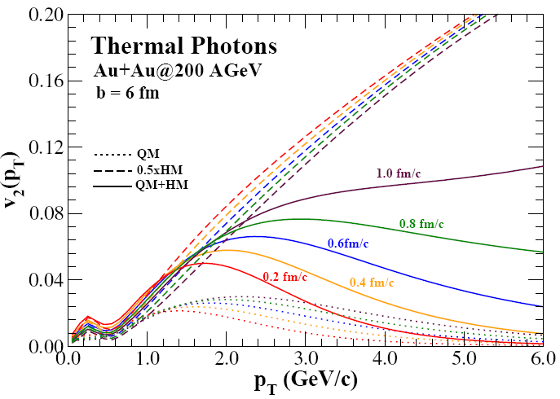
Thermal photon elliptic flow at RHIC for different τ₀
The results for the final v₂ for thermal photons reveal a large
sensitivity to the initial time τ₀.

Slide 38
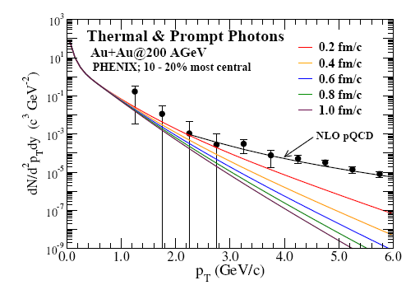
Comparison with PHENIX data

Slide 39
Summary & conclusions
Elliptic flow electromagnetic radiation has a great potential to explore
the properties and early time dynamics of Quark Gluon Plasma.
Photon and dilepton flow at large p_{T} and/or high invariant mass reflect
the anisotropies of the partonic phase.
Temporal contours of elliptic flow and spectra show the gradual build up
of flow and the relative contribution of quark matter and hadronic matter in the total flow with changing time.
v₂ of thermal photon is sensitive to initial time and experimental determination of v₂ can help us to determine τ₀ accurately.

Slide 40
My collaborators
Dinesh K. Srivastava
Variable Energy Cyclotron Centre, Kolkata
Ulrich W. Heinz
The Ohio State University, Columbus
Evan S. Frodermann
The Ohio State University, Columbus
Charles Gale,
Mcgill University, Montreal
Thank you

Slide 41
Photon flow at LHC

Slide 42
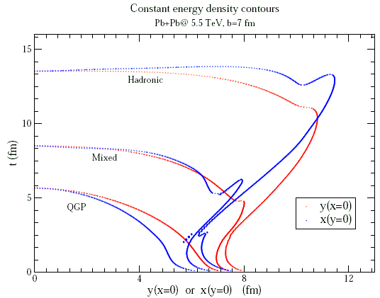
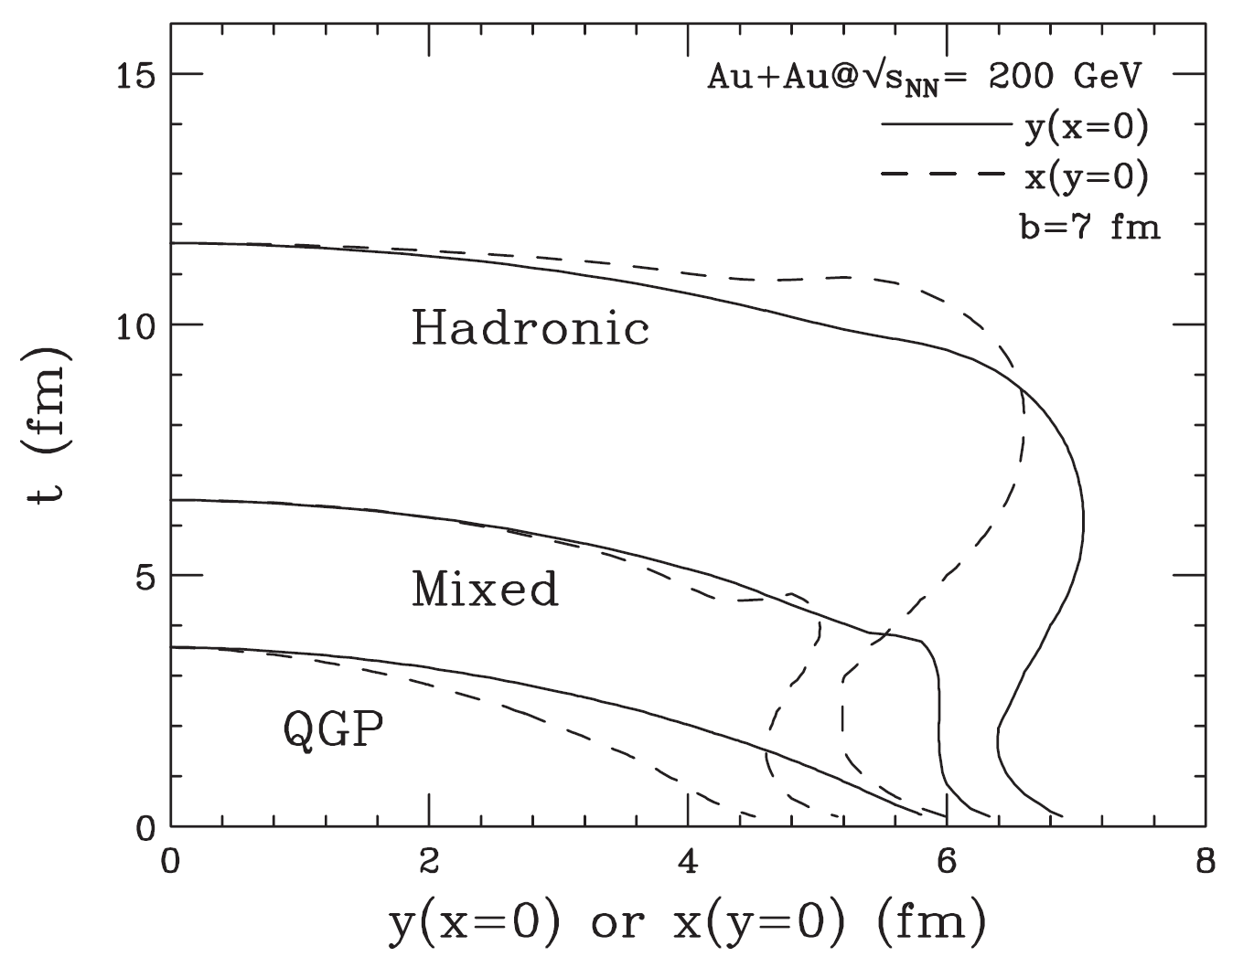
Constant energy contours at RHIC & LHC
R. Chatterjee, E. Frodermann, U. Heinz, D. K. Srivastava, PRL 96, 202302 (2006)
E. Frodermann, R. Chatterjee, U. Heinz,D. K. Srivastava, Nucl-th/0707.1898
x(y=0) or y (x=0) fm x(y=0) or y(x=0) fm
RHIC results are for Au+Au@ 200 GeV & LHC results are for Pb+Pb@ 5.5 TeV.
Both the figures are for b = 7fm.
Energy densities are taken as : ε_{q}=1.60 GeV (end of pure QGP phase)
ε_{h}=0.45 GeV (end of mixed phase) &
ε_{f}=0.075 GeV( freeze-out energy density)
Life time of the system at RHIC is about 12 fm, at LHC life time is 14 fm.

Slide 43
Constant energy contours at RHIC & LHC
x(y=0) or y (x=0) fm x(y=0) or y(x=0) fm
*Life time of QGP phase is much larger at LHC than at RHIC.
*Not much difference in the life time of mixed and hadronic phase.
At freeze out time system size is much larger at LHC compared to RHIC.
At LHC source is initially wider in the y- direction (out of plane), but later becomes larger in the x direction (in- plane).

Slide 44
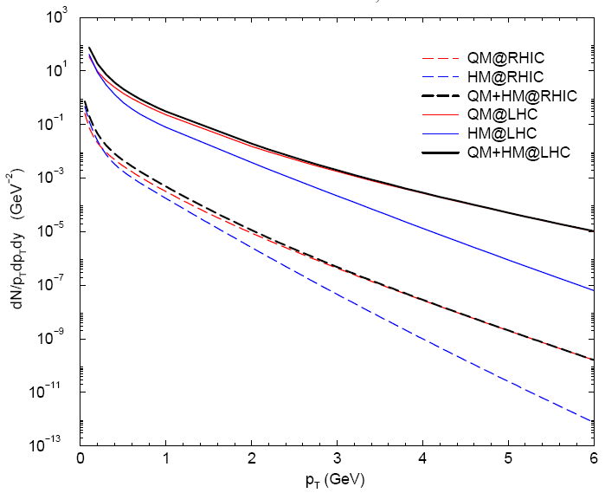
Thermal photon spectra at RHIC & LHC at b= 7 fm
Sum spectrum at LHC is flatter than the same at RHIC as a result of
larger radial flow.
Contribution of hadronic radiation to the sum spectrum at low p_{T} is reduced at LHC compared to RHIC.

Slide 45
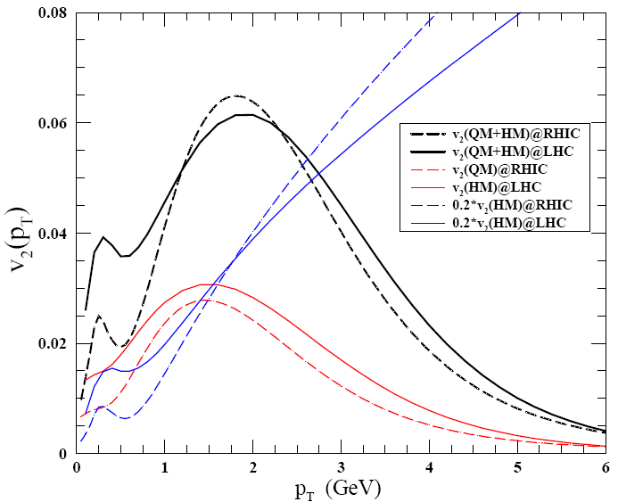
Thermal photon v₂ at RHIC & LHC at b= 7 fm
v₂(QM) at LHC is much higher than v₂(QM) at RHIC.
Peak value of sum v₂ is lower at LHC than RHIC as v₂(HM) is smaller.

Slide 46
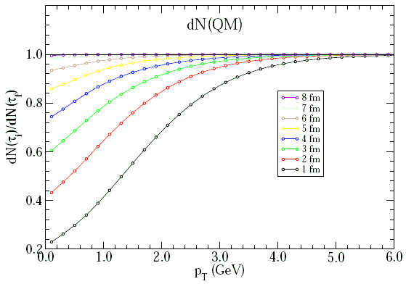
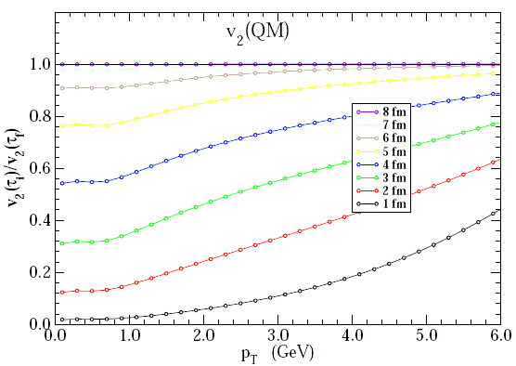
Time evolution of spectra and v₂ of thermal photons from QM @ LHC
Pb+Pb@5.5 TeV, b =7 fm
Temporal contours are taken in steps of 1 fm.
Life time of QGP phase is 7-8 fm, much larger than the lifetime at RHIC.

Slide 47
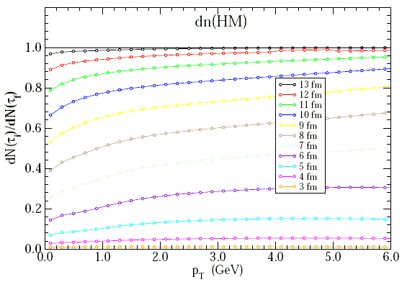
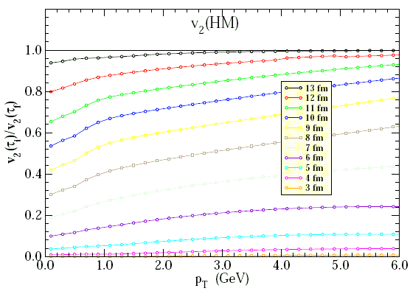
Time evolution of spectra and v₂ of thermal photons from HM @ LHC
HM contribution is significant only after 5 fm.
Nature of spectra and v₂ are similar to what we obatained at RHIC.

Slide 48
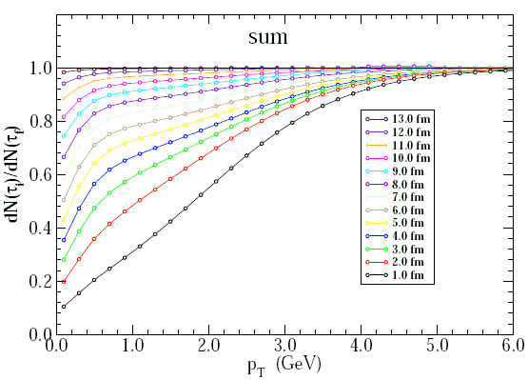

Time evolution of spectra and v₂ of thermal photons @ LHC
Flow and spectra show QGP dominance at early times.

Slide 49


Single photon production from Pb+Pb collisions @SPS

Slide 50
List of publicaions :
Elliptic flow of thermal photons in relativistic nuclear collisions.
Rupa Chatterjee, Evan S. Frodermann, Ulrich W. Heinz, Dinesh K. Srivastava.
Phys. Rev. Lett. 96, 202302, 2006
Azimuthal flow of decay photons in relativistic nuclear collisions.
Biswanath Layek, Rupa Chatterjee, Dinesh K. Srivastava.
Phys. Rev. C74, 044901, 2006
Elliptic flow of thermal dileptons in relativisti nuclear collisions.
Rupa Chatterjee, Dinesh K. Srivastava, Ulrich W. Heinz, Charles Gale
Phys. Rev. C75, 054909, 2007
Evolution of anisotropic flow with eletromagnetic radiation.
Rupa Chatterjee, Dinesh K. Srivastava, Ulrich W. Heinz ( in preparation)
Single photon production from Pb+Pb collisions at SPS.
Rupa Chatterjee, Sangyong Jeon, Dinesh K. Srivastava (in preparation)
Conference proceedings:
Elliptic flow of thermal photons and dileptons
Ulrich W. Heinz, Rupa Chatterjee, Evan S. Frodermann, Charles Gale, Dinesh K. Srivastava.
Nucl. Phys. A783: 379, 2007

Slide 51
Heavy Ion Collisions at the LHC – Last Call for Prdictions
J. Phys. G35: 054001, 2008
a) Evolution of Pion HBT from RHIC to LHC - predictions from ideal hydrodynamics
E. Froderman, R. Chatterjee, U. Heinz
b)Elliptic flow of thermal photons from RHC to LHC
R. Chatterjee, E. Frodermann, U. Heinz, D. K. Srivastava
Exploring evolution of anisotropy with electromagnetic radiation.
Rupa Chatterjee, D. K. Srivastava, U. Heinz, Charles Gale.
(poster presented at QM’08, Jaipur) To be published in Indian Journal of Physics.
Elliptic flow of thermal photons
Rupa Chatterjee, Evan S. Frodermann, Ulrich W. Heinz, Dinesh K. Srivastava.
Proceedings of the DAE – BRNS SNP 51, 530 (2006)
Elliptic flow of decay photons
Biswanath Layek, Rupa Chatterjee, Dinesh K. Srivastava.
Proceedings of the DAE – BRNS SNP 51, 534 (2006)
Thermal Dilepton v₂: an Intereting observable for Study of QGP in Relativistic
Heavy Ion collisions
Rupa Chatterjee, Dinesh K. Srivastava, Ulrich W. Heinz, Charles Gale
Proceedings of the DAE – BRNS SNP 52 (2007)

Slide 52
Decay photons:
  Long lived (cτ » cτ_{AB} ~ 50-100 fm)
  π⁰ → γγ, η → γγ, η’ → ργ/ωγ/2γ
  Shot lived (cτ ≤ cτ_{AB} ~ 50-100 fm)
  ω → πγ, a₁ → πγ, Δ → Nγ, K* → Kγ, φ → ηγ, ρ → ππγ, . . .

Slide 53
Rupa et al calculation
Tuibide et al calculation
Hydrodynamic with a thermalization
at early times followed by
hadronization and decoupling.
2D+1 hydrodynamical model.
Several different sources are considered.
PRL 96, 202302 (2006)
arXiv:0712.0732v2
consistent to theoretical calculation … ?

Slide 54
Subtraction and Tagging methods
Subtraction
Tagging
Measure yield of inclusive photons corrected for hadron contaminations, conversion, efficiency and acceptance.
Measure spectrum of π⁰, η, ω etc.
Calculate yield of decay photons and subtract it from the inclusive yield.
Measure photon spectrum and remove those photons which make π⁰ mass with any other
Correct direct photon candidate sample for contribution from π⁰ decay photons with missing partner and for direct photons with fake partners
Subtract contribution from η, ω etc. decays
N_{γ}^{dir} = N_{γ}^{incl} - N_{γ}^{decay}

Slide 55

Transverse Plane
y
x

Slide 56
Elliptic Flow v₂ and Early Dynamics
Coordinate space:
initial asymmetry
Momentum space:
final asymmetry
p_{y}
y
Pressure induced flow +
Surface emission pattern +
Final state rescattering –
p_{x}
x

Slide 57
Ideal gas vs. perfect liquid
An ideal gas is one that has strong enough interactions to reach thermal equilibrium (on a reasonable time scale), but weak enough interactions so that their effect on P(n,T) can be neglected.
  This ideal can be approached arbitraily by diluting the gas and waiting very patiently (limit t →  first, then V → ).
A perfect fluid is one that obeys the Euler equations, i.e. a fluid that has zero viscosity and infinite thermal conductivity.
  There is no presumption with regard to the equation of state.
  Even an imperfect fluid obeys the Euler equations in the limit of negligible velocity, density, and temperature gradients.

Slide 58






Elliptic flow: early creation
P. Kolb, J. Sollfrank and U.Heinz, PRC 62 (2000) 054909
spatial
eccentricity
momentum
anisotropy
time evolution of the energy density:
initial energy density distribution:
Most model calculations suggest that flow anisotropies are generated at the earliest stages of the expansion, on a timescale of ~ 5 fm/c if a QGP EoS is assumed.
Notes:
Anisotropic observables are of special interest as they reflect the dynamics of the earliest stages of the reaction, and thus the dynamics of the hottest phases, eventually the plasma phase that we hope to achieve in heavy ion collisions at RHIC. The overlap region of two nuclei at finite impact parameter is strongly deformed, which you can see here characterized by contours of constant wounded nucleon density in the plane orthogonal to the beam axis.
If the system is driven apart by the pressure in the system, then you see that it will expand faster into the direction of the strongest pressure gradients, and that is in the direction of the reaction plane. Upon building up an anisotropic flow field, the system will therefore get rounder with time, as you can see in those subsequent shots of the transverse plane at different times.
This reduction of the spatial eccentricity can be quantified by averaging the difference of the width in x direction and the width in y direction over this transverse distribution function. You see how this leads to a rapid decrease of the initial large geometric anisotropy over timescales relevant for heavy ion dynamics, once displayed here for a system with a very hard equation of state of a ideal gas, where the transition is very rapid, and once for an equation of state that involves a phase transition from hadronic to partonic degrees of freedom.
While the system becomes isotropic in coordinate space, it builds up anisotropies in momentum space, which you can characterize by the difference of the diagonal components of the energy momentum tensor. And here you see nicely how, as the system gets round in coordinate space, no further momentum anisotropy is built up. Note that for a system with a large mixed phase, the generation of further anisotropies is stalled significantly earlier. The momentum anisotropy you observe is really built up in the plasma stage!
The timescale suggested from all model calculations, no matter if macroscopic or microscopic is generally below 5 fm/c. Anisotropies thus probe the earliest stages of the collision.

Slide 59





Nuclear Collision Evolution Epoches
η = 0 0.5 Infinite
Kinetic Freeze-out
--- Interaction ceases
Chemical Freeze-out
--- formation of hadrons

Slide 60







Slide 61


Thermal dileptons and hadrons at M=m_{ρ} and M=m_{φ}
p_{T} spectra of ρ and φ mesons are flatter compared to that of thermal
dileptons at M=m_{ρ} and M=m_{φ} respectively.
Dileptons come out from the entire expansion history, whereas hadrons
are emitted only from the freeze-out surface.
Elliptic flow shows opposite nature of spectra.

Slide 63
S.Turbide, C.Gale, R.J.Fries, PRL 96 032303 (2006)
Jets lose more energy where the medium is thicker - more jet-photon conversions (v₂<0), + photons from fragmentation of quenched jets (v₂>0)

Slide 64
At mid rapidity (y=0) and for collision of same type of nuclei,
Systems evolution is mirror symmetric with respect to the reaction plane.
Thus observable under investigation respect the symmetry f(φ)=f(−φ),
sin terms will not appear in the above equation.
For reflection symmetry in the transverse plane, f(φ)=f(π+φ)
only even terms (v₂,v₄, . . . .) survive in the above series.
dN(b)
p_{T}dp_{T}dydϕ
∫ dϕ cos(2ϕ)
v₂(p_{T},b) =
dN(b)
p_{T}dp_{T}dydϕ
∫
dϕ

