Slide 1
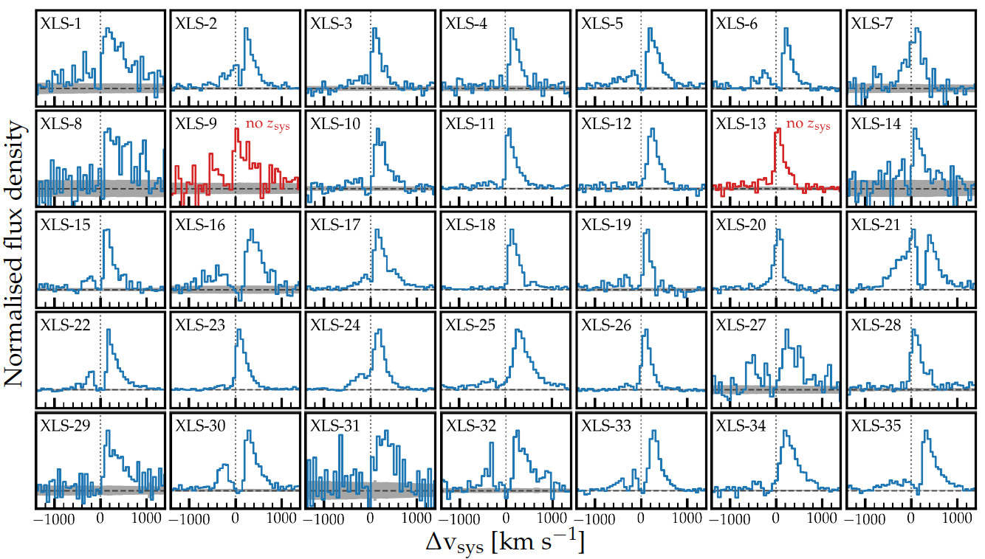
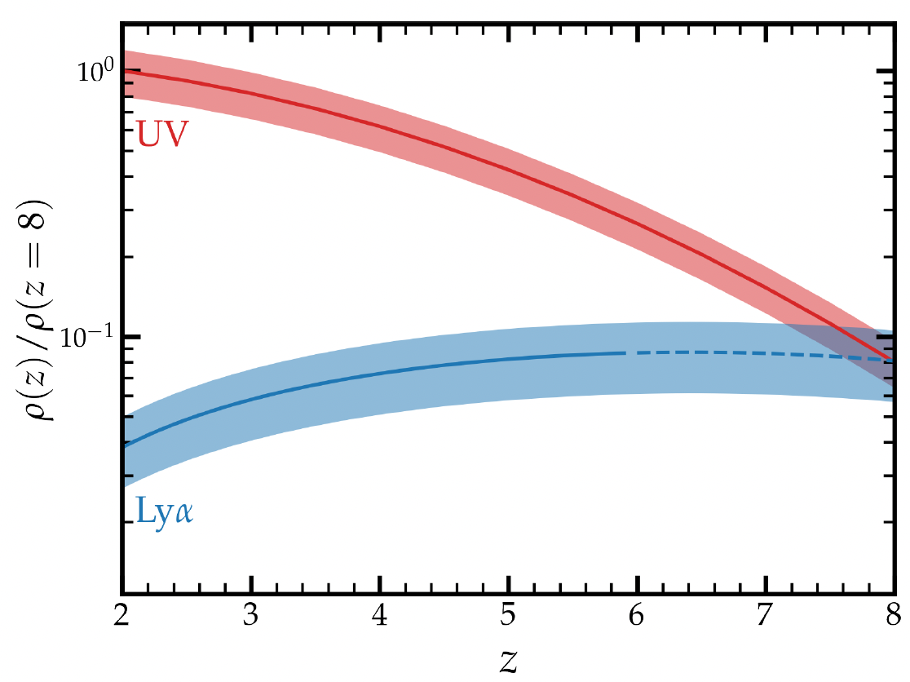
Solving Reionization with Resolved Lyman-α
Rohan Naidu (Harvard)
Jorryt Matthee, Pascal Oesch, Charlie Conroy, XLSz2 Survey Team

Slide 2
Cosmic Reionization
Last major phase transition of the Universe.
Loeb+06

Slide 3
Cosmic Reionization: ionizing photon budget
Reionization Budget = Number of galaxies
x Ionizing photons/galaxy
x Fraction that evade dust+HI
= ⍴_{SFR} ξ_{ion} f_{esc}
Clear path to ⍴_{SFR} and ξ_{ion} with JWST.
Direct measurements of escape fractions (f_{esc}) impossible at z>4 due to IGM opacity.

Slide 4
LyC f_{esc} = What fraction avoids Dust + HI
High fesc, “LyC leakers”
Low fesc, “non-leakers”
Matthee+21

Slide 5
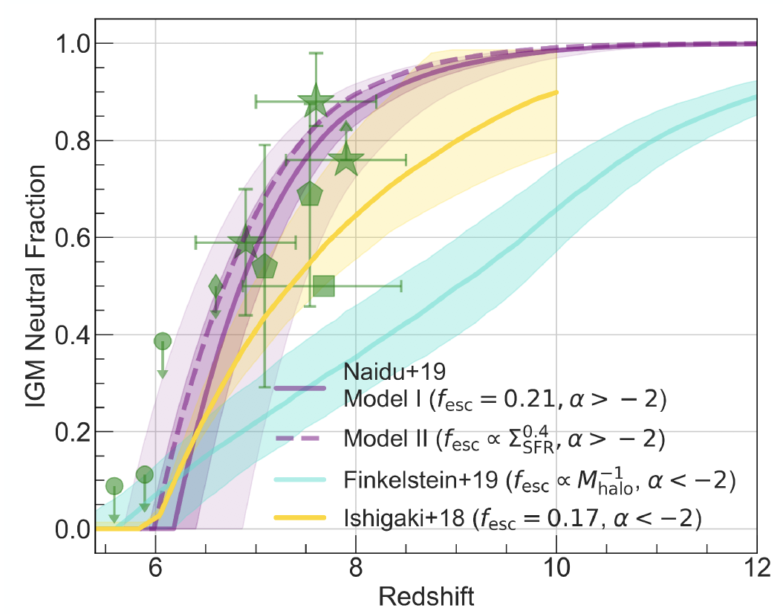
Cosmic Reionization: everything hinges on LyC f_{esc}
Bright galaxies
have high fesc
Timeline
Faint galaxies
have high fesc
Naidu+20, Tacchella+18
Radically different pictures of reionization depending on fesc distribution.

Slide 6
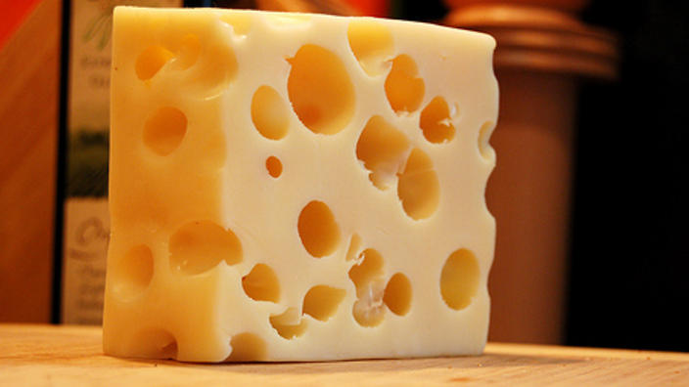
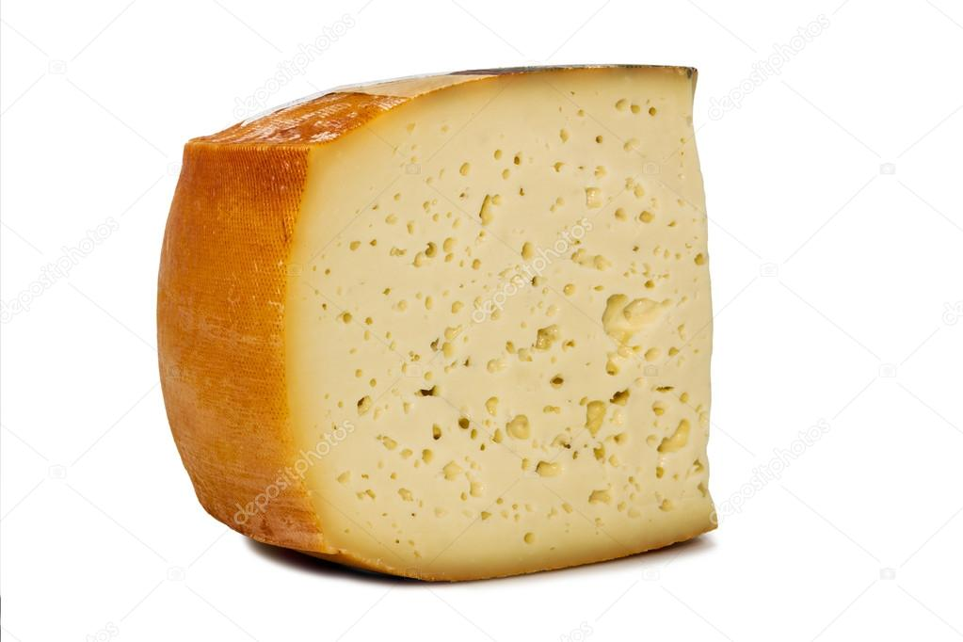
Cosmic Reionization: everything hinges on LyC f_{esc}
Bright galaxies
have high fesc
Timeline
Topology
Faint galaxies
have high fesc
Naidu+20, Tacchella+18
Radically different pictures of reionization depending on fesc distribution.

Slide 7
1. A new route to f_{esc}: resolved Lyα 2. A Lyα formalism for the ionizing background 3. JWST preview: Double Bubble Lyman Trouble

Slide 8
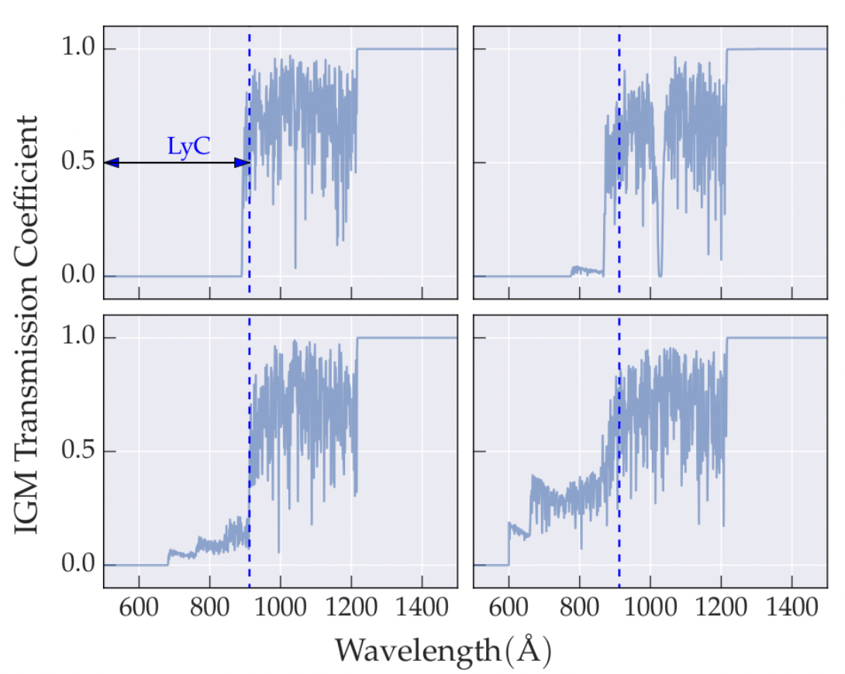
State of the (LyC fesc) Union
Difficult to perform a simple test at significant redshift: what are the properties of leakers vs. non-leakers?
Naidu+17

Slide 9
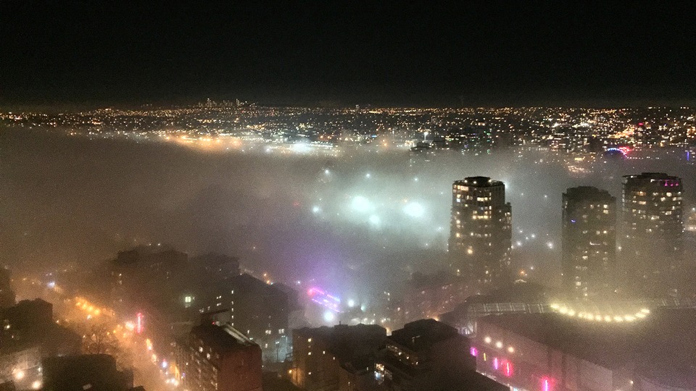
State of the (LyC fesc) Union
Difficult to perform a simple test at significant redshift: what are the properties of leakers vs. non-leakers?
Fog (IGM/viewing angle effects) = can’t tell how bright the city (fesc) is

Slide 10
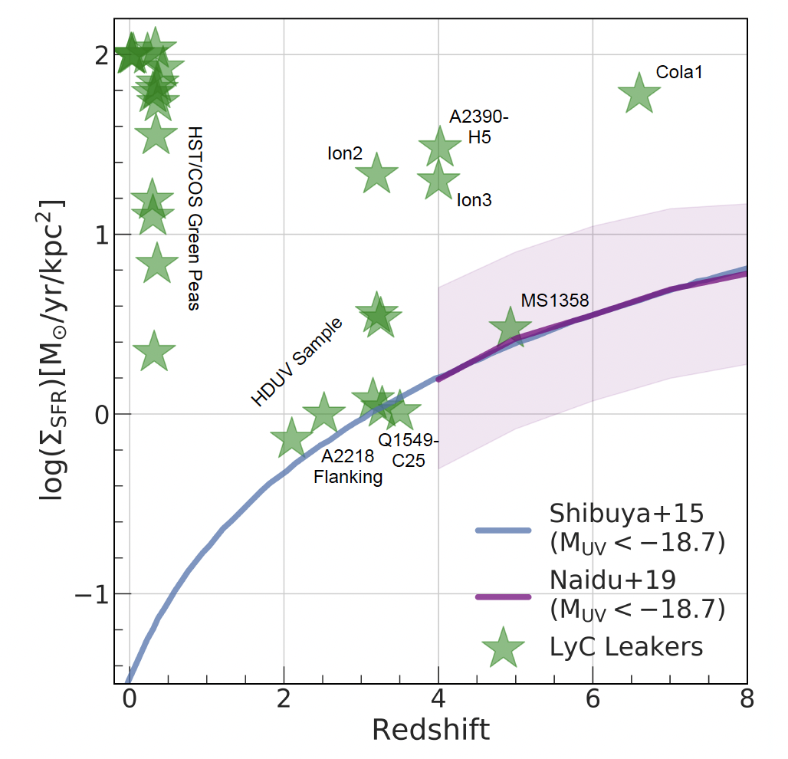
State of the (LyC fesc) Union
Difficult to perform a simple test at significant redshift: what are the properties of leakers vs. non-leakers?
What is the connection between results at lower redshifts and the Epoch of Reionization?
Naidu+20

Slide 11
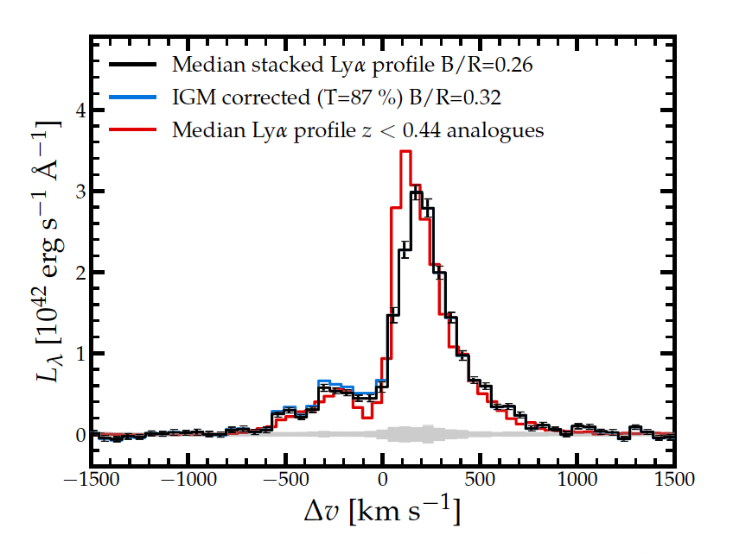
State of the (LyC fesc) Union
Difficult to perform a simple test at significant redshift: what are the properties of leakers vs. non-leakers?
What is the connection between results at lower redshifts and the Epoch of Reionization?
Resolved Lyman-α
is the panacea

Slide 12
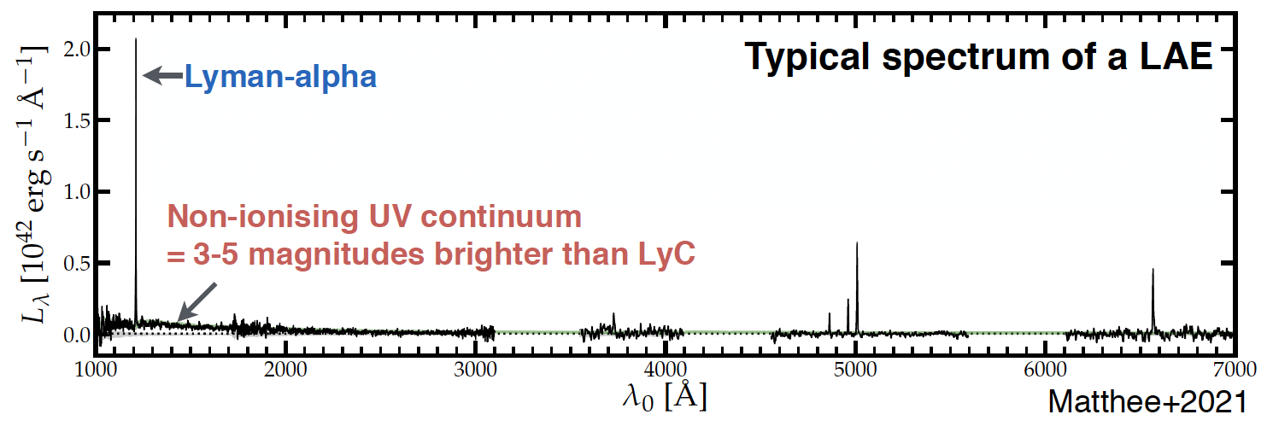
Resolved Lyman-α is the LyC panacea: convenience
~1000x brighter than LyC.
Negligible IGM stochasticity (out to z~3-4).

Slide 13
Lyman-α is uniquely sensitive to HI
Has been used for decades to trace reionization.
Naidu+20, Tacchella+18

Slide 14
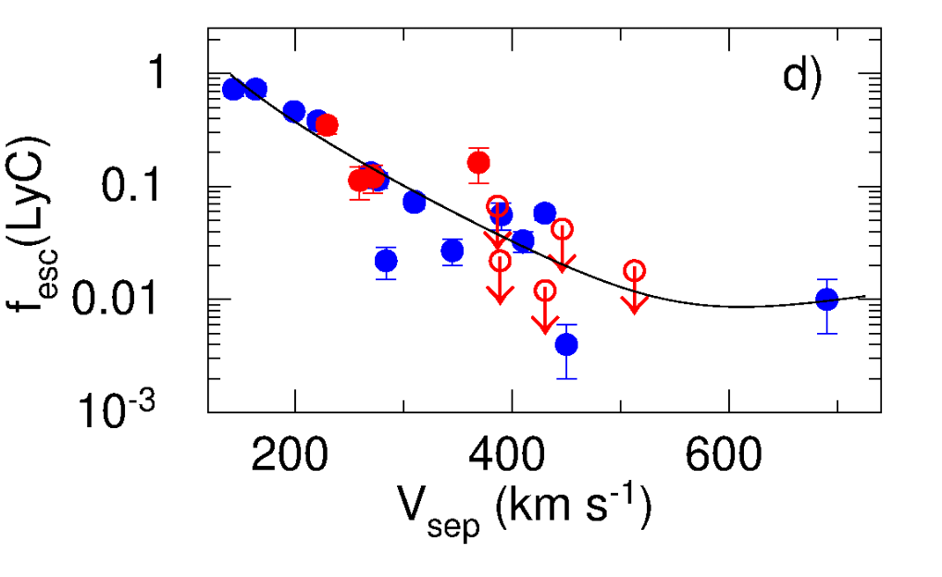
Lyα profiles are excellent tracers of LyC fesc: peak separation (Vsep)
z~0.3
Low Vsep = High fesc
Izotov+21

Slide 15
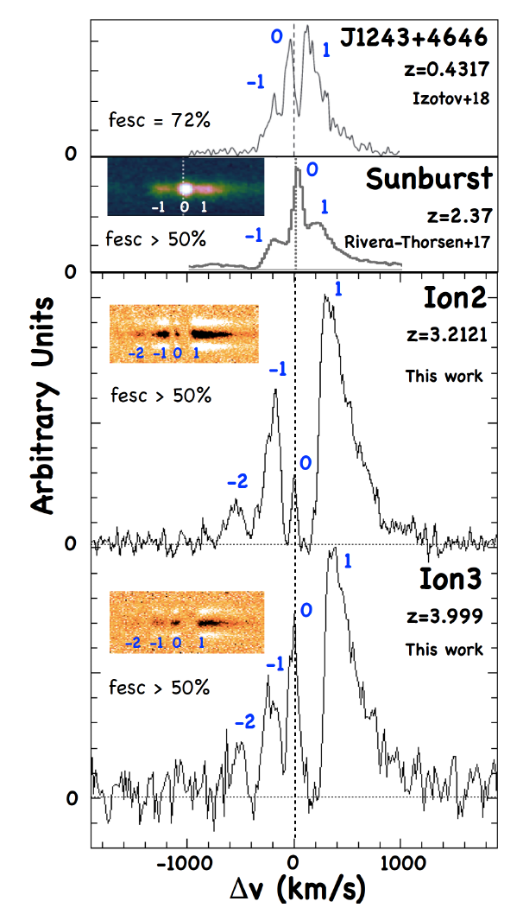
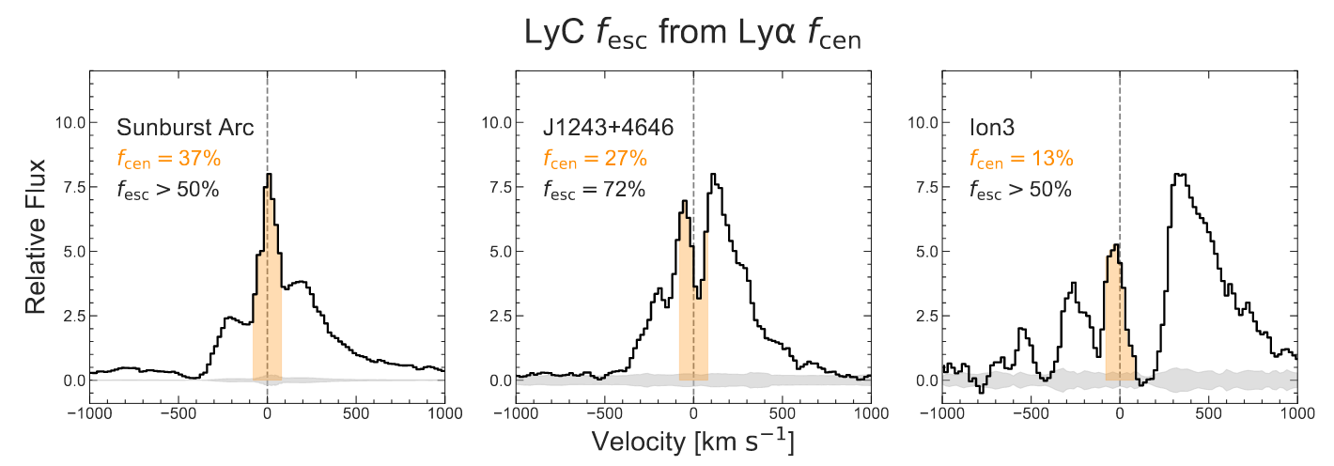
Lyα profiles are excellent tracers of LyC fesc: central Lyα fraction (fcen)
High fcen= High fesc
Systemic Lyα traces ionized channels
Vanzella+18

Slide 16
XLSz2: X-SHOOTER Lyα Survey at z~2
R>4000 Lyα profiles, <10 km/s systemic zs
N=35, well-defined, flux-limited sample (Lyα L>0.2 Lyα L*)
Coverage from Lyα to Hα
Matthee+21, MNRAS, 1292M
PI: Jorryt Matthee
Zwicky Fellow
ETH Zurich

Slide 17
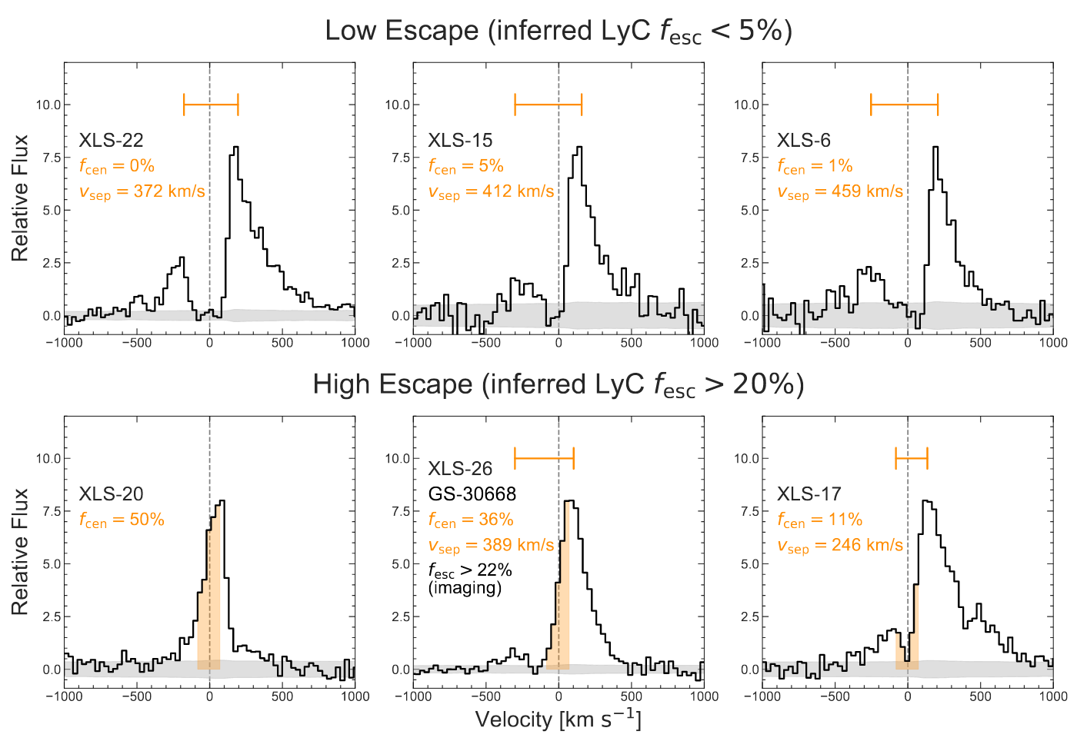
XLSz2: High Escape & Low Escape Sources
35% of sample
50% of sample

Slide 18
Stacks comparable log(M*)~9, Muv~-20, β~-2, 12 + log(O/H)~8

Slide 19
Stacks comparable log(M*)~9, Muv~-20, β~-2, 12 + log(O/H)~8
High Escape (>20%)
Low Escape (<5%)
Lyα fesc ~ 50%
EW ~ 110 A
Lyα fesc ~ 10%
EW ~ 60 A
Sanity checks for LyC fesc:
Differ greatly in dust content: E(B-V) of 0 vs. 0.35
LyC fesc <= LyA fesc Izotov+21, Dijkstra+16

Slide 20
High Escape stack has low column density (Δv of MgII)
High Escape (>20%)
Low Escape (<5%)
Doublet Ratio>2
Δv: +30 km/s
Low N(HI)
Doublet Ratio = 1
Δv: +130 km/s
High N(HI)
Validation of MgII doublet as a faithful tracer of fesc
Henry+18, Feltre+18, Chisholm+20

Slide 21
High Escape occurs in an extreme ionization state ISM (O32, Ne3O2)
High Escape (>20%)
Low Escape (<5%)
O32=8.4
O32=2.7
O32 (5007 A/3727 A) might work out after all!
Scatter in previous studies likely because of viewing angle effects/inhomogeneous samples

Slide 22
What is the fesc & ξion of the leaker stack?
High f_{esc} (>20%)
Low fesc (<5%)
Lyα fesc ~ 50%
EW ~ 110 A
Lyα fesc ~ 10%
EW ~ 60 A
fesc~50% based on empirical Lyα-linked calibrations Gazagnes+20, log(ξion)~25.9 Hz/erg
Half the L>0.2 L* LAEs have this fesc and ξion – completely consistent with Keck LyC Survey stacks Steidel+18.

Slide 23
Timing the High Escape phase to <10 Myrs
During this phase the ξion is ~5x (!) higher than canonically assumed.
High production and escape occur in sync.

Slide 24
Evolutionary sequence for LyA and LyC

Slide 25
Evolutionary sequence for LyA and LyC

Slide 26
Evolutionary sequence for LyA and LyC

Slide 27
Evolutionary sequence for LyA and LyC

Slide 28
Evolutionary sequence for LyA and LyC

Slide 29
1. A new route to f_{esc}: resolved Lyα 2. A Lyα formalism for the ionizing background 3. JWST preview: Double Bubble Lyman Trouble

Slide 30
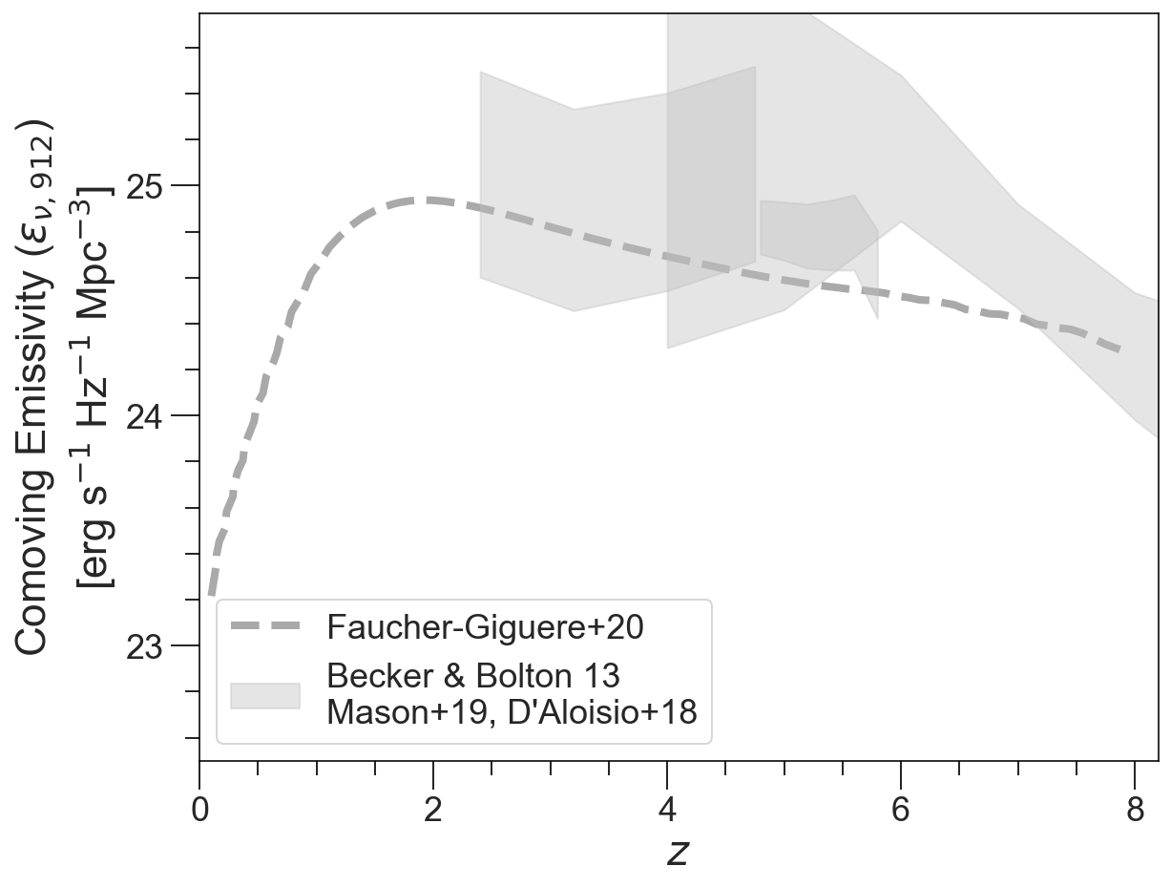
Explaining the Ionizing Emissivity from z~2-8
The ionizing background (UVB) permeates the IGM – origin unclear.

Slide 31
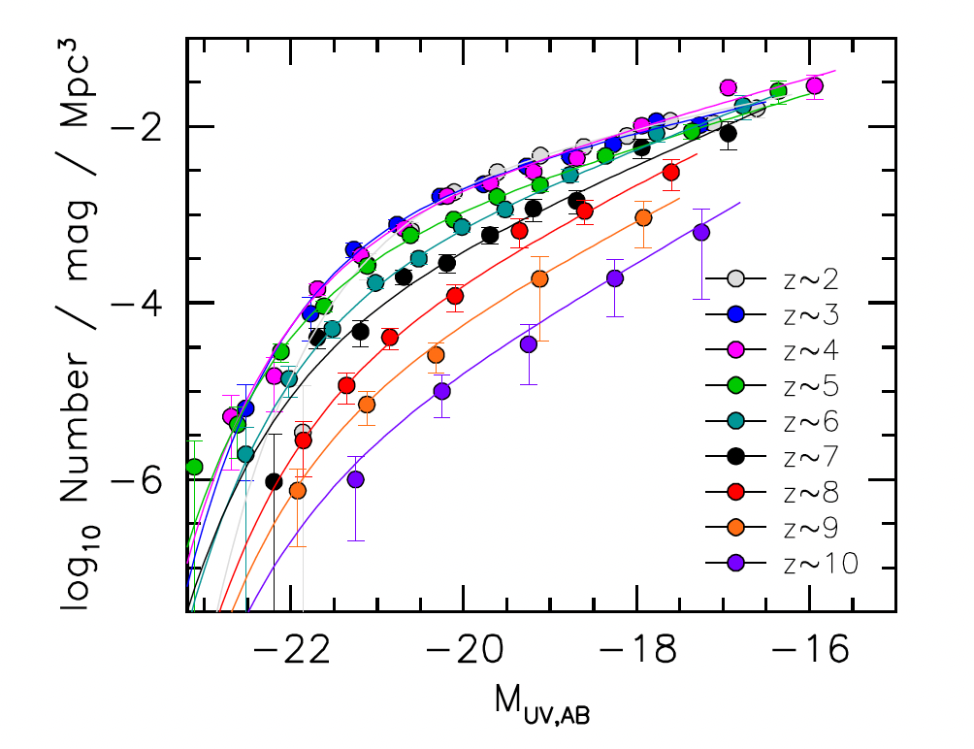
UV Luminosity Functions are the current standard for emissivity calculations
Total photons = Number of galaxies
x Ionizing photons/galaxy
x Fraction that evade dust+HI
= ⍴_{SFR} ξ_{ion} f_{esc}
UV LFs
e.g., Bouwens+21, Finkelstein+15, Ishigaki+18

Slide 32
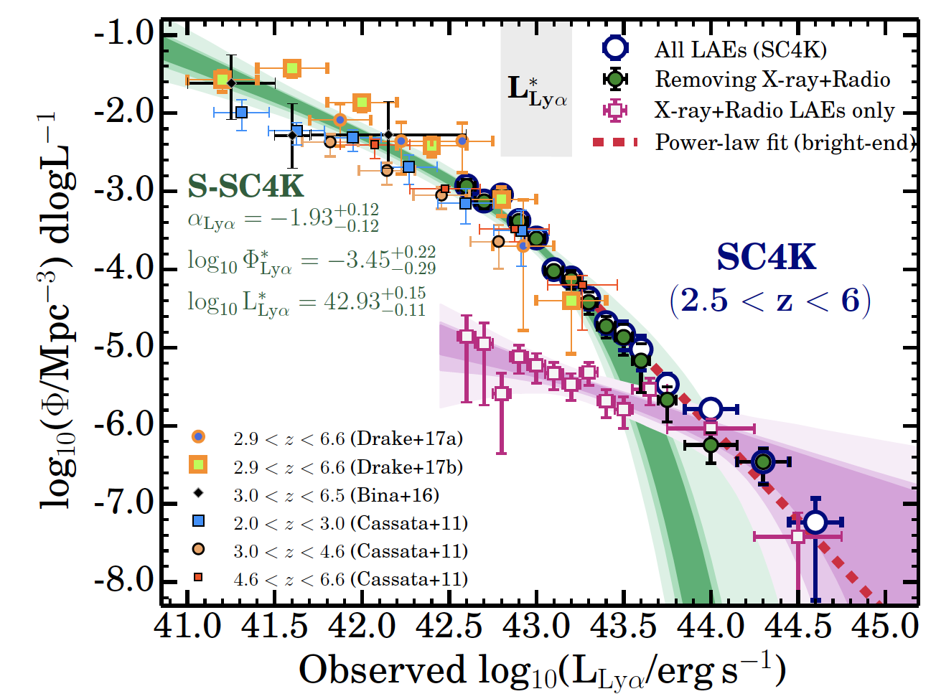
UV Luminosity Functions vs. Lyα LFs
UV LFs vary strongly with redshift
Bouwens+21, Finkelstein+15, Ishigaki+18
Lyα LFs are redshift invariant Sobral+18
Ouchi+08, Cassata+11, Konno+14, Bina+16, Drake+17,Herenz+19

Slide 33
LyA LFs are a more intuitive choice
LyA f_{esc} >= ionizing photon f_{esc} (LyC fesc)

Slide 34
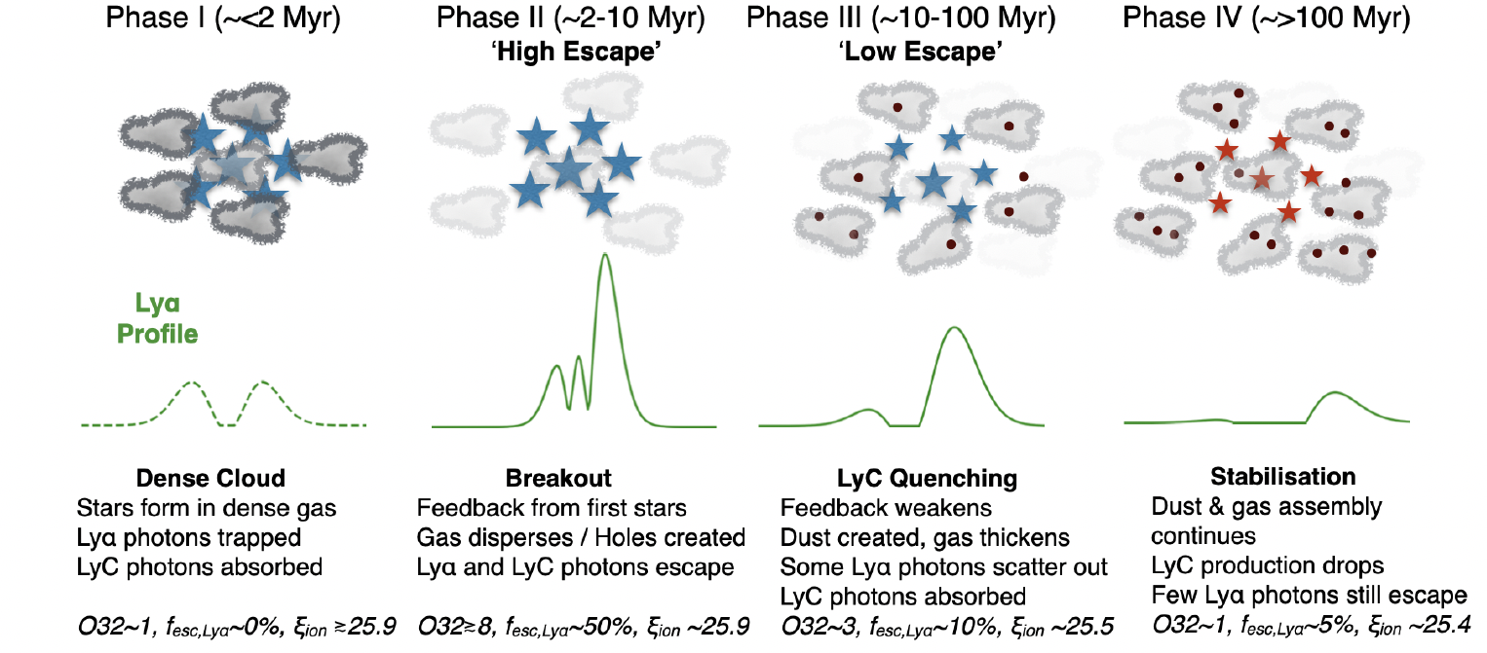
LyA LFs are a more intuitive choice
LyA f_{esc} >= ionizing photon f_{esc} (LyC fesc)
UV LFs sum photons from all galaxies
LyA LFs focus on “productive” galaxies

Slide 35
LyA LFs are a more intuitive choice
LyA f_{esc} >= ionizing photon f_{esc} (LyC fesc)
UV LFs sum photons from all galaxies
LyA LFs focus on “productive” galaxies
Madau+99, Robertson+13
Matthee & Naidu+21, Sobral & Matthee 19

Slide 36
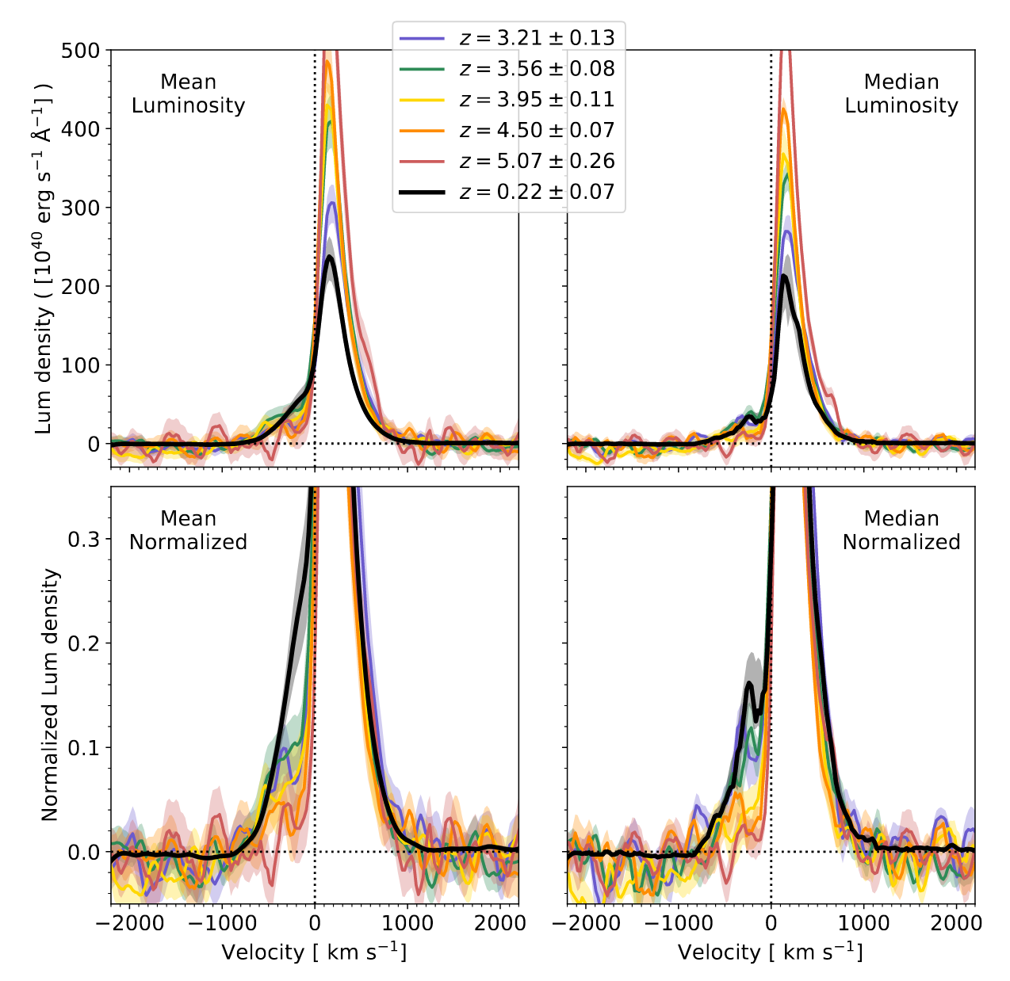
z~2 LAE fesc findings extrapolate to EoR remarkably well
LAE LFs and fundamental properties are redshift invariant Sobral+18, Ouchi+08, Cassata+11, Konno+14, Bina+16, Drake+17,Herenz+19
LAE profiles, intimately linked to fesc, are redshift invariant Hayes+21

Slide 37
z~2 LAE fesc findings extrapolate to EoR remarkably well
LAE LFs and fundamental properties are redshift invariant Sobral+18, Ouchi+08, Cassata+11, Konno+14, Bina+16, Drake+17,Herenz+19
UV-samples and LAE-samples converge at z>6 Matthee & Naidu+21
LAE profiles, intimately linked to fesc, are redshift invariant Hayes+21

Slide 38
The emissivity from z~2-8 is due to >0.2 L* LAEs
Excellent match to the shape of the flat emissivity
The falling ρ_{SFR} is balanced by the rising LAE fraction

Slide 39
A natural explanation for fesc evolution
The increasing LAE fraction with redshift is why <fesc> increases.
Understanding the evolution of the LAE fraction is a much more tractable problem.

Slide 40
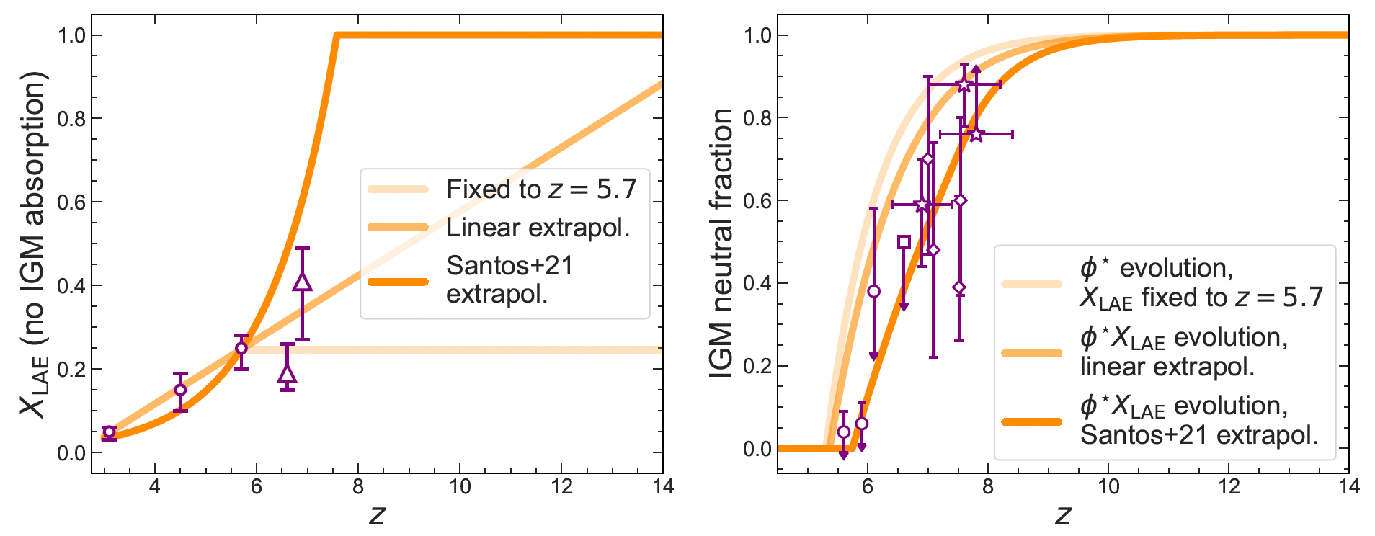
Rapid, Late Reionization by bright LAEs
Requires X_{LAE} extrapolation to account for IGM-damped z>6 Lyα LF – only free/untested parameter

Slide 41
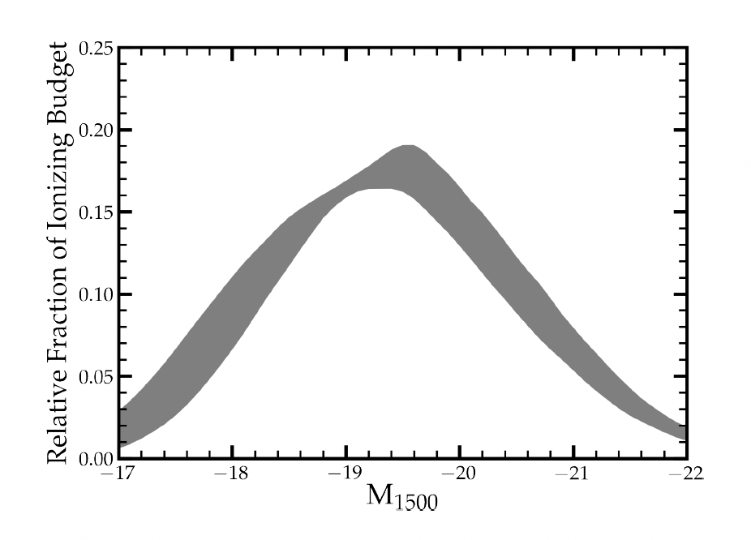
Which galaxies reionized the Universe?
Our model distributes the ionizing output in a small fraction of M_{UV}<-17 galaxies, and these galaxies have a 10x higher f_{esc} ξ_{ion}.

Slide 42
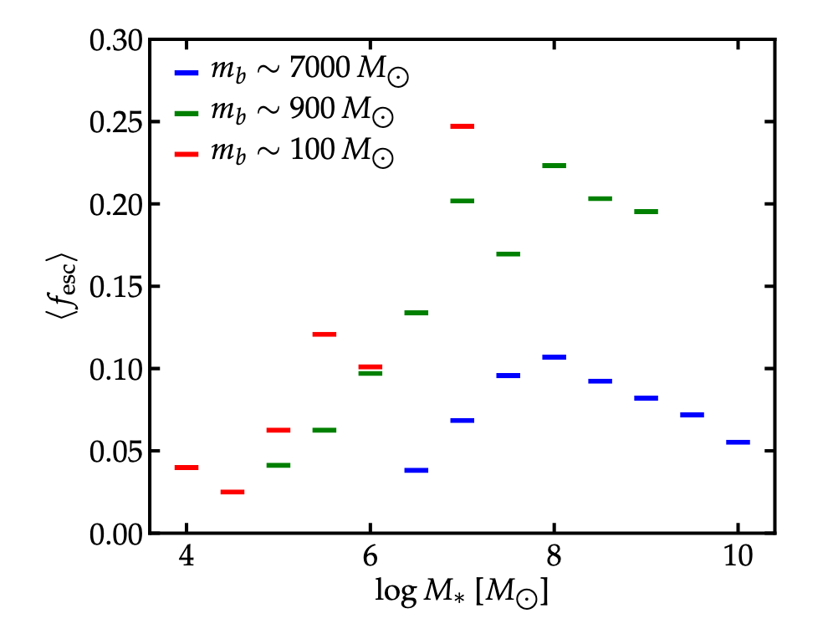
Which galaxies reionized the Universe?
Ma+20, FIRE-2 Simulations
See also Ma+15,16

Slide 43
“Disco” UV background
Ongoing debate about extended troughs in Lyα forest – two possibilities: reionization incomplete till z~5, or fluctuating UV background. Nasir+19, Bosman+21
Zhu+21

Slide 44
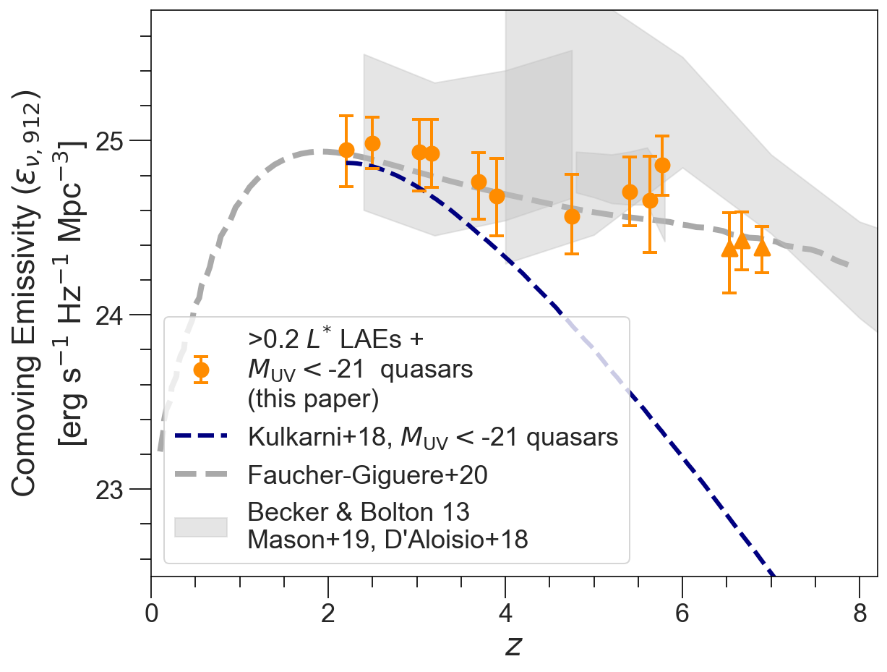
“Disco” UV background
Ongoing debate about extended troughs in Lyα forest – two possibilities: reionization incomplete till z~5, or fluctuating UV background. Nasir+19, Bosman+21
Bright LAEs due to their rarity and ~10 Myr duty cycles produce a highly biased, fluctuating background.
Zhu+21

Slide 45
1. A new route to f_{esc}: resolved Lyα 2. A Lyα formalism for the ionizing background 3. JWST preview: Double Bubble Lyman Trouble

Slide 46
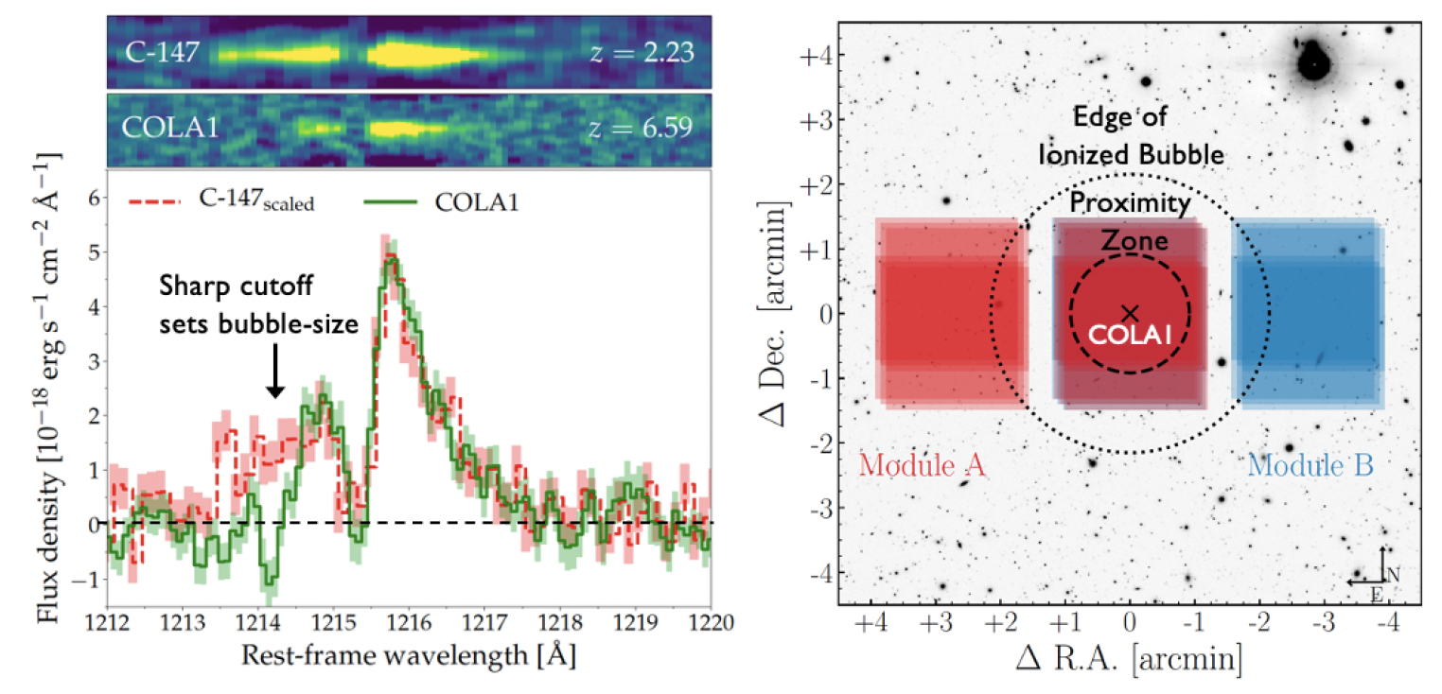
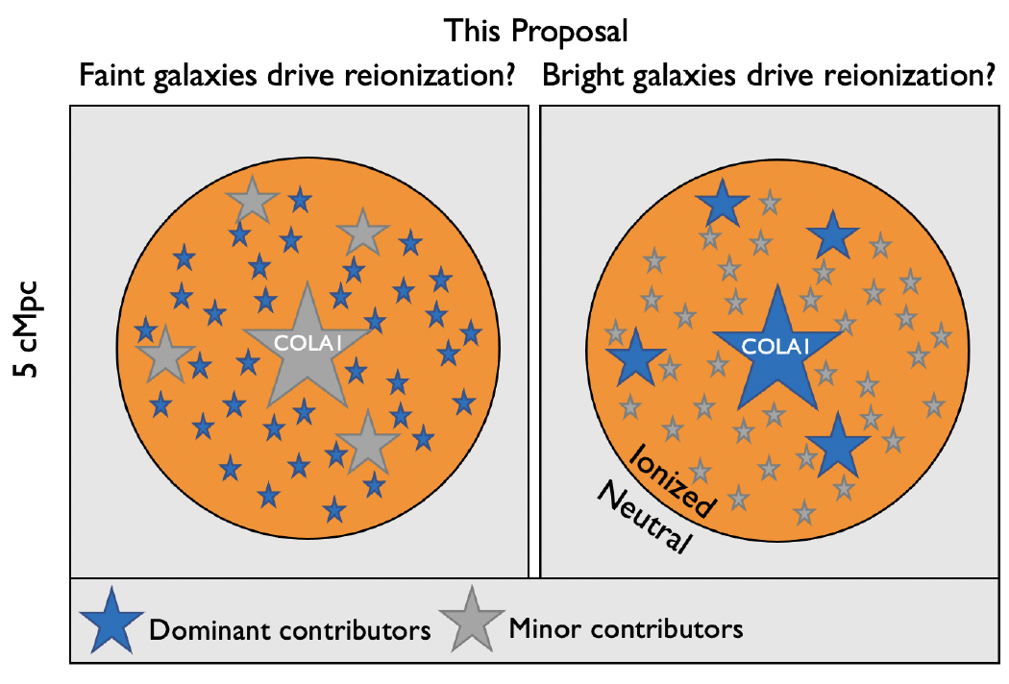
JWST Bubble #1: z=6.6 LAE COLA1Hu+16, Matthee+17
Bubble with strongly constrained size. Matthee+18, Mason & Gronke 2020

Slide 47
JWST Bubble #1: z=6.6 LAE COLA1Hu+16, Matthee+17
Bubble with strongly constrained size. Matthee+18, Mason & Gronke 2020
Blind grism (F356W) survey to characterize ionizing field down to M_{UV}~0.1L*.
[OIII] redshifts, Hβ ξion, Hβ/ Hγ decrement for COLA1.
Deepest NIRCam grism pointings in C1 will yield 100 Pα emitters at z = 0.7-1.1, 200 Hα emitters at z = 3.7-5.0, and 40 [OIII]+Hβ emitters at z = 5.4-6.9. Williams+18
Jorryt Matthee (PI)
Rohan Naidu (co-PI)
Charlie Conroy
Anne Hutter
Pascal Oesch
Gabriele Pezzulli
David Sobral
Sandro Tacchella

Slide 48
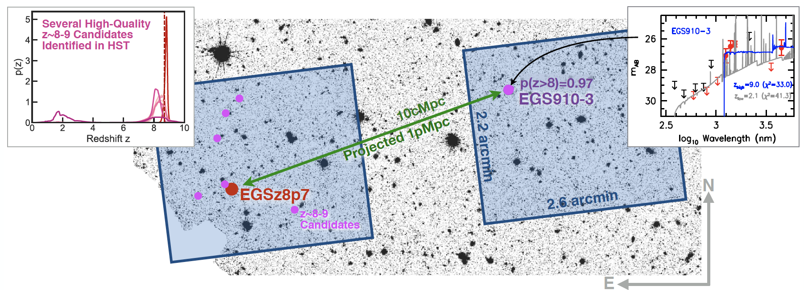
JWST Bubble #2: z=8.7 LAE EGSz8p7 Roberts-Borsani+15, Zitrin+15, Rebecca Larson’s talk
Among the highest-z LAEs, universe ~100% neutral– why then do we see Lyα?
Hypothesis: one of the first ionized overdensities “where cosmic dawn broke first”.

Slide 49
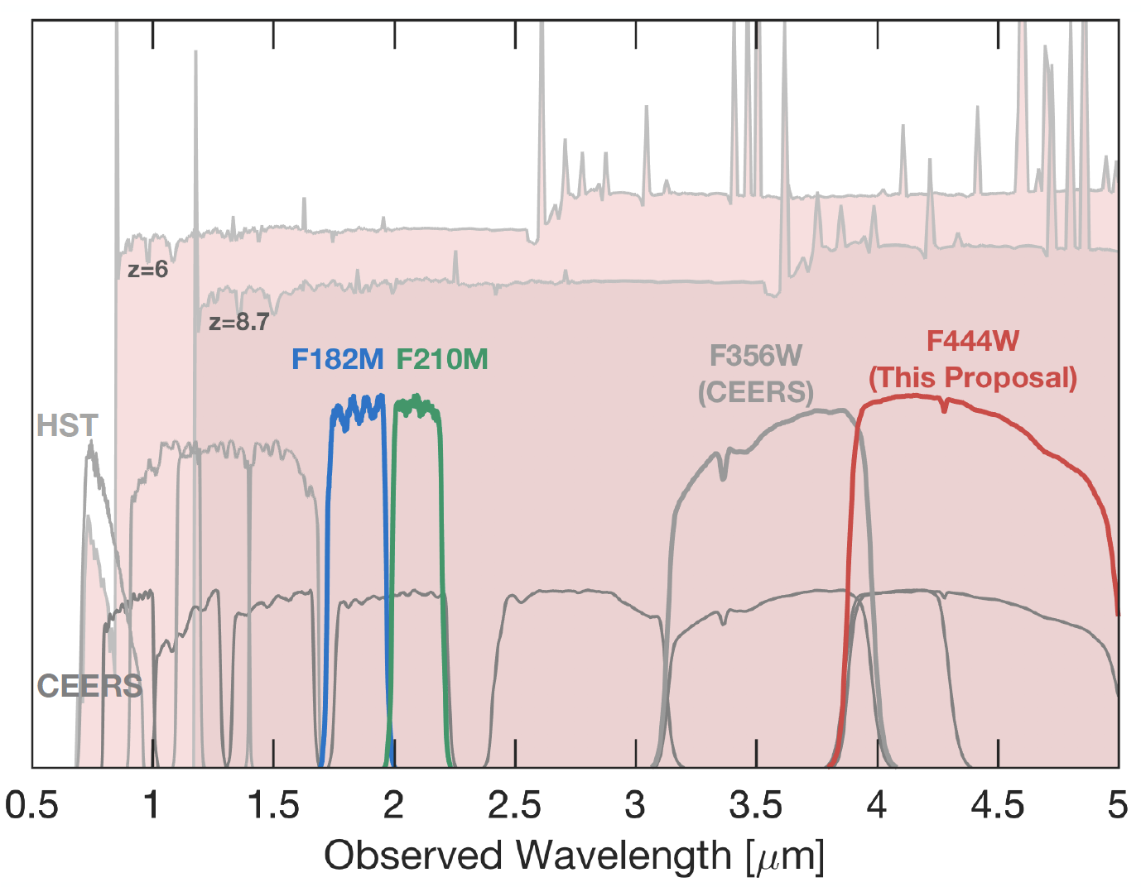
JWST Bubble #2: z=8.7 LAE EGSz8p7 Roberts-Borsani+15, Zitrin+15, Rebecca Larson’s talk
Rohan Naidu (PI)
Pascal Oesch
Richard Ellis
Rychard Bouwens
Charlie Conroy
Ryan Endsley
Anne Hutter
Garth Illingworth
Josie Kerutt
Ivo Labbe
Ekaterina Leonova
Yuxiang Qin
Guido Roberts-Borsani
Renske Smit
Dan Stark
Mauro Stefanon
Sandro Tacchella
Stuart Wyithe
Adi Zitrin
Dan Magee
Simon Mutch
Among the highest-z LAEs, universe ~100% neutral– why then do we see Lyα?
Hypothesis: one of the first ionized overdensities “where cosmic dawn broke first”.
Blind F444W grism survey -- [OIII] redshifts, Hβ ξion.
Strong synergy with CEERS.

Slide 50
Summary | rohan.naidu@cfa.harvard.edu
Lyα profiles provide an efficient, statistical way of understanding and constraining LyC f_{esc.}
Physics of LyC escape: O(10) Myr starbursts that blow ionized channels, destroy dust, produce extremely hard photons in a super-star-cluster-like ISM.
Statistics of LyC escape: half the typical LAEs (>0.2 L*) at z~2 have fesc~50%, ξion~25.9
The saga of the ionizing background from z~2-8 is a story of an increasing LAE fraction – and we now know the ionizing properties of these LAEs!
>0.2 L* LAEs (<M_{UV}>~-19) produce rapid reionization under reasonable assumptions.

