Slide 1
Chronicling the reionization history with 6 < z < 7 quasars
Dominika Ďurovčíková | MIT Kavli Institute for Astrophysics
State of the Universe seminar series at Tata Institute of Fundamental Research, Mumbai
December 1, 2023

Slide 2
Chronicling the reionization history with 6 < z < 7 quasars
Outline:
Brief introduction to Reionization and quasars
The challenges at 6 < z < 7
Predicting quasar continua
Filling in the gap at 6 < z < 7
Feel free to interrupt with questions ☺

Slide 3
Chronicling the reionization history with 6 < z < 7 quasars
Outline:
Brief introduction to Reionization and quasars
The challenges at 6 < z < 7
Predicting quasar continua
Filling in the gap at 6 < z < 7

Slide 4
Brief introduction to Reionization and quasars
neutral IGM -> ionized IGM
timing? sources?
Dominika Ďurovčíková | December 1, 2023

Slide 5
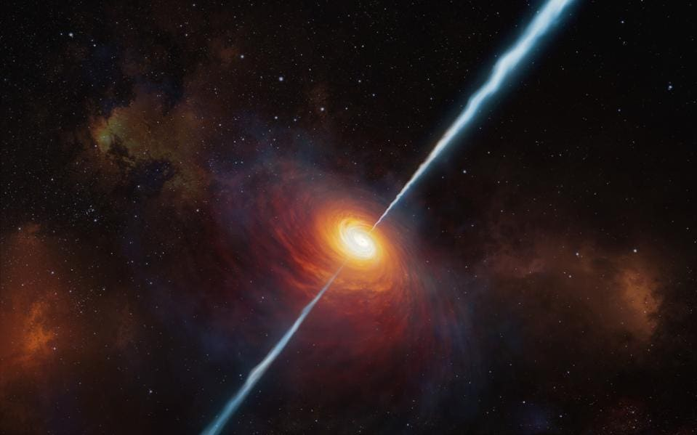
Brief introduction to Reionization and quasars
quasar
IGM
HI
HI
HI
HI
1216 Å
HI
HI
Ly⍺
ESO/M. KORNMESSER
flux
flux
Ly⍺ forest
GP trough
wavelength
wavelength
Dominika Ďurovčíková | December 1, 2023

Slide 6
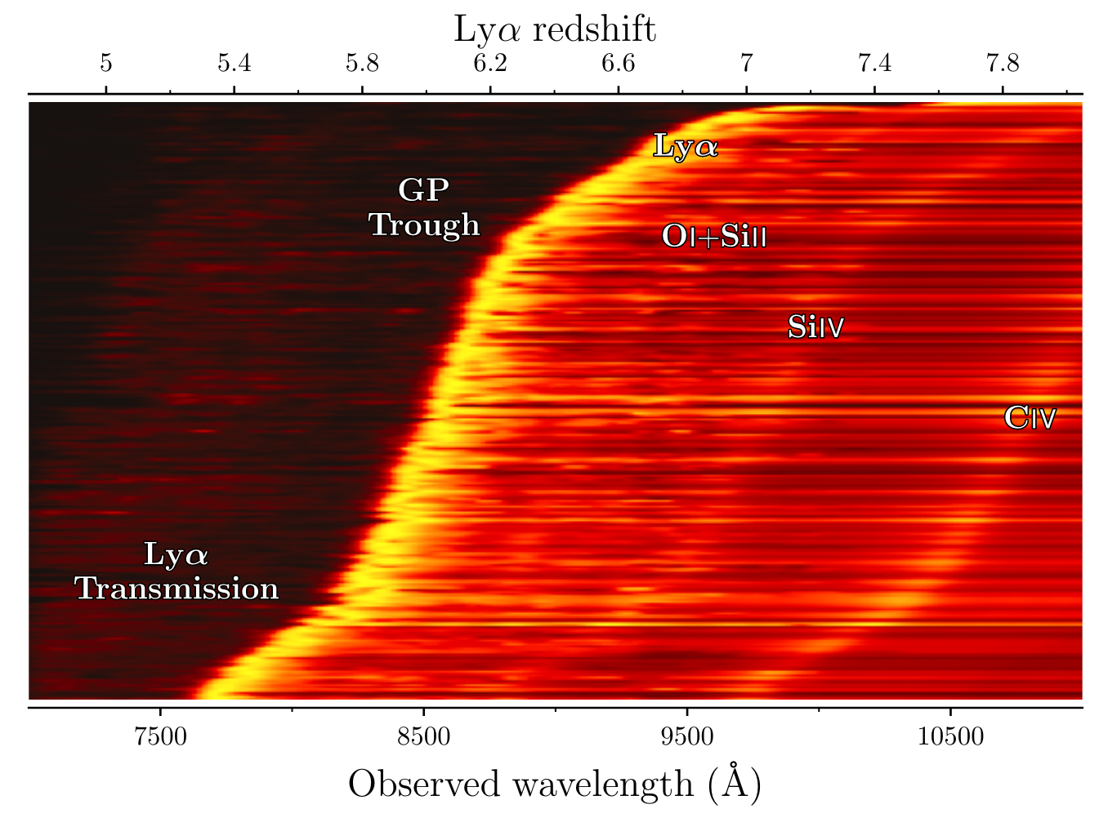
Brief introduction to Reionization and quasars
> 500 published quasar spectra at z $≥$ 5.3
what is the
intrinsic flux?
=
how much neutral gas is around the quasar?
=
timing of EoR
Fan, Banados, and Simcoe, arXiv:2212.06907 (2022)
Dominika Ďurovčíková | December 1, 2023

Slide 7
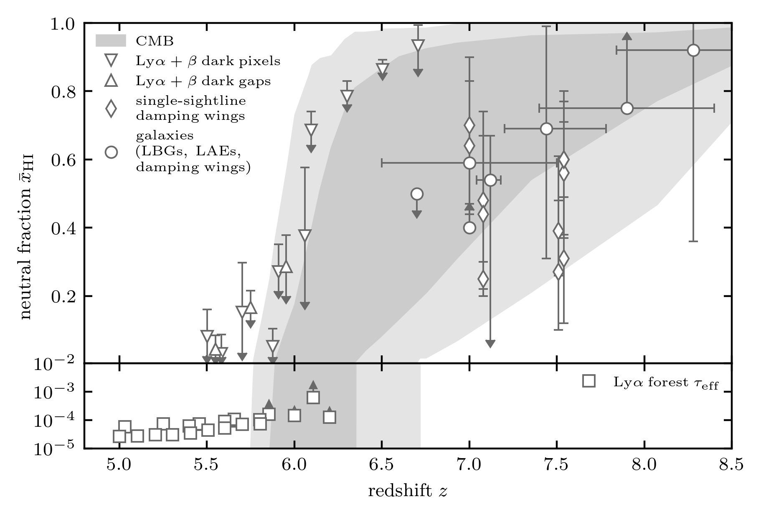
Brief introduction to Reionization and quasars
what is the intrinsic flux? -> how much neutral gas is around the quasar? -> timing of EoR
?
Dominika Ďurovčíková | December 1, 2023

Slide 8
Chronicling the reionization history with 6 < z < 7 quasars
Outline:
Brief introduction to Reionization and quasars
The challenges at 6 < z < 7
Predicting quasar continua
Filling in the gap at 6 < z < 7

Slide 9
The challenges at 6 < z < 7
insensitivity to many orders of magnitude in ${\overline{x}}_{HI}$
?
HI
HI
HI
Ly⍺
HI
HI
HI
damping wing
flux
flux
HI
HI
HI
flux
HI
HI
HI
HI
$${\overline{x}}_{HI} \sim {10}^{−1}$$
$${\overline{x}}_{HI}≾{10}^{−4}$$
wavelength
wavelength
GP trough
wavelength
Dominika Ďurovčíková | December 1, 2023

Slide 10
The challenges at 6 < z < 7
insensitivity to many orders of magnitude in ${\overline{x}}_{HI}$
?
quasar radiation field alters the shape
HI
proximity zone
Ly⍺
912 Å
flux
HII
flux
wavelength
wavelength
Dominika Ďurovčíková | December 1, 2023

Slide 11
The challenges at 6 < z < 7
insensitivity to many orders of magnitude in ${\overline{x}}_{HI}$
?
quasar radiation field alters the shape
reionization is patchy and quasars only provide one sightline through the IGM
Dominika Ďurovčíková | December 1, 2023

Slide 12
The challenges at 6 < z < 7
insensitivity to many orders of magnitude in ${\overline{x}}_{HI}$
?
quasar radiation field alters the shape
reionization is patchy and quasars only provide one sightline through the IGM
damping wing
proximity zone
flux
flux
wavelength
wavelength
combine modeling of damping wings and proximity zones across multiple sightlines
Dominika Ďurovčíková | December 1, 2023

Slide 13
Chronicling the reionization history with 6 < z < 7 quasars
Outline:
Brief introduction to Reionization and quasars
The challenges at 6 < z < 7
Predicting quasar continua
Filling in the gap at 6 < z < 7

Slide 14
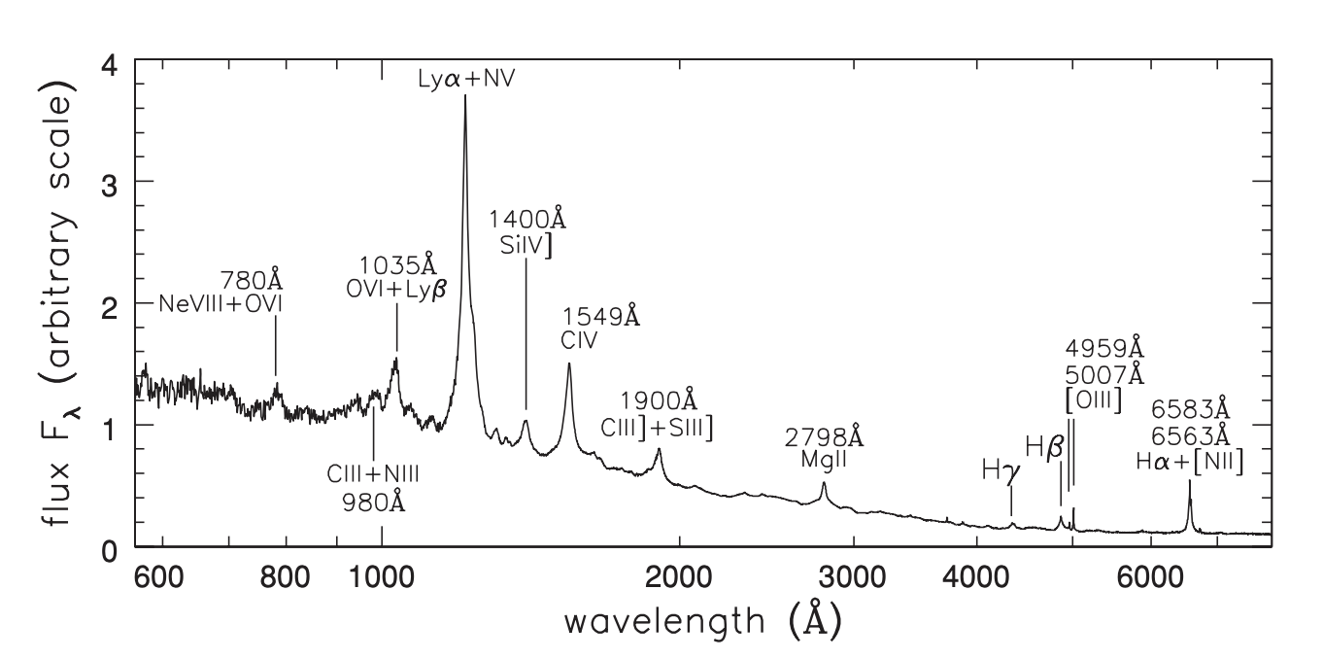
Predicting quasar continua
what is the intrinsic flux? -> how much neutral gas is around the quasar? -> timing of EoR
SDSS DR16 has > 700,000 low-redshift spectra!
+ DESI is underway!
R. Telfer et al. ApJ 565 773 (2002)
Dominika Ďurovčíková | December 1, 2023

Slide 15
Predicting quasar continua
output
input
Dominika Ďurovčíková | December 1, 2023

Slide 16
Predicting quasar continua
what is the intrinsic flux? -> how much neutral gas is around the quasar? -> timing of EoR
covariance matrices
Greig et al. MNRAS 466, 1814 (2017)
Neural networks
DD et al. MNRAS 493 4256 (2020)
Neural networks
DD et al. MNRAS 493 4256 (2020)
PCA
Davies et al. ApJ 864 143 (2018)
Normalizing flows
Reiman et al. arXiv:2006.00615 (2020) (incl. DD)
others...
Gaussian processes
Eilers et al. ApJ 938.1 17 (2022)
Dominika Ďurovčíková | December 1, 2023

Slide 17
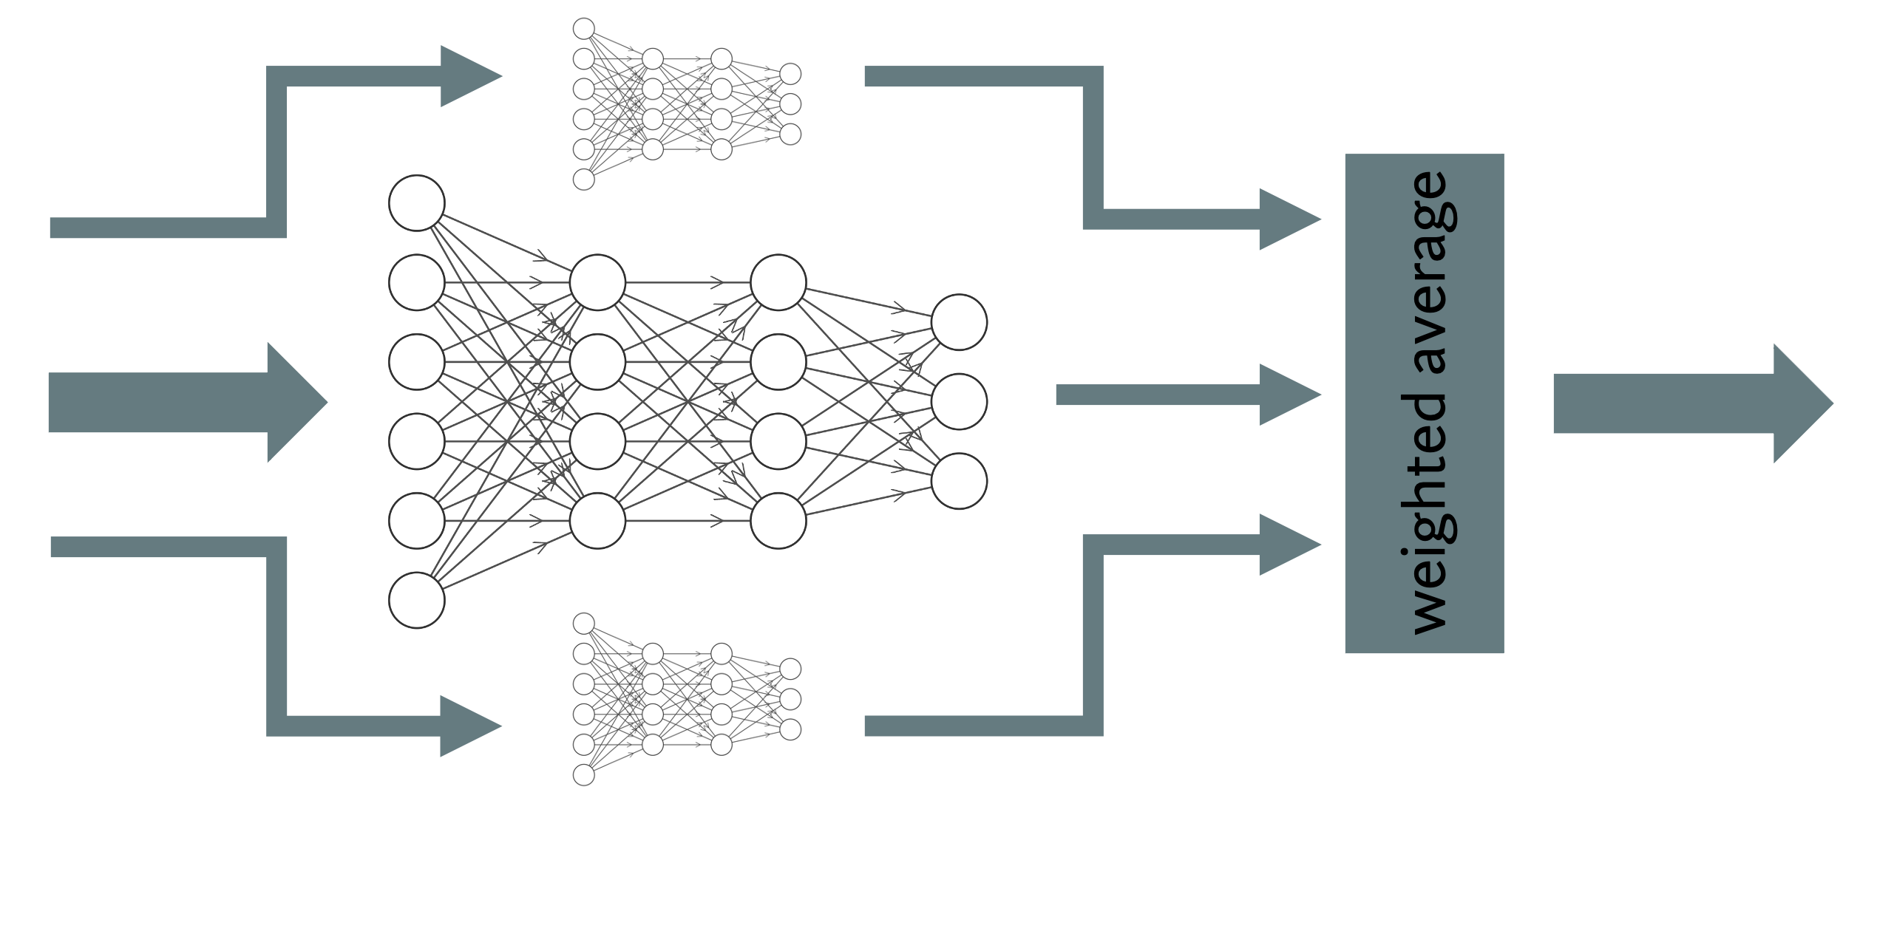
Predicting quasar continua
DD et al. MNRAS 493 4256 (2020)
Dominika Ďurovčíková | December 1, 2023

Slide 18
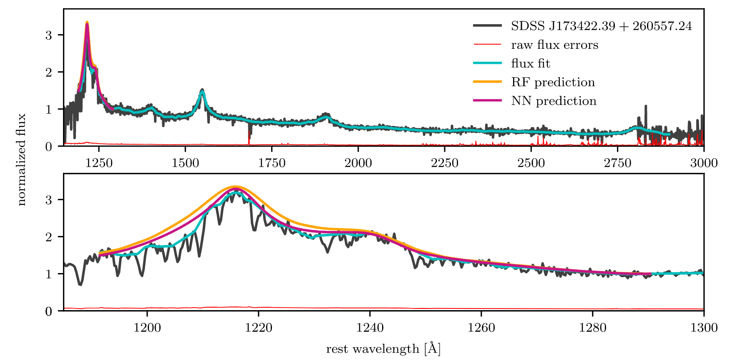
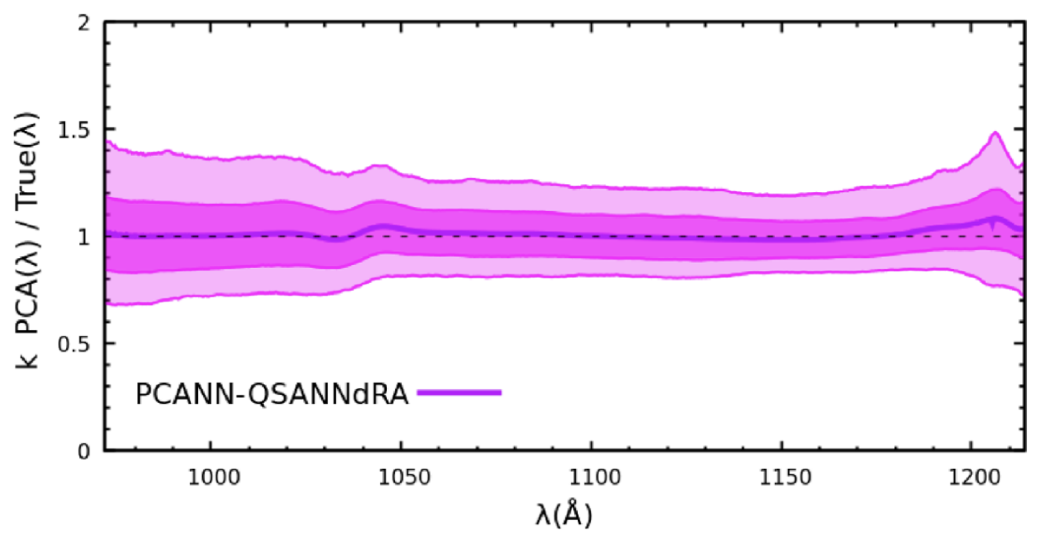
Predicting quasar continua
INPUT
Bosman et al. MNRAS 503 2077 (2021)
OUTPUT
also Greig et al. in prep.
DD et al. MNRAS 493 4256 (2020)
DD et al. MNRAS 493 4256 (2020)
Dominika Ďurovčíková | December 1, 2023

Slide 19
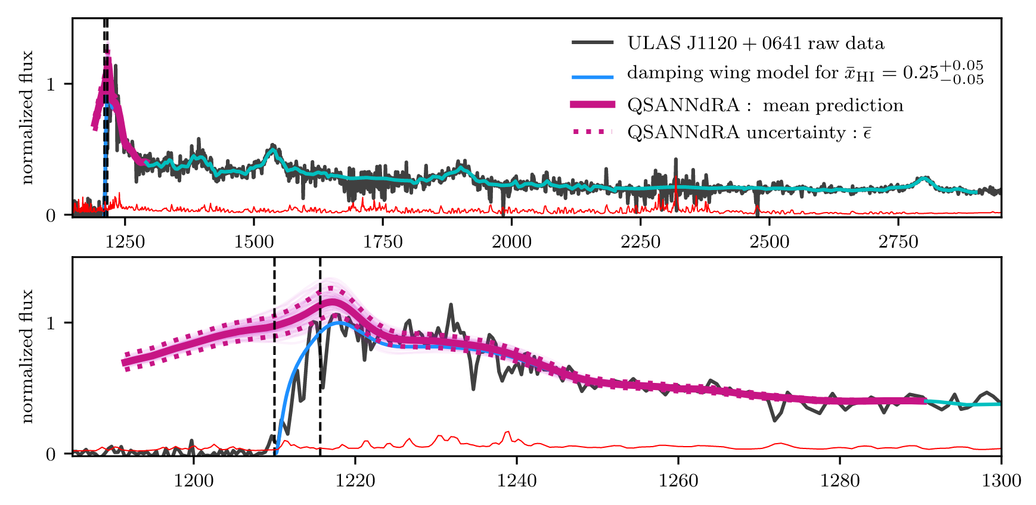
Predicting quasar continua
INPUT
OUTPUT
DD et al. MNRAS 493 4256 (2020)
DD et al. MNRAS 493 4256 (2020)
Dominika Ďurovčíková | December 1, 2023

Slide 20
Chronicling the reionization history with 6 < z < 7 quasars
Outline:
Brief introduction to Reionization and quasars
The challenges at 6 < z < 7
Predicting quasar continua
Filling in the gap at 6 < z < 7

Slide 21
Filling in the gap at 6 < z < 7
combine modeling of damping wings and proximity zones across multiple sightlines
?
Dominika Ďurovčíková | December 1, 2023

Slide 22
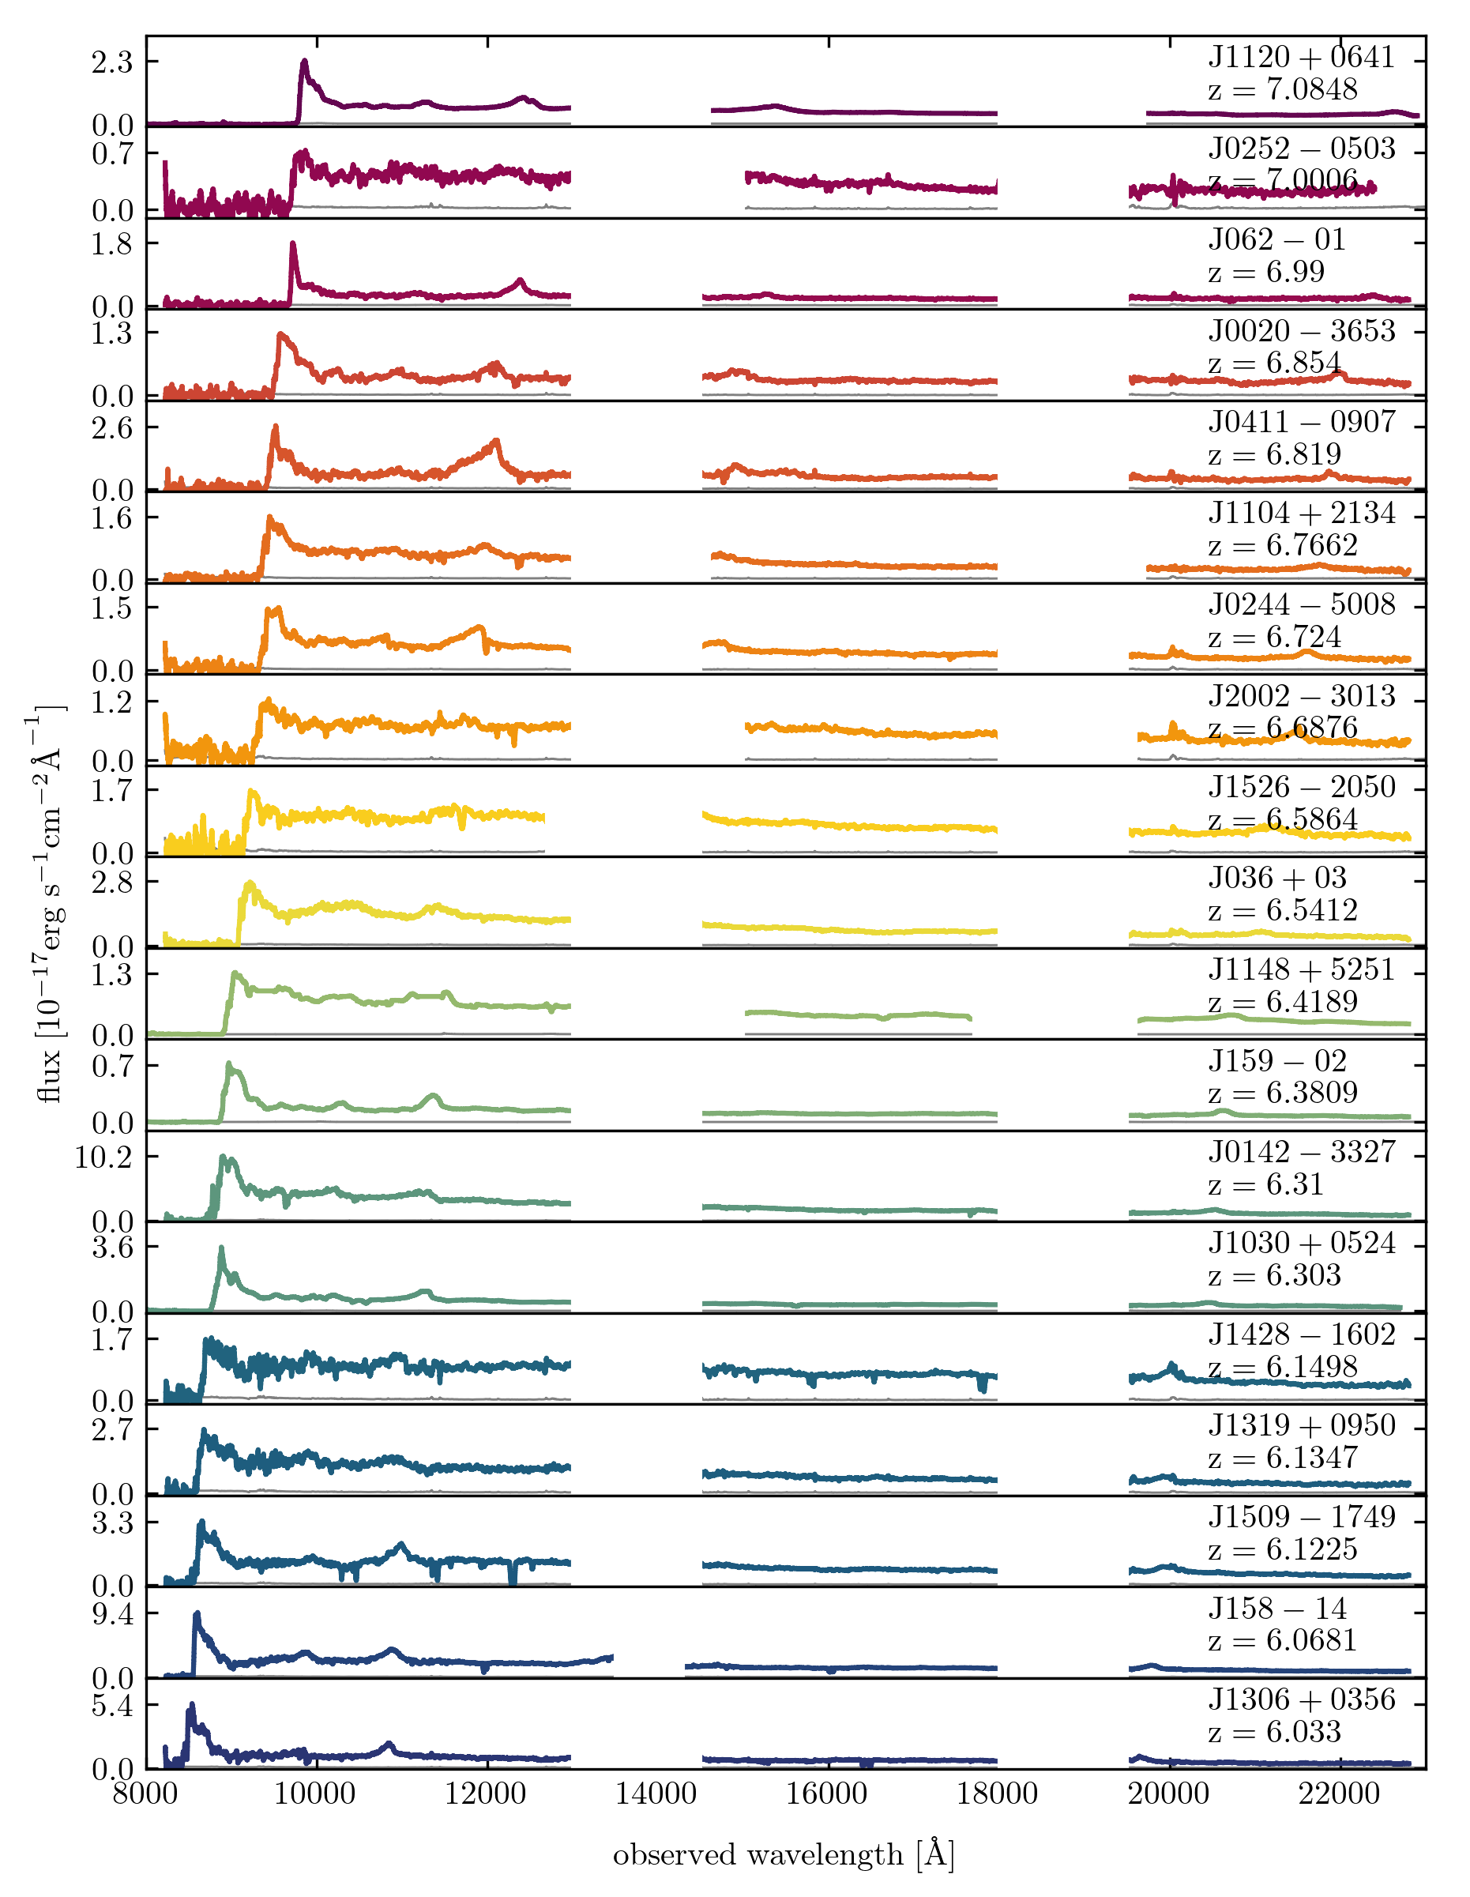
Filling in the gap at 6 < z < 7
sample of 19 quasars observed primarily with Magellan/FIRE, supplemented by VLT/X-Shooter, Keck/MOSFIRE, Keck/ESI
DD et al. (in prep.)
Dominika Ďurovčíková | December 1, 2023

Slide 23
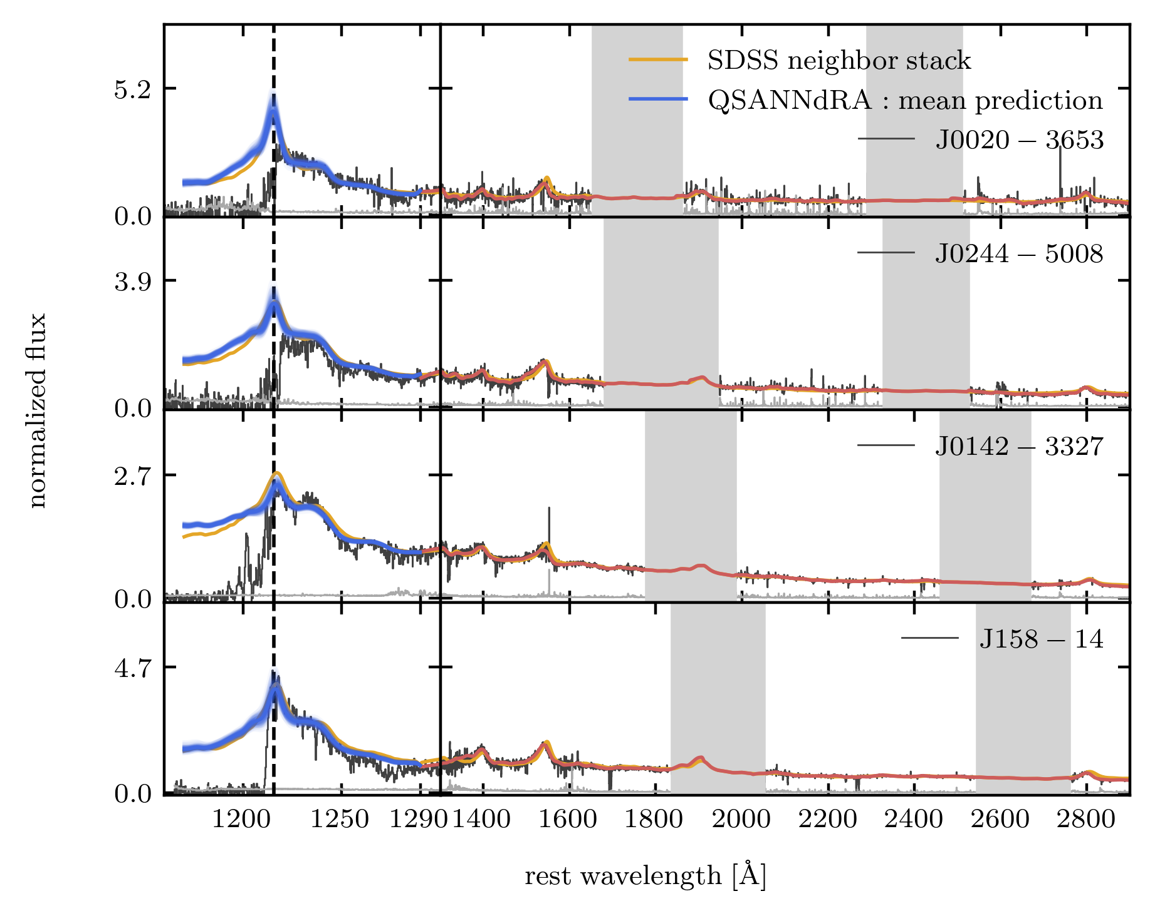
Filling in the gap at 6 < z < 7
sample of 19 quasars observed primarily with Magellan/FIRE, supplemented by VLT/X-Shooter, Keck/MOSFIRE, Keck/ESI
used QSANNdRA to predict the Lya continua for the whole sample
DD et al. (in prep.)
Dominika Ďurovčíková | December 1, 2023

Slide 24
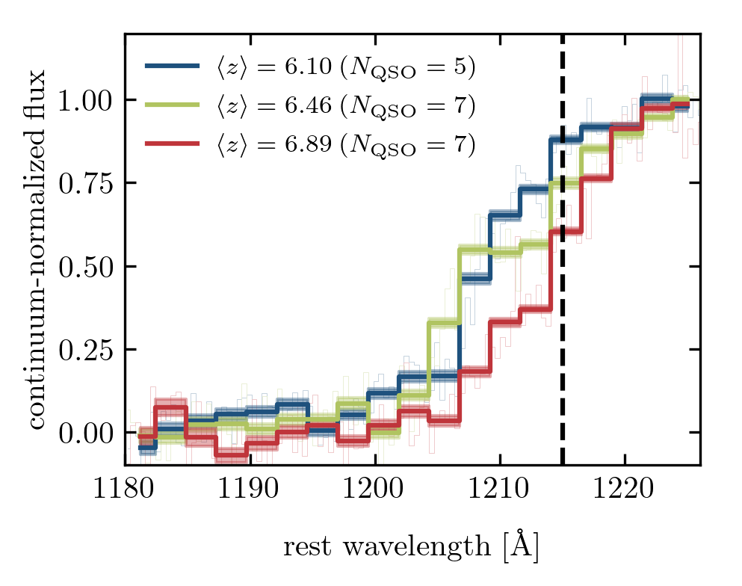
Filling in the gap at 6 < z < 7
sample of 19 quasars observed primarily with Magellan/FIRE, supplemented by VLT/X-Shooter, Keck/MOSFIRE, Keck/ESI
used QSANNdRA to predict the Lya continua for the whole sample
stacked continuum-normalized spectra in three distinct redshift bins
DD et al. (in prep.)
Dominika Ďurovčíková | December 1, 2023

Slide 25
Filling in the gap at 6 < z < 7
emergence of damping wings!
z = 6.7 – 7.1
z = 6.3 – 6.7
z = 6.0 – 6.3
DD et al. (in prep.)
Dominika Ďurovčíková | December 1, 2023

Slide 26
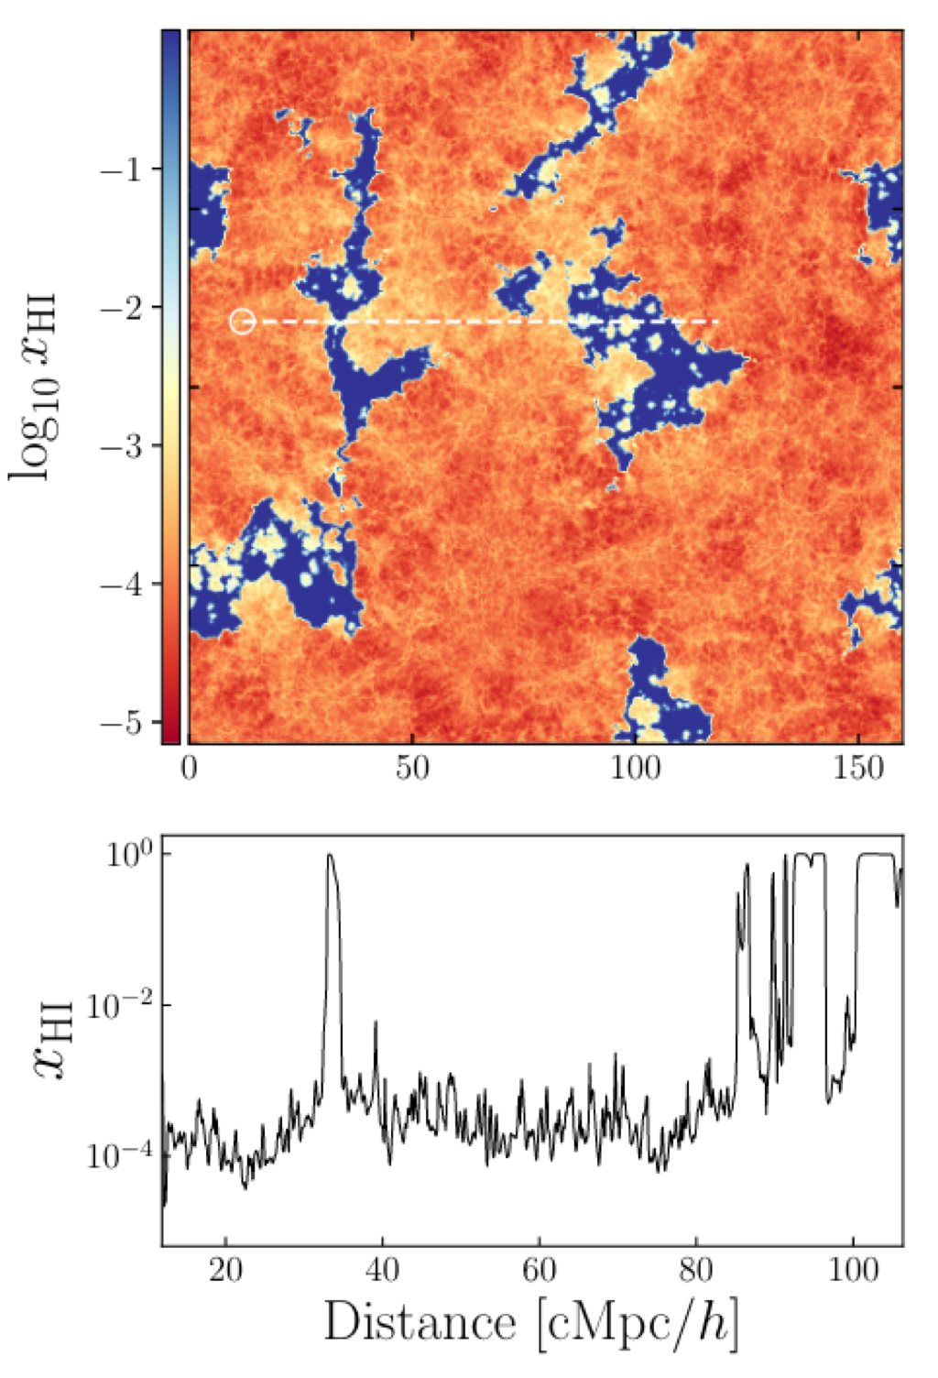
Filling in the gap at 6 < z < 7
P-GADGET-3 + ATON
sample of 19 quasars observed primarily with Magellan/FIRE, supplemented by VLT/X-Shooter, Keck/MOSFIRE, Keck/ESI
used QSANNdRA to predict the Lya continua for the whole sample
stacked continuum-normalized spectra in three distinct redshift bins
fit each stacked spectrum with simulation-based models (${\overline{x}}_{HI}$, $\log{t_{Q}}$)
Sindhu
Satyavolu
Girish
Kulkarni
Satyavolu et al. 2023 MNRAS 521 3108
DD et al. (in prep.)
Dominika Ďurovčíková | December 1, 2023

Slide 27
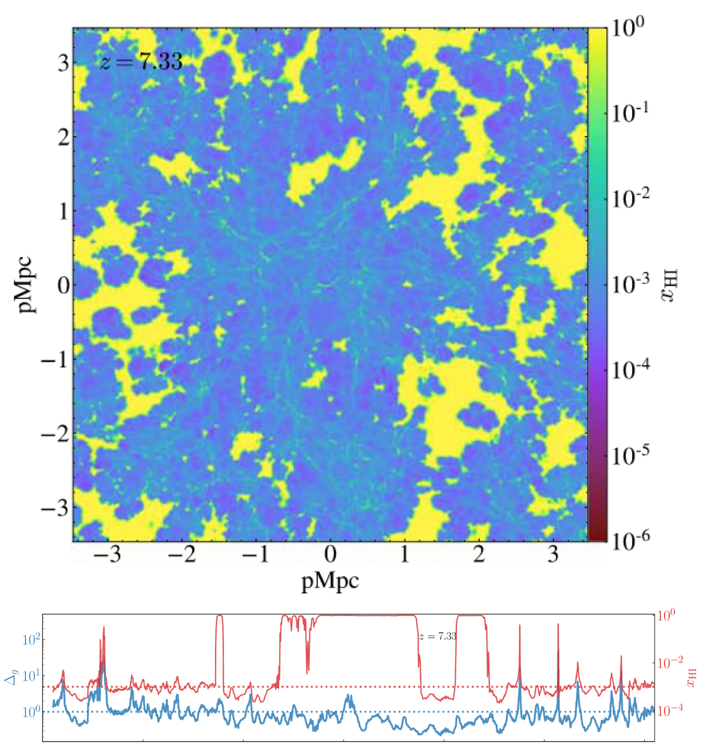
Filling in the gap at 6 < z < 7
CROC
sample of 19 quasars observed primarily with Magellan/FIRE, supplemented by VLT/X-Shooter, Keck/MOSFIRE, Keck/ESI
used QSANNdRA to predict the Lya continua for the whole sample
stacked continuum-normalized spectra in three distinct redshift bins
fit each stacked spectrum with simulation-based models (${\overline{x}}_{HI}$, $\log{t_{Q}}$)
Huanqing
Chen
modeling is ongoing
Chen and Gnedin 2021 ApJ 911 60
DD et al. (in prep.)
Dominika Ďurovčíková | December 1, 2023

Slide 28
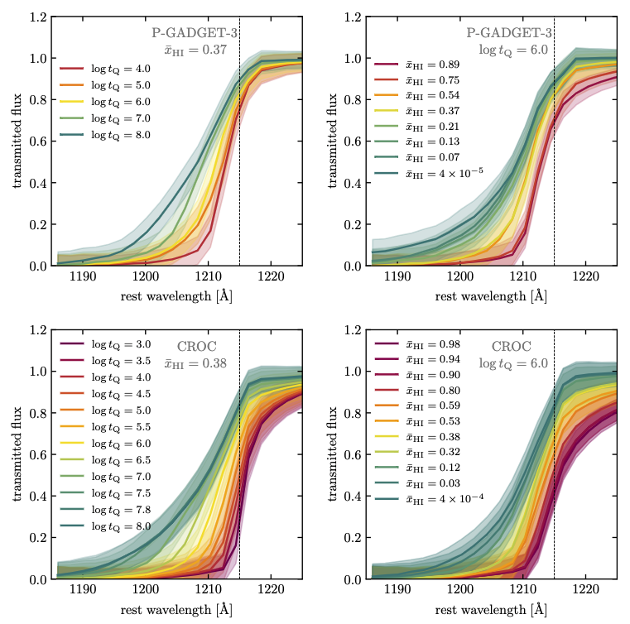
Filling in the gap at 6 < z < 7
ATON
ATON
sample of 19 quasars observed primarily with Magellan/FIRE, supplemented by VLT/X-Shooter, Keck/MOSFIRE, Keck/ESI
used QSANNdRA to predict the Lya continua for the whole sample
stacked continuum-normalized spectra in three distinct redshift bins
fit each stacked spectrum with simulation-based models (${\overline{x}}_{HI}$, $\log{t_{Q}}$)
DD et al. (in prep.)
Dominika Ďurovčíková | December 1, 2023

Slide 29
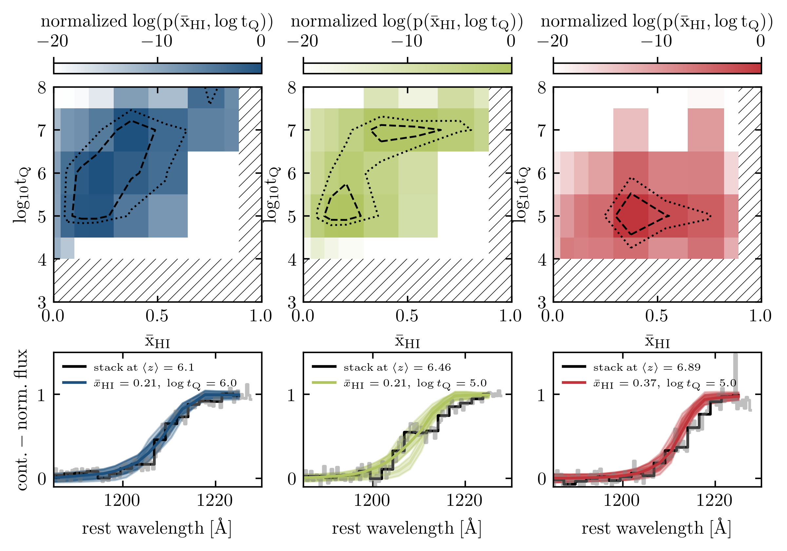
Filling in the gap at 6 < z < 7
ATON
DD et al. (in prep.)
Dominika Ďurovčíková | December 1, 2023

Slide 30
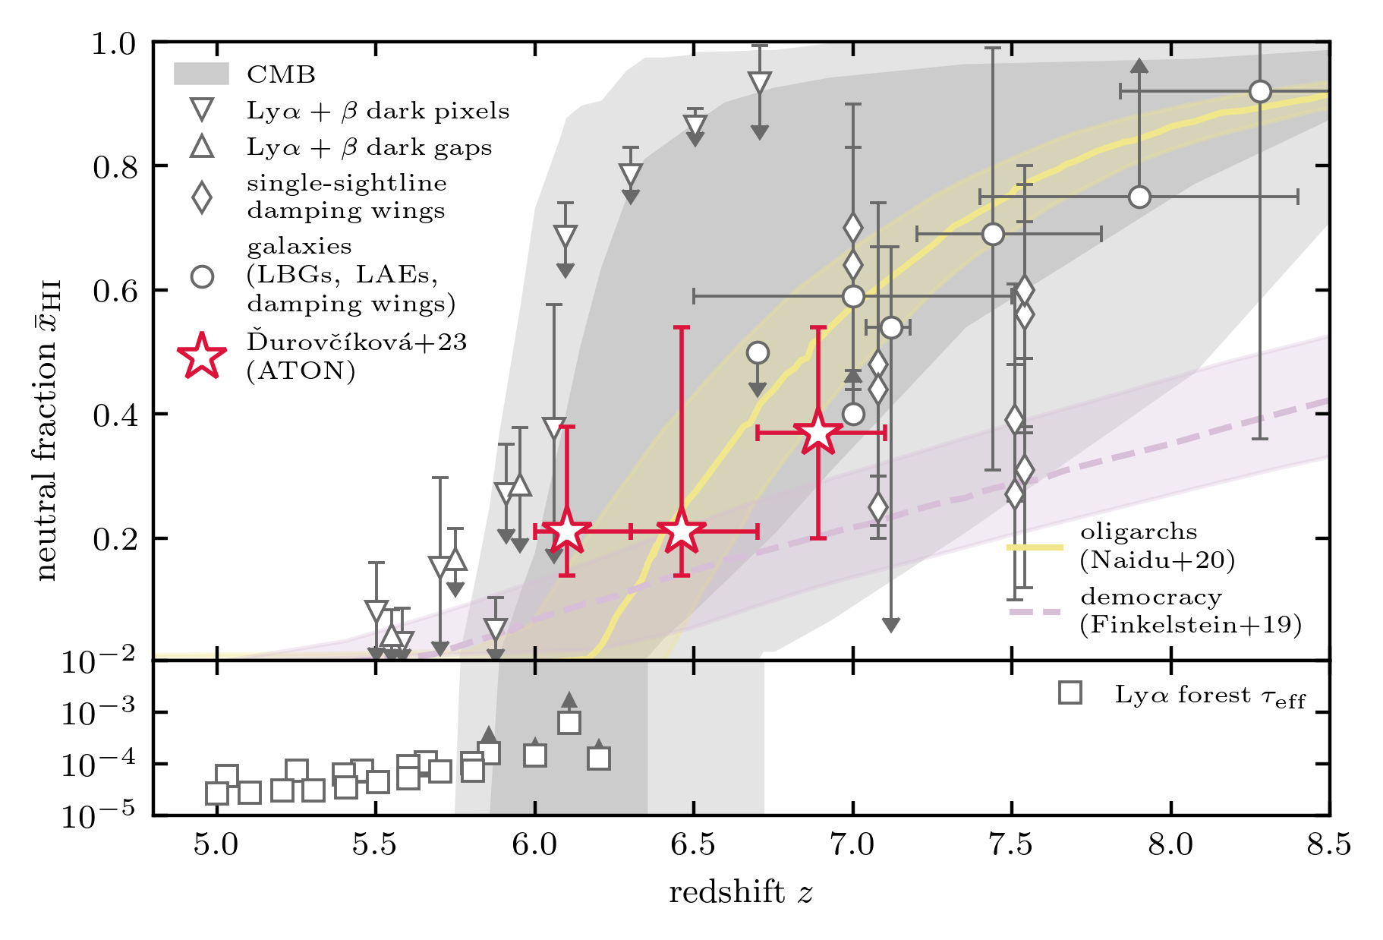
Filling in the gap at 6 < z < 7
late reionization preferred
DD et al. (in prep.)
Dominika Ďurovčíková | December 1, 2023

Slide 31
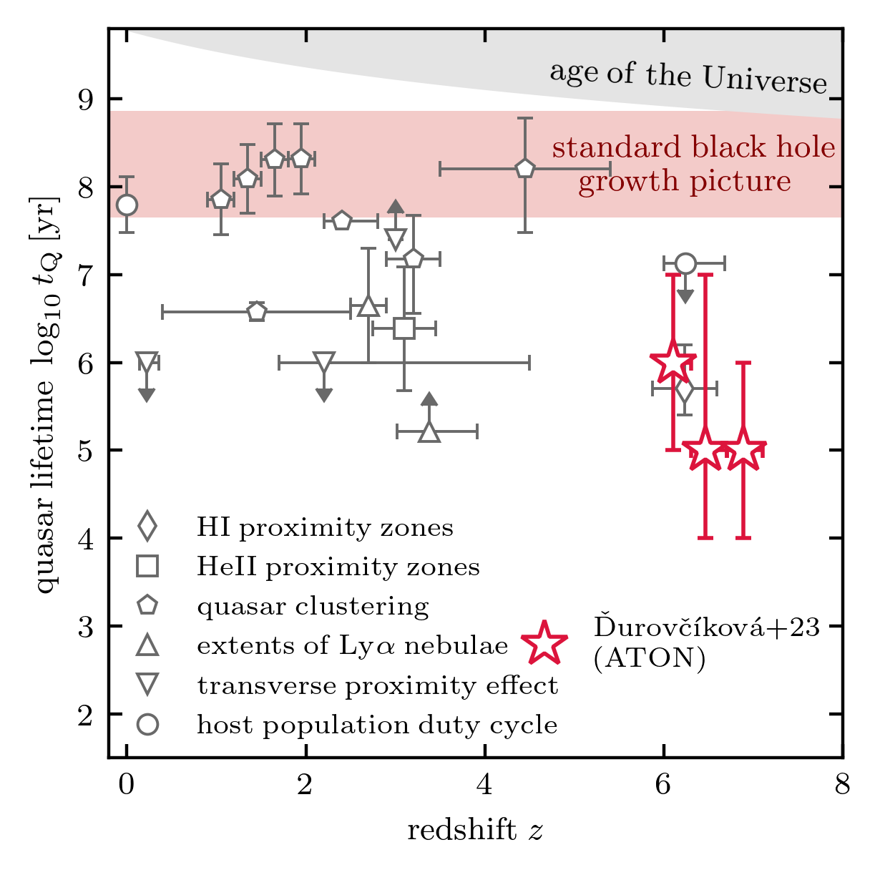
Filling in the gap at 6 < z < 7
confirmed a population of young quasars at redshifts z > 6
increases the tension in the current models of supermassive black hole growth at early times
DD et al. (in prep.)
Dominika Ďurovčíková | December 1, 2023

Slide 32
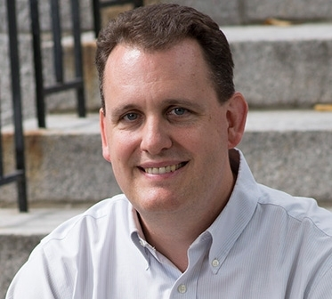
Thanks
to my research group and collaborators,
Anna-Christina
Eilers
Rob
Simcoe
Huanqing
Chen
Sindhu
Satyavolu
Girish
Kulkarni
and to you for hosting me and for listening! ☺
Dominika Ďurovčíková | December 1, 2023

Slide 33
Thank you for your attention!

