Slide 1
Percolation
&
The Phase Transition
Brijesh K Srivastava
Department of Physics
West Lafayette, IN
USA
Bring your own Phase Diagram
TIFR, Mumbai, India
Dec. 13-14, 2010

Slide 2
Percolation : General
The general formulation of the percolation problem is concerned
with elementary geometrical objects placed at random in a
d-dimensional lattice. The objects have a well defined connectivity
radius λ, and two objects are said to communicate if the distance
between them is less than λ.
One is interested in how many objects can form a cluster of
communication and, especially , when and how the cluster become
infinite. The control parameter is the density of the objects or the
dimensionless filling factor ξ. The percolation threshold ξ = ξ_{c}
corresponding to the minimum concentration at which an infinite
cluster spans the space.
Thus the percolation model exhibits two essential features:
Critical behavior Long range correlations

Slide 3
Percolation : General
It is well known that the percolation problem on large lattices
displays the features of a system undergoing a second-order
phase transition.
These characteristics include critical fluctuations, quantities
which diverge, and quantities which vanish as the critical
percolation probability is approached. These quantities are
described by a finite number of critical exponents.
* Transition from liquid to gas
* Normal conductor to a superconductor
* Paramagnet to ferromagnet
H. E. Stanley , Introduction to Phase Transitions and Critical Phenomena
D. Stauffer and A. Aharony, Introduction to Percolation Theory

Slide 4
Percolation : General
D. Stauffer
Phys. Rep. 54, 2(1979)
One expects an enhancement in the critical region of
moments m_{k} . For k > τ-1, τ > 2 in most critical phenomena
Specific heat in fluid
Order parameter
Isothermal compressibility
Various exponents satisfy the scaling relation:

Slide 5
Nuclear Multifragmentation & The Liquid-Gas Phase Transition
The EOS Collaboration studied the MF of 1A GeV Au, La and Kr on carbon. One of the important result was the possible observation of critical behavior in Au and La and the extraction of associated critical exponents. The values of these exponents are very close to those ordinary fluids indicating that MF may arise from a continuous phase transition and may belong to the same universality class as ordinary fluids.
Phys. Rev. Lett. 77, 235 (1996)
Phys. Rev. C 62, 064603(2000)
Phys. Rev. C 64, 041901(2001)
Phys. Rev. C 64, 054602(2001)
Phys. Rev. C 65, 054617(2002)

Slide 6
Nuclear Multifragmentation
Size of the biggest fragment
Fragment size distribution
Second moment

Slide 7
CRITICAL PARAMETERS FROM DATA
Parameter Au La Kr Per. LG
-------------------------------------------------------------------------------------
m_{c}
28±3
24±2
18±3
E_{c}
4.5±0.5
5.5±0.6
6.5±0.8
τ
2.16±0.08
2.10±0.06
1.88±0.08
2.20 2.21
β
0.32±0.02
0.34±0.02
0.53±0.05
0.44 0.33
γ
1.32±0.15
1.20±0.08
1.76 1.24
--------------------------------------------------------------------------------------
m_{c}
= Critical Multiplicity,
E_{c}
= Critical Energy (MeV/A)
Per. = Percolation, LG = Liquid-Gas

Slide 8
Parton Percolation

Slide 9
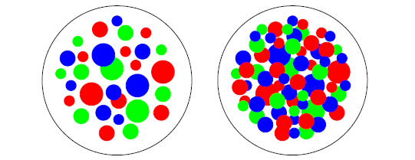
Parton Percolation
De-confinement is expected when the density of quarks and gluons becomes so
high that it no longer makes sense to partition them into color-neutral hadrons,
since these would overlap strongly.
We have clusters within which color is not confined -> De-confinement is thus
related to cluster formation.
This is the central topic of percolation theory, and hence a connection between
percolation and de-confinement seems very likely.
Parton distributions in the
transverse plane of nucleus-nucleus
collisions
1. Color de-confinement in nuclear collisions, H. Satz, Rep. Prog. Phys. 63, 1511 ( 2000).
2. Parton Percolation in Nuclear Collisions, H. Satz , hep-ph/0212046

Slide 10
Parton Percolation
In two dimensions, for uniform string density, the percolation threshold for overlapping discs is:
= critical percolation density
The fractional area covered by
discs at the critical threshold is:
Satz, hep-ph/0212046

Slide 11
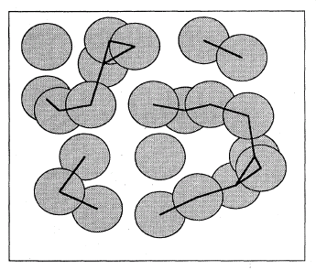
Percolation : General

Slide 12
Color Strings
Multiparticle production at high energies is currently described
in terms of color strings stretched between the projectile and target. Hadronizing these strings produce the observed hadrons.
The no. of strings grow with energy and the no. of participating nuclei and one expects that interaction between them becomes essential.
This problem acquires even more importance, considering the idea that at very high energy collisions of heavy nuclei (RHIC) may produce Quark-gluon Plasma (QGP).
The interaction between strings then has to make the system evolve towards the QGP state.

Slide 13
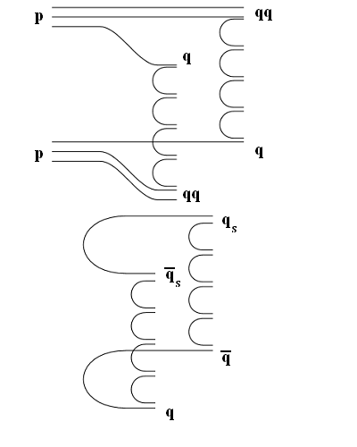
Color Strings
At low energies, valence quarks of nucleons form strings that then hadronize → wounded nucleon model.
At high energies, contribution of sea quarks and gluons becomes dominant.
Additional color strings formed.
1. Dual Parton Model (DPM): A. Capella et al., Phys. Rep. 236, 225 (1994).
2. A. Capella and A. Krzywicki , Phys. Rev. D184,120 (1978).
Notes:
Scattering w/in a single nucleon-nucleon collision, or with different nucleons.
In pp, at low energy dN/deta = 1, at high energy dN/deta = 2, more strings.

Slide 14
References
1. Dual Parton Model:
A. Capella et al., Phys. Rev. D18,4120(1978).
A. Capella et al., Phys. Rep. 236, 225(1994).
2. QGSM :
M. A. Braun and C. Pajares, Nucl. Phys. B390, 542(1993).
M. A. Braun and C. Pajares, Eur.Phys. J. C16,349 (2000).
3. RHIC results and string fusion model
N. Armesto et al., Phys. Lett. B527, 92(2002).
4.
Percolation of Color Sources and critical temperature
J. Dias de deus and C. Pajares, Phys. Lett. B642, 455 (2006).
5. Elliptic flow
I. Bautista, J. Dias de Deus and C. Pajares, arXiv:1007.5206

Slide 15
Color Strings + Percolation = CSPM
Multiplicity and <p_{T}² > of particles produced by a cluster of n strings
Mean Multiplicity & p_{T}² of particles produced by a single string are given by: μ₁ and <p_{T}² >₁ .
Multiplicity (μ_{n}):
Average Transverse Momentum :
Color reduction factor

Slide 16
CSPM
Using the p_{T} spectrum to calculate ξ
To compute the p_{T} distribution, a parameterization of the pp data is used:
a, p₀ and n are parameters fit to the data.
This parameterization can be used for nucleus-nucleus collisions, accounting for percolation by:
In pp at low energy , <nS₁/S_{n}>_{pp} = 1 ± 0.1, due to low string overlap probability in pp collisions.
M. A. Braun, et al. hep-ph/0208182.

Slide 17
Parametrization of pp UA1 data at 130 GeV
from 200, 500 and 900 GeV
ISR 53 and 23 GeV
QM 2001 PHENIX
p₀ = 1.71 and n = 12.42
Ref: Nucl. Phys. A698, 331 (2002).
STAR has also extrapolated UA1 data from
200-900 GeV to 130 GeV
p₀ = 1.90 and n = 12.98
Ref: Phys. Rev. C 70, 044901( 2004).
UA1 results at 200 GeV
p₀ = 1.80 and n = 12.14
Ref: Nucl. Phys. B335, 261 ( 1990)

Slide 18
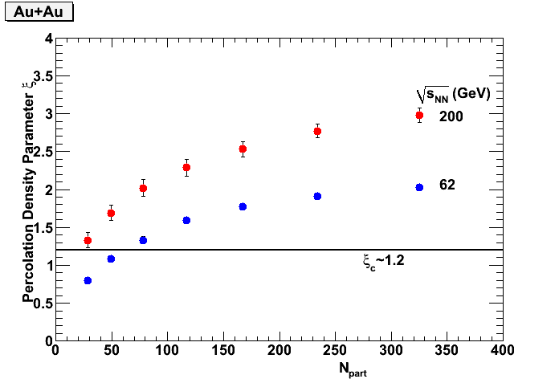
STAR Preliminary

Slide 19
Relation between Temperature
&
Color Suppression factor F(ξ)
Ref :
1. Fluctuations of the string and transverse mass distribution
A. Bialas, Phys. Lett. B 466 (1999) 301.
Percolation of color sources and critical temperature
J. Dias de Deus and C. Pajares, Phys.Lett B 642 (2006) 455

Slide 20
Temperature
It is shown that quantum fluctuations of the string tension
can account for the ‘thermal” distributions of hadrons created in the
decay of color string.
Clustering of color sources ---→ Percolation Transition
Critical density of percolation -→ critical temperature.

Slide 21
Temperature
In the string picture the transverse mass spectrum of the produced
quarks is given by Schwinger mechanism
String tension
Transverse mass
On the other hand the ‘thermal” distribution is exponential in m_{t}

Slide 22
Temperature
The tension of the macroscopic cluster fluctuates around its mean
value because the chromoelectric field is not constant . Assuming a
Gaussian form for these fluctuations one arrives at the probability
distribution of transverse momentum:
which gives rise to thermal distribution
with temperature

Slide 23
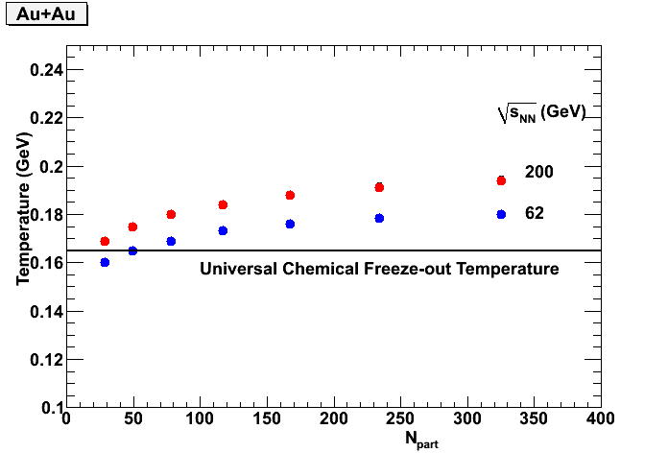
Temperature

Slide 24
The comparative Analysis of Statistical Hadron Production
indicates that the Temperature is the same for Different
Initial Collision configurations , Independent of energy (√s )
1) A Comparative analysis of statistical hadron production.
F. Beccattini et al, Eur. Phys. J. C66 , 377 (2010).
2) Thermodynamics of Quarks and Gluons, H. Satz , arXiv: 0803.
1611v1 hep-ph 11 Mar 2008.

Slide 25
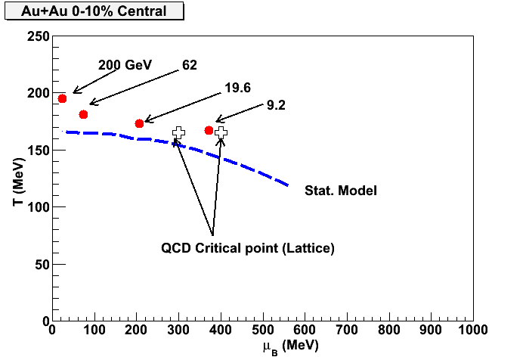
Temperature

Slide 26
Summary
Color string percolation concept has been explored to study the de-confinement in nuclear collisions.
2. The collision energy around 9 GeV for Au+Au seems to be most appropriate for locating CP .

